Slide 1

VALUE INITIATIVE PROGRAM (VIP)
AMPATH-FPI, Export Promotion Council, Fintrac
part of the SEEP Network Value Initiative
Horticulture
Urban Value Chain Development

Slide 2
The Value Chain Initiative Program
Problem: High poverty levels; economic marginalization of the poor and HIV affected in the Rift Valley and Western region of Kenya
Goal: increased income for MEs within HIV/AIDS affected communities
Purpose: increased productivity and access to passion fruits markets for the poor and HIV/AIDS affected populations.

Slide 3
AMPATH-FPI Approach
Holistic Approach:
Health + Economic Strengthening
Target entire community
Create a “path out of poverty”
Strengthen community safety nets
to reverse spread and destruction of HIV.

Slide 4
The Value Chain Initiative Program
Consortium:
AMPATH – FPI (Over 70,000 AMPATH patients)
Export Promotion Council (Over 4,000 clients served)
Fintrac (Over 80,000 farmers assisted)
SEEP Network

Slide 5
VIP TARGET OUTREACH
ME owners | 7,000
Employees | 2,500
Sensitized community members | 1,600
TOTAL | 11,100

Slide 6
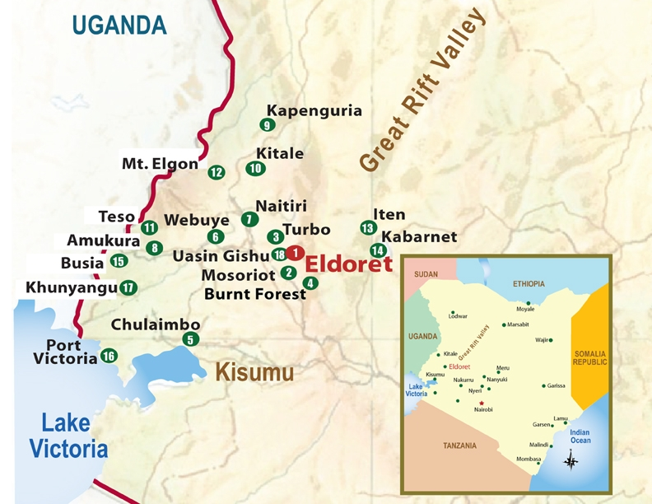
Main Social-Economic Features of the Target Region
Population
7.6 million
Average Farm Household
6.8
Poverty Rate
48%-65%
HIV/AID Prevalence Rate
5.7 %
VIP target Coverage: At least 12 Districts (see map)
Main Economic Activities
Agriculture, bread basket for Kenya

Slide 7
Expected Outputs
Improved knowledge and understanding of market demand & competitive quality of product amongst the MEs
Increased MEs productivity
Improved market access for MEs
Increased income opportunities for ME’s
Increased labor options as the industry grows, as the environment becomes more conducive for successful MEs

Slide 8
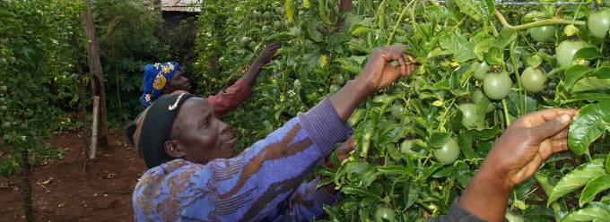
WHY PASSION FRUIT FOR MEs?
Passion fruit is a vine with a life cycle of 2 to 3 years
Starts fruiting at 6th month
42kgs life cycle average production

Slide 9
Why passion Fruits?
End Market Opportunities for MEs
Global Demand
Fruit juice import trade 2001-2006 increased by 73% to nearly US 11 billion.
This trend applies to all fruit juices including passion fruit juice
Regional Demand
In East Africa, market for fresh and processed fruit products e.g. passion fruit is growing at 10% p.a.
Premiums paid for high quality

Slide 10
End Market Opportunities for MEs
Why passion Fruits?
Local Demand
The domestic demand is increasing for both fresh product and juices
Current supply is unable to meet the demand
As a result the prices to farmers are increasing
Yr 2007 Kenya Consumption was 70,148 tons while in Yr 2006 it was 60,371 tons-a 16% increase in local demand

Slide 11
Kenyan National Passion production

Slide 12
Competitiveness of Passion Fruit
Ideal for the small-scale growers and micro-processors the VIP is targeting.
Managed manually reducing the advantages of economies of scale of large farmers
Low perishability, sweeter taste and increased juice % a few days after harvest.
Higher market value for higher quality fruit.

Slide 13
Passion Fruit Value Chain- CURRENT
MARKET FUNCTIONS
DOMESTIC MARKET
REGIONAL MARKET
INTERNATIONAL MARKET
Retail
Individual Retailer
Retail Shops/Hotels
Local Supermarket
Distributors (EU)
Major Supermarkets
(EU)
Importing
Exporting
Wholesaling
Reg. Brokers
(Uganda)
Large Exporters
(e.g. EAGA, KHE.....)
Local Processors
(Del Monte, Pick N Peel)
Processing
Small Scale Processors
Med-Scale Processors
(kevian, Fips, etc)
Local Trading
Local Brokers
Farmers Groups
Production
Small-Scale Farmers
Medium - Large Scale Farmers
Input Supply /Services
Inputs Retailers
KARI
Private Nurseries
Extension
(MOA/HCDA)
Inputs Suppliers
Chemical Sprayers
LEGEND
Major Product Flow
Processed Product Flow

Slide 14

CONTRAINTS ANALYSIS
GOAL STATEMENT:
Increased income for micro
-
enterprises (MEs) within HIV/AIDS affected communities
who are or become active participants in the horticultural value chain
PURPOSE STATEMENT:
To enable excluded poor and HIV/AIDS affected populations to increase their productivity and
access to high value export, regional and local markets.
Low Volume, Low Quality and Exclusion of Poor and HIV Affected
Production Issues
Health Issues
Market Access
Support Products and Services (Fee-for-service) | Poor have difficult time accessing convenient capital No solid commercial agricultural extension support BDS providers are typically MFIs that limit business training support to a few days training Inadequate packaging and handling | Lower financial barrier: Lower start up cost, Increase access to credit, Group savings Work with medium to large processors to provide agricultural extension support Facilitate meetings between support product/service providers and MEs Facilitate training on handling/transport of fruits
Business Performance (MEs and others in the value chain) | Requires business management knowledge of which many of the poor are lacking | Facilitate training by BDS providers on business management practises
Poor quality
Limited access
/ low
to production
Poor Market
volume
Inputs
Linkage, poor
Inconsistent
vertical and
fruit/juice
Low Knowledge and
Inadequate cash flow to purchase inputs
horizontal linkages
volume/sales
Skills in Crop Husbandly
and Business
Management
Inadequate
Poor Quality
Lack of organization
Lack of
Poor Quality, Supply
Training and
of Inputs
among Farmers,
information and
& Biz Mgt skills
Extension Services
traders and
knowledge of
exporters
Markets
Low
awareness or
Inadequate capacity
availability
Weak Associations
building
appropriate
credit
Under
-
developed
Low Knowledge and
Under
-
developed
supply of sustainable
supply of sustainable
business solutions and
skills in Group
business and service
service markets
Management
markets
Socio
-
economic factors, Limited Household Resources,
Policy Issues

Slide 16
SOLUTIONS ANALYSIS
GOAL STATEMENT:
Increased income for micro
-
enterprises (MEs) within HIV/AIDS affected communities
who are or become active participants in the horticultural value chain
PURPOSE STATEMENT:
To enable excluded poor and HIV/AIDS affected populations to increase their productivity and
access to high value export, regional and local markets.
Reliable Volume, High Quality and inclusion of Poor and HIV Affected
Increased Production
Improved Health
Market Access
Support Products and Services (Fee-for-service) | Poor have difficult time accessing convenient capital No solid commercial agricultural extension support BDS providers are typically MFIs that limit business training support to a few days training Inadequate packaging and handling | Lower financial barrier: Lower start up cost, Increase access to credit, Group savings Work with medium to large processors to provide agricultural extension support Facilitate meetings between support product/service providers and MEs Facilitate training on handling/transport of fruits
Business Performance (MEs and others in the value chain) | Requires business management knowledge of which many of the poor are lacking | Facilitate training by BDS providers on business management practises
high quality
Convenient access
/ increased
to production
Sustainable Market
volume
Inputs
Linkage, strong
Consistent
vertical and
fruit/juice
Adequate Knowledge and
Convenient access to
horizontal linkages
volume/sales
Skills in Crop Husbandly
Affordable inputs
and Business
Credits
Management
Access to
improved Quality
Organization
Available
Improved Quality, Supply
Training and
of Inputs
among Farmers,
information and
& Biz Mgt skills
Extension Services
traders and
knowledge of
exporters
Markets
Increased
awareness on
Adequate capacity
availability of
Strengthened Associations
building
appropriate
credit
Developed
Increased Knowledge and
Developed
supply of sustainable
supply of sustainable
business solutions and
skills in Group
business and service
service markets
Management
markets
Socio
-
economic factors, Limited Household Resources,
Policy Issues

Slide 18
VIP INTERVENTIONS

Slide 19
HOLISTIC APPROACH-PROVIDING PARALLEL SERVICES
Objective: To assist the Farmers and other Potential Entrepreneurs to Enter the passion Fruit Value Chain
AMPATH
Public Health Services
TARGET COMMUNITY
Value Chain Development
AMPATH/FPI will provide HIV/AIDS care and education alongside value chain development initiatives

Slide 20
INTERVENTION AREAS
INTERVENTION AREA | SPECIFIC INTERVENTIONS
1. Fruit Output and Quality | 1.1 Technical Assistance provider 1.2 Tailored Financial Services 1.3 Inputs and Equipment package
2. Micro processing / Value Add Products | 2.1 Quality control system 2.2 Tailored Financial service Products. 2.3 Technical and Business training provider 2.4 Infrastructure Service
3. Market Linkage: Farmer - Trader | 3.1 Market Information market 3.2 Business Skills / Management Training
4. Market Linkages:-Trader to Formal Markets | 4.1 Promotion and Marketing services

Slide 21
CAUSAL MODELS

Slide 22
INTERVENTION AREA # 1: FRUIT OUTPUT AND QUALITY

Slide 23
INTERVENTION AREA # 2: MICROPROCESSING

Slide 24
INTERVENTION AREA # 3
MARKET LINKAGES
FARMER-TO-TRADER

Slide 25
INTERVENTION AREA # 4: MARKET LINKAGES
TRADER-TO- FORMAL MARKETS

Slide 26
EXAMPLES OF BUSINESS MODELS TO BE TESTED BY VIP

Slide 27
INTERVENTION # 1.1 TECHNICAL ASSISTANCE PROVIDER
Lead firms access technical skills and embed them or lead firms purchase “master farmer” / agro-vet expertise and deliver to their targeted groups on embedded terms
ENTRY
Identify geographic area , analyze market, conduct stakeholder meetings, identify & assess lead farmers; assess training needs, Identify TA provider, develop training modules ;sign trainer/farmer MoU
PILOTING
Refine Training package; test & revise business model strategy; measure results; disseminate information; identify and test trainers for the market up-take phase
REPLICATION/LEARNING
Foster linkages between the farmers and TA providers; promote business concept, assess results; document and share lessons
EXIT
Follow up with Pilot Trainer (via MOU); assess market sustainability
STRATEGY
VALUE CHAIN CHANGE
Increased production and market access for MEs
Wide geographic outreach, increased ME activity

Slide 28
INTERVENTION 1.2: TAILORED FINANCIAL SERVICE PRODUCTS
Traders borrow from financial institutions; provide inputs to farmers on credit
ENTRY
Indentify geographic area; analyze market; identify MFIs, assess target beneficiaries (traders); develop model financial arrangement & ToRs
PILOTING
Test and revise model; assess viability and impact; disseminate information; identify and assess other service providers (MFIs) for market up-take
MARKET
UPTAKE
Establish linkages between the MFIs and Traders/Lead firms; promote business concept; assess results; document and share lessons learned
EXIT
Follow up with MFIs & Traders/Lead firms; assess market sustainability
STRATEGY
VALUE CHAIN CHANGE
Increased production and Market access for MEs
Improved business relationships

Slide 29
INTERVENTION 1.3: INPUTS AND EQUIPMENT PACKAGE
Traders pay consultant/agro-vet to quality control nurseries where they sources seedlings traders provide to farmers; traders provide the farmers with inputs –especially seedlings on credit
ENTRY
Identification of geographic area; market analysis; community sensitization & assessment ; participants identification & assessment; identify the service provider ; develop and sign MoU
PILOTING
Test & revise Biz model, disseminate information; identify and assess other service providers (traders/lead firms) for the market uptake
MARKET
UPTAKE
EXIT
Follow ups with lead firms (via MOU); ensure capacity of agro-vets to provide nursery quality control on sustainable basis
Work with government to train master agro-vets who establish networks of agro-vets to quality control nurseries; establish farmer-to-traders and traders-to-agro-vets linkages; assess results; document and share lessons learnt
STRATEGY
VALUE CHAIN CHANGE
Improved quality and outputs
Increased market access for MEs

Slide 30
M & IA: FRUIT OUTPUT AND QUALITY - PILOTS
Causal Chain | Indicators
Increased farmer sales | % increase in monthly sales volume/value per farmer # of farmers registering increased monthly sales
Increased farmers output of quality fruit | % increase in monthly volume of quality fruits output # of farmers producing quality fruit
Improved farming techniques; improved access and use of quality inputs | # of farmers applying improved farming techniques; # of farmers accessing and using quality inputs
Business Model work | Profitability/sustainability of the Business model # of traders accessing and using appropriate business services (TA/Finance/Inputs & Equipment
Test business models TA provider Financial service products Inputs and equipment package | Business models tested

Slide 31
M & IA: FRUIT OUTPUT AND QUALITY ( MARKET UPTAKE)
Causal Chain | Indicators
Increased ME participation and increased market output | % increase in # of MEs participating in value chain % increase in market output
Increased farmer sales | % increase in monthly sales volume/value per farmer # of farmers registering increased monthly sales
Increased farmers output of quality fruit | % increase in monthly volume of quality fruits output # of farmers producing quality fruit
Improved farming techniques; improved access and use of quality inputs | # of farmers applying improved farming techniques; # of farmers accessing and using quality inputs
Uptake of business models TA provider Financial service products Inputs and equipment package | # of traders providing enhanced services to farmers # of traders accessing appropriate business services # of farmers demanding and accessing services

Slide 32
VIP STRATEGIES TO REACH THE VERY POOR AND VULNERABLE: EXAMPLE
INTERVENTION AREA 2 (Micro-processing /Value add products) | ENTRY STRATEGY FOR VERY POOR AND VULNERABLE
BUSINESS MODELS 2.1 Quality control system 2.2 Tailored Financial Service Products 2.3 Technical and Business Training provider | Very vulnerable Trainings: juice processing technology, hygiene/quality, KBS services (certification), biz mgmt, municipal biz permit, BDS provisions (credit & savings), public health certification, value add (home economics department) Output: one glass ready to drink is KES 40 (200ml) or KES 200/liter; aim for revenue of KES4, 000/day. Approximately KES2, 000/day. Savings requirement Move to “Vulnerable” Experienced, rent a room or purchase cool-box Increase production capacity and manage and train other juice providers Output: Increase in income Savings requirement

Slide 33
PASSION FRUIT VALUE CHAIN - FUTURE
DOMESTIC MARKET
REGIONAL MARKET
INTERNATIONAL MARKET
MARKET FUNCTIONS
Trade Association (networking, information sharing, lobbying)
Retail
Individual Retailer
Retail Shops/Hotels
Local Supermarket
Reliable supply =
Growth in Sales
Distributors (EU)
Major Supermarkets
(EU)
Importing
Street Outlets, HHs
Local Processors
(Del Monte, Pick N Peel)
Exporting
Wholesaling
Reg. Brokers
(Uganda)
Large Exporters
(e.g. EAGA, KHE.....)
Micro Scale Processors / Distributors
Med-Scale Processors
Processing
FP
Local Brokers
Technical Service Providers
Partner Financial Institutions
Local Trading
Farmers Groups
Ag Ext Svc Provider
(lead farmers, traders)
Production
FP
Small-Scale Producers
Medium - Large Scale Producers
Quality Certification , Monitoring , Development (KARI, Moi Univ, KEPHIS)
FP
Input Supply /Services
Inputs Retailers
Private Nurseries
LEGEND
Major Product Flow
Processed Product Flow
Business Service Flow
Inputs Suppliers
Chemical Sprayers

Slide 34
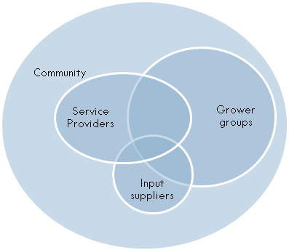
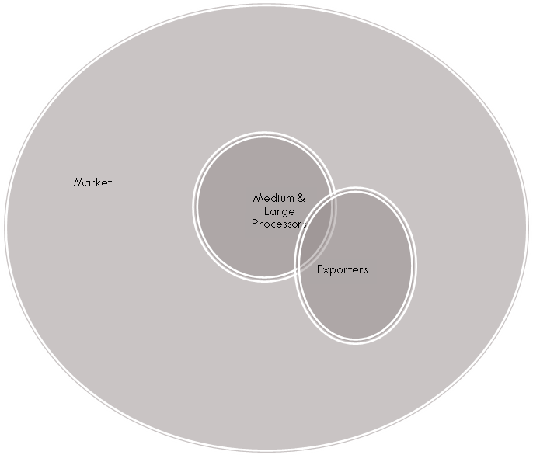
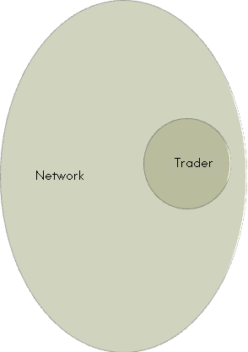

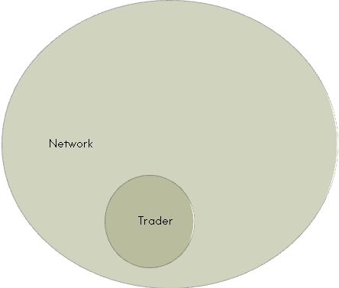
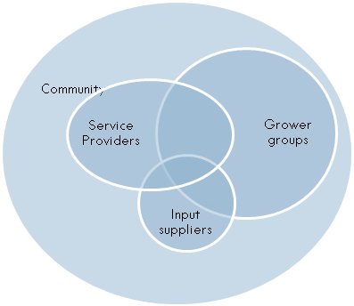
STRATEGY FOR MARKET UPTAKE: FUTURE MARKET SYSTEM
= micro-enterprise activity
Market Up-Take
Future Diagram

Slide 35
For More Information About VIP Ampath-Kenya Please Contact:
Naiomi Lundman
Associate Field Manager, FPI/ AMPATH
Tel: +254-0723-246-19
Email: nlundman@gmail.com

Slide 36



THANK YOU

