Slide 1
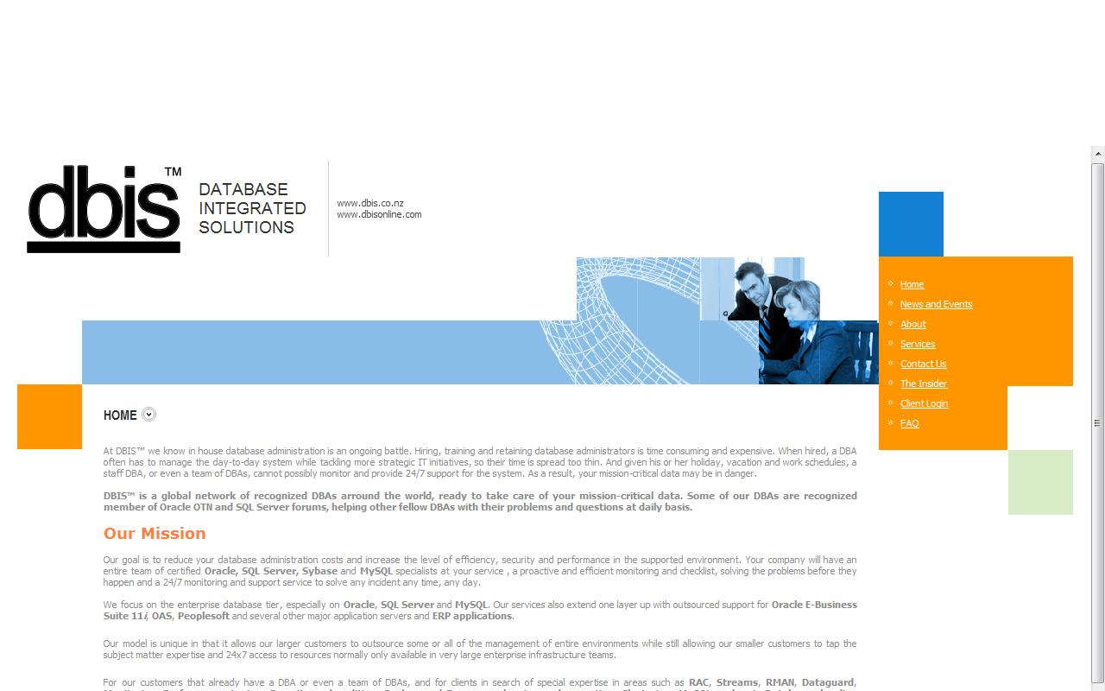


LOGGING OR NOLOGGING
THAT IS THE QUESTION
NZOUG 2008 Conference
2008 October, Rotorua
By:
Francisco Munoz Alvarez

Slide 2
LOGGING OR NOLOGGING : THAT IS THE QUESTION
Francisco Munoz Alvarez
Oracle ACE
8/9/10g OCP, RAC OCE, AS OCA, E-Business OCP, SQL/PLSQL OCA, Oracle 7 OCM
ITIL Certified
Blog: www.oraclenz.com
Email: falvarez@dbisonline.com
Database Director at DBIS ™
Database Integrated Solutions
www.dbisonline.com
www.dbis.co.nz

Slide 3
LOGGING OR NOLOGGING : THAT IS THE QUESTION
Database Integrated Solutions
www.dbisonline.com
www.dbis.co.nz
Remote DBA Services
Oracle Consulting
Contractor
Monitoring Tools

Slide 4
“Redo generation is a vital part of the Oracle recovery mechanism. Without it, an instance will not recover when it crashes and will not start in a consistent state. By other side, excessive redo generation is the result of excessive work on the database.“

Slide 5
Common Questions?
Does creating a table with the NOLOGGING option means there is “no generation of redo ever”, or just that the initial creation operation has no redo generation, but that DML down the road generates redo?

Slide 6
How and when can the NOLOGGING option be employed?

Slide 7
The Rule:
“The most important rule with respect to data is to never put yourself into an unrecoverable situation.”
The importance of this guideline cannot be stressed enough, but it does not mean that you can never use time saving or performance enhancing options.

Slide 9
Topics
What is Redo?
Redo Generation and Recoverability
Redo and Undo
Important Points about Logging and NoLogging
Disabling Redo Generation (NoLogging)
Tips
Common Problems
How to detect Redo Generation

Slide 10
What is Redo? (Long Answer)
When Oracle blocks are changed, including undo blocks, oracle records the changes in a form of vector changes which are referred to as redo entries or redo records. The changes are written by the server process to the redo log buffer in the SGA. The redo log buffer is then flushed into the online redo logs in near real time fashion by the log writer (LGWR).

Slide 11
Short Answer?
In other words:
Redo = Transactions

Slide 12
How it Works

Slide 13
When Redo is flushed?
The redo are flushed from Log Buffer by the LGWR:
When a user issue a commit.
When the Log Buffer is 1/3 full.
When the amount of redo entries is 1MB.
Every three seconds
When a database checkpoint takes place.
The redo entries are written before the checkpoint to ensure recoverability.

Slide 14
Redo Generation and Recoverability
“The main purpose of redo generation is to ensure recoverability. “
This is the reason why, Oracle does not give the DBA a lot of control over redo generation. If the instance crashes, then all the changes within SGA will be lost. Oracle will then use the redo entries in the online redo files to bring the database to a consistent state.

Slide 15
Some Frequent Questions:
Why I have excessive Redo Generation during an
Online Backup?
Why Oracle generates redo and undo for DML?
Does temporary tables generate Redo?
Can Redo Generation be Disabled During Materialized
View Refresh?
Why my table on NoLogging still Generating Redo?

Slide 16
Why I have excessive Redo Generation during an Online Backup?
When a tablespace is put in backup mode the redo generation behaviour changes but there is not excessive redo being generated, there is additional information logged into the online redo log during a hot backup the first time a block is modified in a tablespace that is in hot backup mode.
The datafile headers which contain the SCN of the last completed checkpoint are NOT updated while a file is in hot backup mode. DBWR constantly write to the datafiles during the hot backup. The SCN recorded in the header tells us how far back in the redo stream one needs to go to recover that file.

Slide 17
Why Oracle generates redo and undo for DML?
When you issue an insert, update or delete, Oracle actually makes the change to the data blocks that contain the affected data even though you have not issued a commit. To ensure database integrity, Oracle must write information necessary to reverse the change (UNDO) into the log to handle transaction failure or rollback. Recovery from media failure is ensured by writing information necessary to re-play database changes (REDO) into the log. So, UNDO and REDO information logically MUST be written into the transaction log of the RDBMS

Slide 19
Does temporary tables generate Redo?
The amount of log generation for temporary tables should be approximately 50% of the log generation for permanent tables.
However, you must consider that an INSERT requires only a small amount of "undo" data, whereas a DELETE requires a small amount of "redo" data.
If you tend to insert data into temporary tables and if you don't delete the data when you're done, the relative log generation rate may be much lower for temporary tables that 50% of the log generation rate for permanent tables.

Slide 20
Can Redo Generation Be Disabled During Materialized View Refresh?
There is no way to turn off redo generation when refreshing materialized views.
Setting the NOLOGGING option during the materialized view creation does not affect this, as the option only applies during the actual creation and not to any subsequent actions on the materialized view.
The amount of redo generated can be reduced by setting ATOMIC_REFRESH=FALSE in the DBMS_MVIEW.REFRESH options.

Slide 21
Why my table on NoLogging mode still Generating Redo?
The NOLOGGING attribute tells the Oracle that the operation being performed does not need to be recoverable in the event of a failure.
In this case Oracle will generate a minimal number of redo log entries in order to protect the data dictionary, and the operation will probably run faster.
Oracle is relying on the user to recover the data manually in the event of a media failure.

Slide 22
It is important to note that just because an index or a table was created with NOLOGGING does not mean that redo generation has been stopped for this table or index. NOLOGGING is active in the following situations and while running one of the following commands but not after that.

Slide 23
This is a partial list:
DIRECT LOAD (SQL*Loader)
DIRECT LOAD INSERT (using APPEND hint)
CREATE TABLE ... AS SELECT
CREATE INDEX
ALTER TABLE MOVE
ALTER TABLE ... MOVE PARTITION
ALTER TABLE ... SPLIT PARTITION
ALTER TABLE … ADD PARTITION (if HASH partition)

Slide 24
(continuation…)
ALTER TABLE … MERGE PARTITION
ALTER TABLE … MODIFY PARTITION
  ADD SUBPARTITON
  COALESCE SUBPARTITON
  REBUILD UNUSABLE INDEXES
ALTER INDEX ... SPLIT PARTITION
ALTER INDEX ... REBUILD
ALTER INDEX ... REBUILD PARTITION

Slide 25
Logging is stopped only while one of the commands in the previous slides is running, so if a user runs this:
SQL> ALTER INDEX new_index NOLOGGING.
SQL>ALTER INDEX new_index REBUILD;
The actual rebuild of the index does not generate redo (all data dictionary changes associated with the rebuild will do) but after that any DML on the index will generate redo this includes direct load insert on the table which the index belongs to.

Slide 26
Here is another example to make this point more clear:
SQL>CREATE TABLE new_table_nolog_test NOLOGGING(….);
All the following statements will generate redo despite the fact the table is in NOLOGGING mode:
SQL> INSERT INTO new_table_nolog_test ...,
SQL> UPDATE new_table_nolog_test SET …,
SQL> DELETE FROM new_table_nolog_test ..
The following will not generate redo (except from dictionary changes and indexes):
INSERT /*+APPEND+/ …
ALTER TABLE new_table_nolog_test MOVE …
ALTER TABLE new_table_nolog_test MOVE PARTITION …

Slide 27
Consider the following example:
SQL> select name,value from v$sysstat where name like '%redo size%';
NAME VALUE
-------------------------------------------------------- ----------
redo size 27.556.720
SQL> insert into scott.redo1 select * from scott.redotesttab;
50000 rows created.
SQL> select name,value from v$sysstat where name like '%redo size%';
NAME VALUE
------------------------------------------------------- ----------
redo size 28.536.820 => 980.100 bytes
SQL> insert /*+ APPEND */ into scott.redo1 select * from scott.redotesttab;
50000 rows created.
SQL> select name,value from v$sysstat where name like '%redo size%';
NAME VALUE
-------------------------------------------------------- ----------
redo size 28.539.944 => 3.124 bytes

Slide 28
To activate the NOLOGGING for one of the ALTER commands add the NOLOGGING clause after the end of the ALTER command.
For example:
SQL> ALTER TABLE new_table_nolog_test NOLOGGING;
The same applies for CREATE INDEX but for CREATE TABLE the NOLOGGING should come after the table name.
Example:
SQL> CREATE TABLE new_table_nolog_test NOLOGGING AS SELECT * FROM big_table;
"It is a common mistake to add the NOLOGGING option at the end of the SQL (Because oracle will consider it an alias and the table will generate a lot of logging)."

Slide 29
LOGGING and NOLOGGING
Despite the importance of the redo entries, Oracle gave users the ability to limit redo generation on tables and indexes by setting them in NOLOGGING mode.
NOLOGGING affect the recoverability. Before going into how to limit the redo generation, it is important to clear the misunderstanding that NOLOGGING is the way out of redo generation, this are some points regarding it:

Slide 30
NOLOGGING is designed to handle bulk inserts of data which can be easy re-produced.
Regardless of LOGGING status, writing to undo blocks causes generation of redo.
LOGGING should not be disabled on a primary database if it has one or more standby databases. For this reason oracle introduced the ALTER DATABASE FORCE LOGGING command in Oracle 9i R2. (Means that the NOLOGGING attribute will not have any effect on the segments) If the database is in FORCE LOGGING MODE. NOLOGGING can be also override at tablespace level using ALTER TABLESPACE … FORCE LOGGING.

Slide 31
Any change to the database dictionary will cause redo generation. This will happen to protect the data dictionary.
An example:
if we allocated a space above the HWM for a table, and the system fail in the middle of one INSERT /*+ APPEND */ , the Oracle will need to rollback that data dictionary update. There will be redo generated but it is to protect the data dictionary, not your newly inserted data.

Slide 32
The data which are not logged will not be able to recover. The data should be backed up after the modification.
Tables and indexes should be set back to LOGGING mode when the NOLOGGING is no longer needed.
NOLOGGING is not needed for Direct Path Insert if the database is in NO ARCHIVE LOG MODE.

Slide 33
The data which is not able to reproduce should not use the NOLOGGING mode. If data which can not be reloaded was loaded using NOLOGGING. The data cannot be recovered when the database crashes before backing the data.
NOLOGGING does not apply to UPDATE, DELETE, and INSERT.

Slide 34
NOLOGGING will work during certain situations but subsequent DML will generate redo. Some of these situations are:
  direct load INSERT (using APPEND hint),
  CREATE TABLE ... AS SELECT,
  CREATE INDEX.
If the LOGGING or NOLOGGING clause is not specified when creating a table, partition, or index the default to the LOGGING attribute, will be the LOGGING attribute of the tablespace in which it resides.

Slide 35
Some Tips and Directions when using Logging Mode (DEFAULT)

Slide 36
While Backing Up
RMAN does not need to write the entire block to redo because it knows when the block is being copied. If the user needs to use the user managed backup then they can follow these steps to reduce redo generation:
Do not back up all the tablespaces in one go. This will put every tablespace in backup mode for longer than it needs to be and therefore generates redo for longer than it needs to do.
Automatic backup on the busy tablespaces
Backup a tablespace during a time when it is least busy in terms of DML.

Slide 37
Bulk Inserts
By bulk we mean a large percentage compared to the existing data
To reduce the amount of redo generation in a bulk data load, the user needs to disable the indexes (when making a direct load to a table that have indexes, the indexes will produce redo) before the load then re-build them again as follow:
Alter index index_name unusable ; # Do this for every index
Alter session set skip_unusable_indexes=true ; (*)
Insert into table_name select …
Alter index index_name rebuild;
(*)skip_unusable_indexes is an instance initialization parameter in 10g and it default to true. Before 10g, skip_unusable_indexes needs to be set in a session or the user will get an error. It is a good practice to set it in a session, regardless of the database version, when the above steps is done.

Slide 38
Bulk Delete
Create table new_table with logging
Insert into new_table select the records you want to keep from current_table.
Create the indexes on the new_table (*)
Create constraints, grants etc.
Drop current_table.
Rename new_table to current.
(*) If the data left is so small or there are a lot of dependencies on the table (views, procedures, functions, etc) the following steps can be used instead of 3-6 above:
Disable constrains on current_table.
Truncate current_table;
Insert into current_table select * from new_table ;
commit;
enable constraints
drop table new_table;

Slide 39
Bulk Update
Use this method if indexes are going to be affected by the update. This is because mass updating indexes is more expensive than re-building them.
If a small portion of the data is updated then use this method:
Disable constraints.
Alter index index_name unusable ;
Alter session set skip_unusable_indexes=true ;
Update the table.
Commit;
Alter index index_name rebuild ;
Enable constraints.
If the update causes a good portion of the data to be updated then follow this method:
Create new_table as select (updating statement)
Create indexes on the new_table,
Create grants, constraints etc on the new_table
Drop current table
Rename the new_table to current_table.

Slide 40
Tips For Developers
Run the DML in as few SQL statements as you can. This will reduce the generation of undo and block header update and therefore reduces redo generation.
That’s how it should be done:
SQL> set autotrace on statistics
SQL> insert into test select rownum from dba_objects;
93,244 rows created.
Statistics
---------------------------------------------------------------
... 912,326 redo size
… 93,244 rows processed

Slide 41
That’s how it should NOT be done:
SQL> set autotrace on statistics
SQL> declare
2 cursor c1 is
3 select rownum r from dba_objects;
4 begin
5 for v in c1
6 loop
7 insert into test values( v.r) ;
8 end loop ;
9 end;
10 /
PL/SQL procedure successfully completed.
Statistics
---------------------------------------------------------------
... 16,112,247 redo size
UFFF - 912,326 redo size against 16,112,247 redo size

Slide 42
Do not commit more than you need.
By issuing the commit command you are forcing Oracle to do some internal updates which produces redo.
  I ran the PL/SQL code used in the previous example with the command COMMIT; inserted after line 7.
  The redo generated was: 28,642,216.
  I also ran the script again with the commit at the end followed by a “select * from test” statement to force committed block cleaning the redo generated, and the result was 13,216,188.
You can see that using a lot of committing to insert the same amount of data has produced far more redo. By reducing commits you also will reduce the strain on the LGWR process.

Slide 43
DEMO
“Let see if it’s true”

Slide 44
Some Tips and Directions Now using NoLogging Mode

Slide 45
DIRECT PATH INSERT
When direct path insert is used oracle does the following:
Format the data to be inserted as oracle blocks.
Insert the blocks above the High Water Mark (HWM)
When commit takes place the HWM is moved to the new place (The process is done bypassing the buffer cache).
It is very important to understand how Direct Path Inserts affects redo generation. As mentioned above it does not affect indexes but it is affected by the following factors:
The database Archivelog mode.
Using the /*+ APPEND */ hint.
The LOGGING mode of the table.
The FORCE LOGGING mode of the database (from 9i R2).
If the database is in FORCE LOGGING mode then Oracle will treat the table as if it was in LOGGING mode regardless of its mode.

Slide 47
Bulk Inserts
To load bulk data using Direct Path.
Alter table table_name nologging;
Alter index index_name unusable ;
Alter session set skip_unusable_indexes=true ;(*)
Insert /*+ APPEND */ into table_name select …
Alter index index_name rebuild nologging;
Alter table table_name logging ;
Alter index index_name logging ;
Backup the data.
(*)skip_unusable_indexes is an instance initialization parameter in 10g and defaulted to true. Before 10g, skip_unusable_indexes needs to be set in a session or the user will get an error. It is a good practice to set it in a session, regardless of the database version, when the above is done.

Slide 48
Bulk Delete
Create a new_table with no logging.
Insert /*+ Append */ into new_table select the records you want to keep from current_table.
Create the indexes on the new table with NOLOGGING (*)
Create constraints, grants etc.
Drop current_table.
Rename new_table to current.
Alter new_table and indexes logging.
Backup the data.

Slide 49
(*) If the data left is so small or there are a lot of dependencies on the table (views, procedures, functions) the following steps can be used instead of 3-6 in the previous slide:
Disable constrains on current_table;
Truncate current_table;
make indexes unusable;
alter current table NOLOGGING ;
Insert /*+ APPEND */ into current_table select * from new_table ;
commit;
rebuild indexes with NOLOGGING;
enable constraints
Put current table and indexes in LOGGING mode
backup the data
drop table new_table;

Slide 50
Bulk Update
Follow the steps for bulk Delete but integrate the update within the select statement. Lets say that you want to update the value column in the goods table by increasing it by 10% the statement will be like:
Create a new_table with no logging.
Insert /*+ Append */ into new_table select (update statement eg: col1, col2* 1.1,…)
Create the indexes on the new table with NOLOGGING (*)
Create constraints, grants etc.
Drop current_table.
Rename new_table to current.
Alter new_table and indexes logging.
Backup the data.

Slide 51
Some Common Problems
Block Corruption due to NoLogging (Standby DB)
Recover problems (NoLogging Data)
Excessive Log Swiches on Bulk Transactions (Logging)
'log file parallel write'
'log file sync'

Slide 52
ORA-01578: ORACLE data block corrupted (file # 3, block # 2527)
ORA-01110: data file 1: '/u1/oracle/dbs/stdby/tbs_nologging_1.dbf‘
ORA-26040: Data block was loaded using the NOLOGGING option“

Slide 53
How to Detect Redo
Just Examine the amount of undo generated. When a transaction generates undo, it will automatically generate redo as well.
1) Query V$SESS_IO. This view contains the column BLOCK_CHANGES which indicates how much blocks have been changed by the session. High values indicate a session generating lots of redo.
The query you can use is:
SQL> SELECT s.sid, s.serial#, s.username, s.program,
2 i.block_changes
3 FROM v$session s, v$sess_io i
4 WHERE s.sid = i.sid
5 ORDER BY 5 desc, 1, 2, 3, 4;
Run the query multiple times and examine the delta between each occurrence of BLOCK_CHANGES. Large deltas indicate high redo generation by the session.

Slide 54
Detecting Redo (Part II)
2) Query V$TRANSACTION. These view contains information about the amount of undo blocks and undo records accessed by the transaction (as found in the USED_UBLK and USED_UREC columns).
The query you can use is:
SQL> SELECT s.sid, s.serial#, s.username, s.program,
2 t.used_ublk, t.used_urec
3 FROM v$session s, v$transaction t
4 WHERE s.taddr = t.addr
5 ORDER BY 5 desc, 6 desc, 1, 2, 3, 4;
Run the query multiple times and examine the delta between each occurrence of USED_UBLK and USED_UREC. Large deltas indicate high redo generation by the session.
You use the first query when you need to check for programs generating lots of redo when these programs activate more than one transaction. The latter query can be used to find out which particular transactions are generating redo.

Slide 55
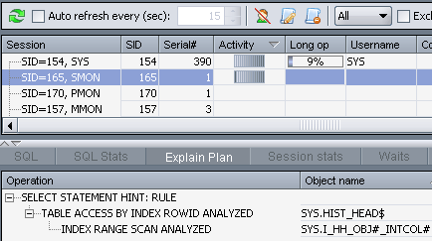
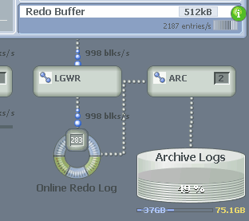
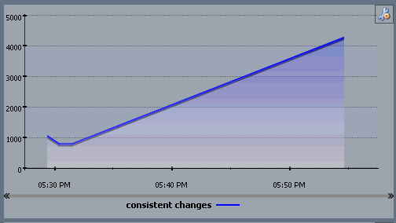
Download Insider here:
http://www.dbisonline.com

Slide 56
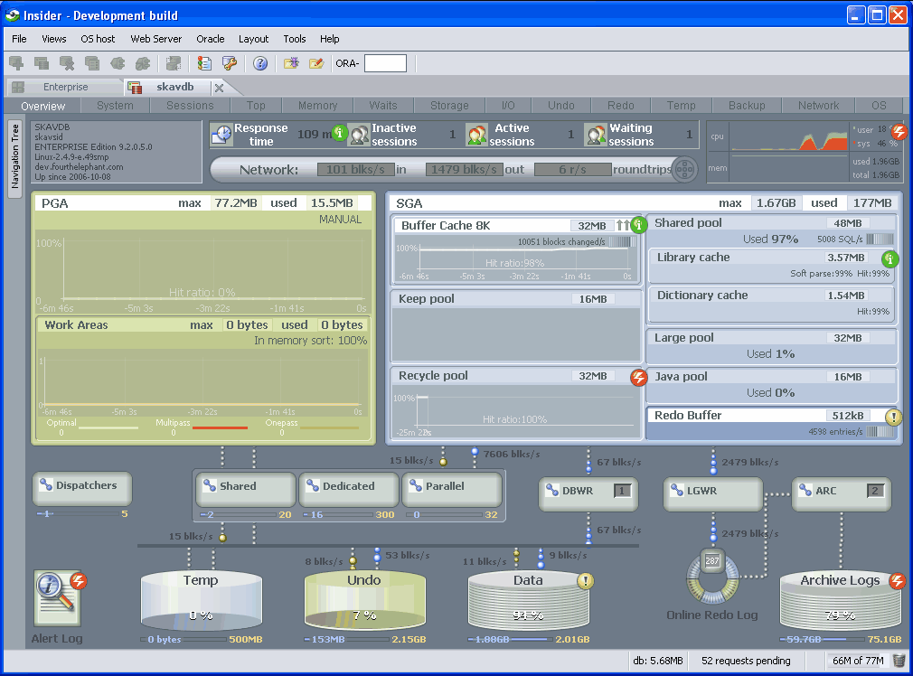

Slide 57
Overview
What is Redo?
Redo Generation and Recoverability
Redo and Undo
Important Points about Logging and NoLogging
Disabling Redo Generation (NoLogging)
Tips
Common Problems
How to detect Redo Generation

Slide 58
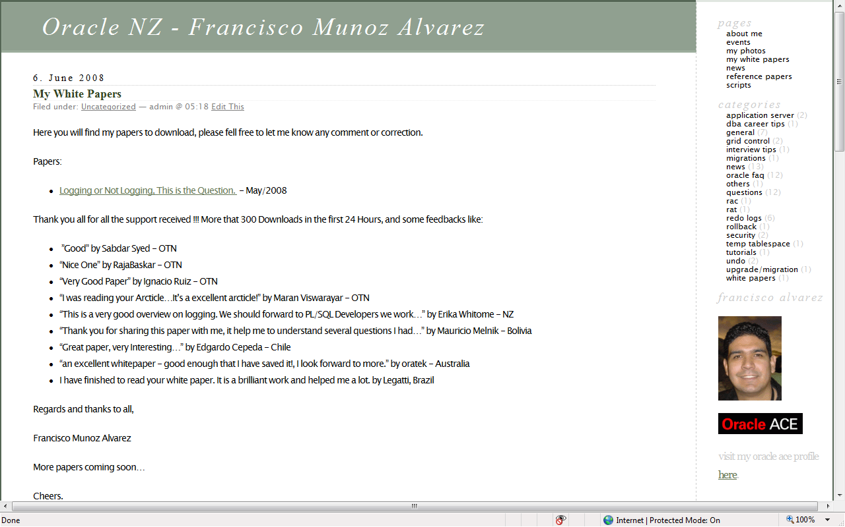

Slide 59

Now is your time to take the control of your Redo Generation

Slide 60
QUESTIONS?

Slide 61
Thank you !

