Slide 1
Framework for planning and evaluating action on inequalities
Pauline Craig
Public Health Programme Manager
Glasgow Centre for Population Health

Slide 2
Development of the framework
Analysis of Greater Glasgow and Clyde NHS CH/CP strengths and areas for development in addressing health inequalities through development plans and three service plans
Analysis used Whitehead and Dahlgren’s 10 principles for policy action on social inequities in health (Levelling Up)
Search for indicators relevant to CH/CP actions for evaluation and review
Issues of variation across CH/CPs in addressing inequalities and their capacity for indicator analysis and tracking: generic framework produced for CH/CPs to use to identify own indicators

Slide 3
Inequalities framework
Final framework based on CH/CP actions to address inequalities together with knowledge from over 30 years of inequalities research
Key concepts
  Aim to reduce inequalities (vs population health improvement)
  Know your population: complexity of gender, ethnicity, deprivation
  Individual health improvement plus action on social circumstances
  Three interlinked but distinct approaches to addressing inequalities and consequently to measuring progress

Slide 4
Target the worst off
Examples of actions: Regeneration, employability, targeted health improvement, services for vulnerable children

Slide 5
Reduce the gap
Examples of actions: increase minimum wage alongside a millionaire prevention programme, re-allocation of resources from affluent to poor areas

Slide 6
Reducing the gradient
Reducing systematic inequalities for income, gender, ethnicity, disability etc ie improve access and opportunities, inequalities sensitive practice

Slide 7
Framework for reviewing action on inequalities
Stated aims for reducing inequalities Three approaches
What
Targeting the worst off
Reducing the gap between groups
Reducing inequalities across the population
Why
Identification of need and baseline position
Additional research
Data about individuals
Data about the population
How
Interventions
Evidence informed services for individuals
Action on social and economic circumstances
Progress
Outcome measurement and review Three approaches
Reducing the gap between groups
Reducing inequalities across the population
Targeting the worst off

Slide 8
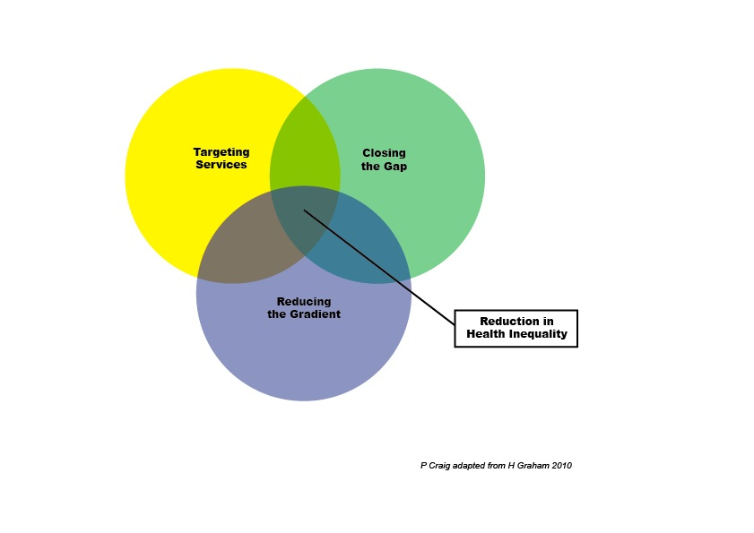

Slide 9
Interaction of approaches
All approaches should be underpinned by inequalities sensitive practice
Targeting and reducing the gap: resource re-distribution favouring most in need
Reducing the gradient and targeting: eg antenatal classes for teenagers, audit of service use by ethnic groups
Socioeconomic duty: a potential springboard for aligning the three approaches?

Slide 10
Application: strategy and evaluation
Primary care mental health team (SE Glasgow)
Children’s services (East Glasgow)
Diabetes (GG&C)
Three Equally Well test sites (SE Glasgow,
East Lothian and Fife)
Dundee CHP Health Equity Action Plan
Child Poverty Strategy (Glasgow City)

Slide 11
Child poverty strategy
Targeting families experiencing child poverty | Increase incomes for families in, or at risk of falling into poverty, eg through income maximisation and supporting parents into and within employment
Acting on social circumstances (reducing the gap) | Reduce outgoings of families by ensuring that services contributing to children reaching their potential are affordable, equitable and of high quality, eg childcare, education, nutritious food, health enhancing environments
Improving outcomes for targeted group from population programmes and services (reducing the gap) | Mitigation of the impact of poverty eg service planning and delivery considers risk factors for poverty and its impact on the health and wellbeing of children.

Slide 12
Application: practice
Capacity building in health promotion (Lothian)
Antenatal inequalities (MSAG)
Tools for CH/CPs for Shifting the Balance (QIS)
(Volunteers?)

Slide 13
Addressing antenatal inequalities
Aim to reduce inequalities in outcomes for mother and child. Knowledge of SIMD and age/sex/ethnicity etc of a population; understanding of levels of risk and the impact of social circumstances on health of the people in the area; evaluations of interventions; decisions made so that those at high risk have greater input that those at low risk. Planning through services for individuals and action on social circumstances.
Target high risk group
Eg MH, Subs misuse, homelessness, asylum
seekers
Agree targeted high risk and low risk groups
Eg asylum seekers vs general population, deprived area vs CH/CP
Reduce inequalities across the population
Eg equality legislation, person-centredness
Planning action in partnership with agencies and targeted group
Planning action in partnership with agencies and communities
Planning action in partnership with agencies and communities
Identify indicators
progress in targeted group eg audit under-20s booking by 12 weeks
Identify indicators
absolute or relative differences between groups
Identify indicators
- sensitivity to inequalities, eg EQIA; research: different responses to different groups

Slide 14
Making it happen
To implement interventions as proposed by research, teams need capacity for or access to:
  community engagement,
  agency engagement,
  planning,
  inequalities research,
  data analysis,
  evaluation,
  service redesign,
  change management,
  working differently, and
  time.
Notes:
Our reflections on actions to address inequalities as developed by the three test sites:
Some things clearly needed to be in place to carry through the work as suggested by research. We felt that we were bringing some of that to some teams which is not what they were looking for and suggests that further development might be helpful?

Slide 15
Learning from application
The framework has filled a theory-practice gap for understanding inequalities in all its complexity: helped to pin down the what, why, how and areas for development in addressing inequalities
Linked equality agenda with health inequalities
Applicable to a variety of settings and topics
Established the starting point for planning interventions on inequalities and evaluation and monitoring of progress.

Slide 16

ScotPHO Health & Wellbeing
Profiles
CASE STUDIES
Dr Diane Stockton

Slide 17
In this session I will
Provide an overview of the profiles
Summarise three case studies

Slide 18
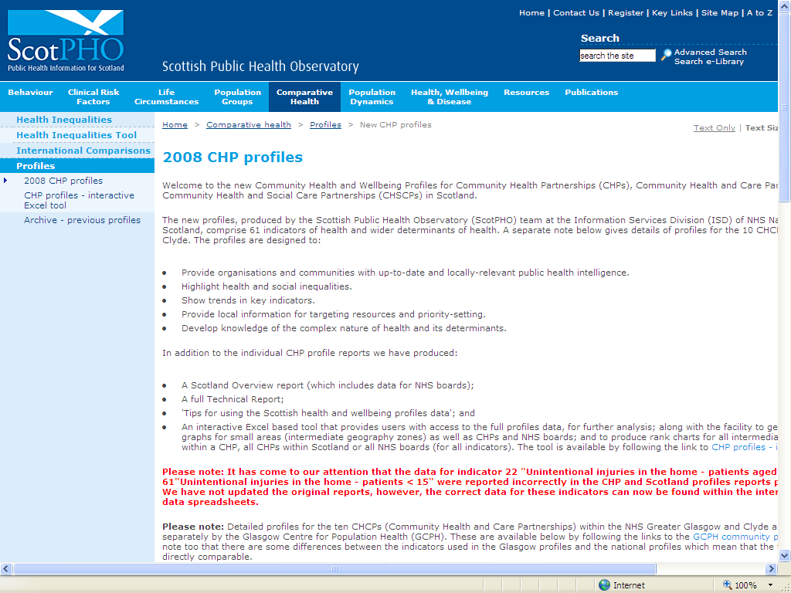
www.scotpho.org.uk/profiles

Slide 19
12 domains (68 indicators)
Population profile
Life expectancy and mortality
Behaviours
Ill health & injury
Mental health & function
Social care, function & housing
Education
Economy
Crime
Environment
Child & maternal health
Immunisation and screening
Notes:
Mention that most indicators available at CHP level or below, but we have included a small number of indicators available only at LA level – e.g. some of the social care and housing ones, because only available at that level….

Slide 20
Spine charts

Slide 21
Time trend graphs

Slide 22
Maps
Alcohol related and attributable hospital patients

Slide 23
Rank charts

Slide 24
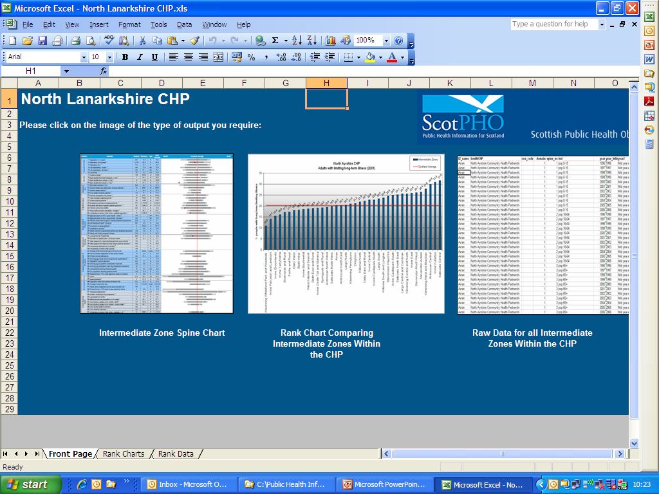
Online small area tool:

Slide 25
Socio-economic circumstances / behaviours strongly associated with health outcomes
For example, the areas with the lowest life expectancy, highest mortality and poorest self-assessed health tend to also have the highest levels of income deprivation, worklessness, violence and smoking, and the lowest educational attainment.
Conversely, the areas with highest life expectancy and best health overall are significantly more affluent, have more people in work, better educational attainment, are far less affected by violence and show healthier behaviours e.g. less smoking, and higher breastfeeding levels.

Slide 26
Positive trends in Profiles 2008
Deaths from heart disease have fallen significantly in all CHPs, and cancer and stroke mortality has dropped in the majority of areas.
Rises in breastfeeding in a number of CHPs
Downward trends in levels of worklessness

Slide 27
Some key findings in Profiles 2008
Life expectancy improving overall in all CHPs but there are wide gaps in life expectancy
  77.3 years / 67.9 years in best and worst CHPs
  In a number of the more deprived intermediate zones there has been a reduction or flat trend in life expectancy over the period. This is particularly notable for men.
Striking (and increasing) impact of alcohol on health with wide inequalities
Wide inequalities in behaviours like breastfeeding (14.3% to 42.5%) and smoking

Slide 28
CASE STUDY 1:
Building a business case for a new health centre in North Glasgow (Evelyn Borland)
Notes:
“Used to highlight vulnerable communities. To influence service redesign in community nursing/children's services. Disease specific information”.
“Used as part of our annual planning for 2009/10 and will be used again for 2010/11. Used to provide a comparison to Scotland as a whole which provides justification for certain work streams. To provide information on alcohol for use within a project proposal”.
“Used in maternity strategy development. Helped agree priorities for SOA”.
“Used within health & wellbeing themed planning group for developing the SOA. Used to provide a local context for identifying priorities within the SOA & Community Plan”.
“SOA, Improving Health and Wellbeing Action Plan of the Community Plan Children, and Young People's Service Plan”.
“Some of the information has helped support the development of the SOA for 2009/12. Used in the local Health Improvement Plan”.
“As a resource for a local authority joint health improvement plan development & steering group. Key aspects of findings presented to Operating Management Group of one of our Community Health Partnerships”.
“To support capital planning bid. To support Healthy Weight Community programme. To inform 'Enquiry by Design' programme - planning model village - Prince's Trust”.
“To target walking booklets at particular areas of deprivation. Used within the team to get a better understanding of the local picture Will be using to help forward planning and development in terms of the health improvement work plan”.
“With elected members to provide them with the information they need in working with community groups on local projects, and to inform/challenge what they know about their area. Shared with public health practitioners working within CHP areas. With senior managers to give them an at a glance overview of a geographic area”.
“Incorporated into briefing notes for elected members to strengthen the decision making process, to inform the development of locality based programmes, to support service development”.
“During teaching of health promotion units”.
“Used to illustrate patterns of health in Scotland in lectures to nursing students”.
“Information used to enhance discussions at meetings”.
“Review of health issues to inform priorities”.
“Use in gathering info and data for a needs assessment”.
“Implementation of smoking cessation groups”.
“The profiles have been used to highlight areas of concern and to improve understanding of why we have that profile e.g. non-intentional injury in the home. This led to discussion on the partners potential input to improve that result. The statistics on alcohol have been used to inform discussion on resource allocation and partnership working”.
“Connecting health and other data to deprivation e.g. showing the alcohol related illness matches deprivation (and other illness) and not simply consumption”.
“An example is around there was the feeling that suicide rates were higher in Orkney than other areas - however death from suicide published in 2008 ScotPHO - health and wellbeing profile demonstrated that Orkney death rates from suicide
6
matched the national average. This was great hard evidence to influence the mental health strategy, and then this discussion took place why do we think there is more ... know the people? reported in our local paper? National averages were also used in the alcohol and drugs partnership strategy, to help in planning services”.
“Alcohol planning policy, Keep Well, Local 'traffic light' system”.
“To look at specific targeting of areas for delivery of Keep well health checks. To increase understanding for staff on health indicators within deprived communities. To inform local documents, proposals and reports as an evidence base”.
“Translated into more accessible traffic lights form separating demographic from health data, these have been used to support plans, policy, programmes and applications for funding and used with every level of organisation including third sector. On their own the community health profiles are not accessed by key decision makers, in our experience, but rather more by middle managers and the very 'switched on' executive…”.
“Used to develop local action plan to improve sexual health info. Used to base funding apps on for voluntary organisations”.
“Local Area has many different sub-communities, each with different needs. Useful to compare the likenesses and differences when making funding decisions on thematic projects (e.g. addictions where these levels were highest). Used information in local profile as justification for project briefs to other funding bodies. Used comparisons of health board areas against local areas to convince national groups/organisations of the benefit to targeting our (specific) area for pilot projects and seed funding”.
“I used the profiles to compare Oxgangs and Firrhill against Edinburgh CHP on certain indicators as part of a project to decide what type of community health promotion support the Oxgangs community would most benefit from. Part of community service planning”.
“NHS D&G is currently undergoing formal consultation of Clinical Services Strategy. IG profiles have been extremely helpful in providing some quick responses to consultation queries”.
“I have used the profiles to inform partner agencies about health data. I have used the profiles to compare 2 similar CHP areas”.
“Redesigning services: medical practice amalgamation; community nursing profiles; mental health services”.

Slide 29
Extract from the business case
The profiles ….. “confirm the situation of North Glasgow as one where people’s difficult circumstances result in poor quality of life, high rates of ill-health and low life expectancy. The profiles also highlight the differences between different neighbourhoods in North Glasgow, and will therefore help us to target our services to greatest impact.”

Slide 31
Life expectancy variation within North Glasgow CHP (Males)
Notes:
In Ruchill and Possilpark male life expectancy is 63.4 (more than 12 years less than the average in Kelvindale and Kelvinside and female life expectancy is 72.1 (9 years less than Kelvindale and Kelvinside).

Slide 32
The local Possilpark profile
Highlighted that its residents experience a range of health and social problems that are related to living in circumstances of deprivation.
It particularly highlighted high levels of addiction (smoking, alcohol and drugs).
These issues were pulled out in the business case.

Slide 33
Outcome
The profiles allowed a clear evidence-based demonstration of why Possilpark needed investment
Consultants putting together the bid were so shocked by some of the profiles data that they queried the figures – they were correct
Firstly the team competed to get NHS Board approval
Then they successfully received Scottish Government's Primary Care modernisation fund (for £9m)
The objective figures in the profiles made a strong case

Slide 34
CASE STUDY 2:
Grampian “Traffic Light” charts
(Linda Leighton-Beck)
Notes:
Colour-coded picture of health status in our communities, making it easier to see 'at a glance' the issues that may need to be addressed.
Red - more than 5% worse than Scotland average; Green – more than 5% better than Scotland average; Amber – within + or – 5% of Scotland average

Slide 35
Wanted a simple approach to integrate health data in local planning
The profiles…… “have allowed us to take health inequalities to the heart of service planning ….. our interface has helped to move it along. They have made a difference here.”

Slide 36
Example of Grampian traffic light chart
Notes:
Colour-coded picture of health status in our communities, making it easier to see 'at a glance' the issues that may need to be addressed.
Red - more than 5% worse than Scotland average; Green – more than 5% better than Scotland average; Amber – within + or – 5% of Scotland average

Slide 37
Outcome
Used in a number of funding bids to highlight specific issues in areas of deprivation.
Used to induct all new Health Visitors in NHS Grampian – leading to rapid understanding of local issues and so improved quality and service locally.
Used within community planning and board planning to focus debate on areas that are evidence-based; giving a clear rationale for the topics discussed.
Used by elective members in their neighbourhood statistics, ensuring that health data is integrated in their thinking.

Slide 38
CASE STUDY 3:
Community planning and
Single Outcome Agreement
North Lanarkshire
Notes:
“Used to highlight vulnerable communities. To influence service redesign in community nursing/children's services. Disease specific information”.
“Used as part of our annual planning for 2009/10 and will be used again for 2010/11. Used to provide a comparison to Scotland as a whole which provides justification for certain work streams. To provide information on alcohol for use within a project proposal”.
“Used in maternity strategy development. Helped agree priorities for SOA”.
“Used within health & wellbeing themed planning group for developing the SOA. Used to provide a local context for identifying priorities within the SOA & Community Plan”.
“SOA, Improving Health and Wellbeing Action Plan of the Community Plan Children, and Young People's Service Plan”.
“Some of the information has helped support the development of the SOA for 2009/12. Used in the local Health Improvement Plan”.
“As a resource for a local authority joint health improvement plan development & steering group. Key aspects of findings presented to Operating Management Group of one of our Community Health Partnerships”.
“To support capital planning bid. To support Healthy Weight Community programme. To inform 'Enquiry by Design' programme - planning model village - Prince's Trust”.
“To target walking booklets at particular areas of deprivation. Used within the team to get a better understanding of the local picture Will be using to help forward planning and development in terms of the health improvement work plan”.
“With elected members to provide them with the information they need in working with community groups on local projects, and to inform/challenge what they know about their area. Shared with public health practitioners working within CHP areas. With senior managers to give them an at a glance overview of a geographic area”.
“Incorporated into briefing notes for elected members to strengthen the decision making process, to inform the development of locality based programmes, to support service development”.
“During teaching of health promotion units”.
“Used to illustrate patterns of health in Scotland in lectures to nursing students”.
“Information used to enhance discussions at meetings”.
“Review of health issues to inform priorities”.
“Use in gathering info and data for a needs assessment”.
“Implementation of smoking cessation groups”.
“The profiles have been used to highlight areas of concern and to improve understanding of why we have that profile e.g. non-intentional injury in the home. This led to discussion on the partners potential input to improve that result. The statistics on alcohol have been used to inform discussion on resource allocation and partnership working”.
“Connecting health and other data to deprivation e.g. showing the alcohol related illness matches deprivation (and other illness) and not simply consumption”.
“An example is around there was the feeling that suicide rates were higher in Orkney than other areas - however death from suicide published in 2008 ScotPHO - health and wellbeing profile demonstrated that Orkney death rates from suicide
6
matched the national average. This was great hard evidence to influence the mental health strategy, and then this discussion took place why do we think there is more ... know the people? reported in our local paper? National averages were also used in the alcohol and drugs partnership strategy, to help in planning services”.
“Alcohol planning policy, Keep Well, Local 'traffic light' system”.
“To look at specific targeting of areas for delivery of Keep well health checks. To increase understanding for staff on health indicators within deprived communities. To inform local documents, proposals and reports as an evidence base”.
“Translated into more accessible traffic lights form separating demographic from health data, these have been used to support plans, policy, programmes and applications for funding and used with every level of organisation including third sector. On their own the community health profiles are not accessed by key decision makers, in our experience, but rather more by middle managers and the very 'switched on' executive…”.
“Used to develop local action plan to improve sexual health info. Used to base funding apps on for voluntary organisations”.
“Local Area has many different sub-communities, each with different needs. Useful to compare the likenesses and differences when making funding decisions on thematic projects (e.g. addictions where these levels were highest). Used information in local profile as justification for project briefs to other funding bodies. Used comparisons of health board areas against local areas to convince national groups/organisations of the benefit to targeting our (specific) area for pilot projects and seed funding”.
“I used the profiles to compare Oxgangs and Firrhill against Edinburgh CHP on certain indicators as part of a project to decide what type of community health promotion support the Oxgangs community would most benefit from. Part of community service planning”.
“NHS D&G is currently undergoing formal consultation of Clinical Services Strategy. IG profiles have been extremely helpful in providing some quick responses to consultation queries”.
“I have used the profiles to inform partner agencies about health data. I have used the profiles to compare 2 similar CHP areas”.
“Redesigning services: medical practice amalgamation; community nursing profiles; mental health services”.

Slide 39
Online small area tool:

Slide 42
Online small area tool:

Slide 43
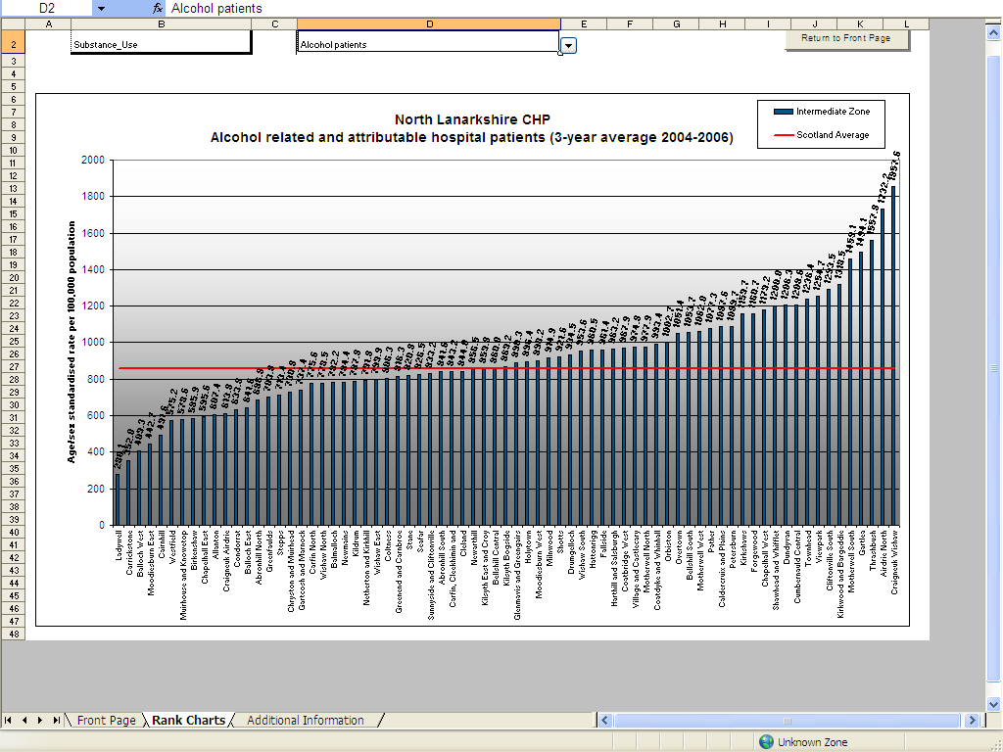

Slide 44
Online small area tool:

Slide 46
Outcome
Appropriate and evidence-based measures included in their Single Outcome Agreement and their Community plan.

Slide 47
Further examples of uses of the profiles data
(from our evaulation)

Slide 48
Influenced service redesign in community nursing/children's services
Used to agree priorities for SOA
Influenced maternity strategy development
Used for local authority joint health improvement plan development & steering group
Supported a capital planning bid
Incorporated into briefing notes for elected members to strengthen the decision making process
Used during training and teaching nurses and health promotion staff
Used to implement smoking cessation groups
Alcohol statistics informed discussion on resource allocation and partnership working
Used in health needs assessments
Used to develop local action plan to improve sexual health information
Used for funding applications for voluntary organisations
Comparisons of health board areas against local areas used to convince national groups/organisations of the benefit to targeting (specific) area for pilot projects and seed funding
Used to decide what type of community health promotion support local areas would most benefit from
Used in redesigning services: medical practice amalgamation; community nursing profiles; mental health services

Slide 49
Do you use your local profiles data effectively?
  Profiles 2010 will be published on 30th November 2010
  Similar indicators to last time with some additions; it includes data up to end 2009 wherever possible
  Scotland report, CHP reports, IZ spine packs, online small area presentation tools, technical report
  Children and Young People profiles will be published at the same time

