Slide 1



Defense Procurement and Acquisition Policy
and
Business Transformation Agency
3in1 Tool Program
Information Brief
Lt Col Ann Christianson
Program Manager
Updated: 15 Aug 2010

Slide 2
Outline
Key Players
SF44 Process and Challenges
3in1 Tool
  Equipment
  End to End Process
    Set Up
    Field Purchases
    Clearance
    Data Transfer
    Reporting
Features
Benefits
User Assessments
Timeline

Slide 3
Requirement
Process: Contingency Micro-purchases processed manually using SF44s
  To conduct on-the-spot, over-the-counter, purchases of supplies & services when GPC is not available
  FY09 Iraq/Afghanistan: 2,664 Soldiers executed 36,600 orders, total $82.5M
  Identified Problems:
Requirement: Improve internal procurement & payment controls, & safety
  Validated: Task Force 849 Team 6 (Gansler Report); Prior Joint Contracting Command Iraq/Afghanistan Commander; Joint Working Group
Solution: Automate the SF44 process from end-to-end with a technology-based solution to record and transfer purchase and payment data from a handheld device to a backend database (does not include CERP/Rewards)
Illegibility SF44/Receipts No Theater wide visibility Lost documents Wasted time Duplicating data entry Excessive Paper Reproduction Traveling to Clear | Delayed oversight/visibility of purchases/cash control Unnecessary Risk due to travel Unmatched documents requiring manual tracking Errors: typos, calculation of order or ledger totals or exchange rate

Slide 4
Key Players
Program Office
  LeAntha Sumpter - Director, Program Development & Implementation
  Lt Col Ann Christianson - 3in1 Program Manager (DPAP)
  Martina Johnson - JCCS Program Manager (BTA)
  Lou Gaudio (Ctr) - Program Tech Support (DPAP)
Service Reps:
  USA - MAJ Chambers/Andy Eger
  USA (FMC) - CPT Reinhart/Mr Castleman
  USAF - Lt Col Bill Braden
  Navy - CDR Turner
  USMC - MSG Scoffield
  DFAS - Laura Cross
Level 2 SMEs:
  Capt Briggs (USMC/PA/DA)
  CWO2 Romero (USMC/PA/DA)
  MSgt Sosa (USMC/PA/DA)
  MSgt Tuzon (USMC/KO)
  SSgt Rivers (USMC/KO)
  SFC Jones (USA/FOO/PA)
  SFC Crawley (USA/PA)
  SFC Pearey (USA/PA)
  MSgt Snyder (AF/KO)
  SMSgt Riegler (AF/KO)
  SSgt DuBose (AF/KO)
  SFC Mitchell (USA/PA)
  Capt Pease (AF/KO)
  MSG Hoover (USA/PA)
  SFC Murray (USA/FOO Mgr)
  SFC Martinez (USA/FOO)
  SFC Moore (USA/PA)
Level 1 SMEs:
  Iraq - MSgt Miller (USA/KO)
  Afghanistan - LTC Bailey (USA/KO)
  CPT Reinhart (USA/DA)
  SGM Davis, James E (USA/DA)
  Ms. Cross (DFAS)
  Mr. Castleman (USA/DO)
  LCDR King (USN/KO/DA)
  LTC Grover (USA/KO)
  LtCol Harbin (AF/KO)
  LtCol Christianson (AF/KO)

Slide 5
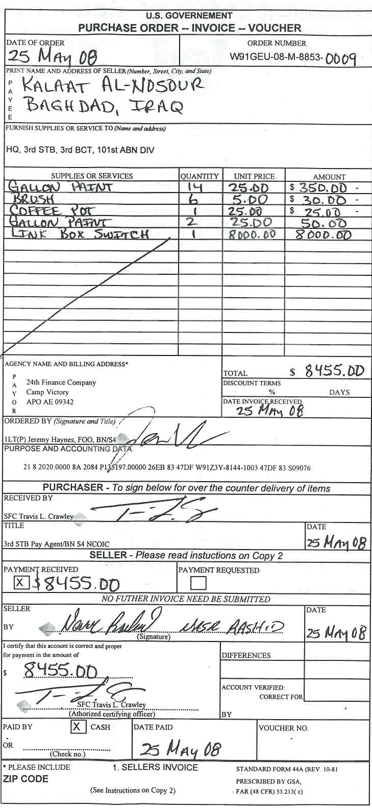
SF44
Field
Ordering
Officer
Receiver
Vendor Invoice
Payment
5

Slide 6
SF44 Process
FOO ASSIGNMENT
Baghdad RCC
Current Process
Hand write SF44
Type up SF44 on PIIN Log
Make 5 Copies Receipts, Log, and other documents
Travel to PBO, FM, RCC, RM to Clear orders and funds
DA enter SF44 in DDS
DA updates manual PR ledger
DA scans doc. for archive
  Hardcopy shipped CONUS
KO maintains files
FOO maintains files
PA maintains files
DA maintains files
Problems
Illegibility SF44/Receipts
Errors: typos, calculation of order or ledger totals or exchange rate
Lost documents
Wasted time
  Duplicating data entry
  Excessive Paper Reproduction
  Traveling to Clear
Lack of oversight/visibility of purchases/cash control from delayed clearing
Unnecessary Risk due to travel
Unmatched documents requiring manual tracking
No Theater wide visibility
Assign PIIN
Certification Memo
Designation Memo
Send E-mail Files
0-5 Memo
Recommendation
Sign-in
Label Folder
Fill-out Forms
45 Minute Block Of Instruction
Check on learning
FOO CLEARING
IPBO
Baghdad RCC
FINANCE
Finance
Office
0-5 Clearing Memo
Copies of SF44 and Receipts
PIIN Log
PR&C
IPBO Clearing memo
Will place items on Property Book
MNF-I
MNC-I
Verifies Info
Check for legality of buys
Completeness
IPBO Clearing memo
Clearance Memo
Original SF44 and receipts
Clearance memorandum
6

Slide 7

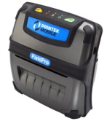

3in1 Tool
3in1 Tool automates field ordering, receiving & payment functions
3in1 Tool is comprised of 2 key components
  Handheld Device
    Used by FOO and PA to make purchases
    Stores purchase data and transfers it to JCCS
    Maintains purchase and expenditure logs
    Provides limited reports for FOO/PA
    Prints SF44 on portable printer (optional)
  3in1 Module within the Joint Contingency Contracting System (JCCS)
    (JCCS is a fielded system used by contracting for vendor & contract tracking, and the COCOMs to track ACSA Agreements)
    Provision the device for FOO/PA authorization
    Transfers data to/from device
    Stores purchase and payment data
    Clears orders online
    Provides management reports
    Transmits to other Business Systems

Slide 8
JCCS System Architecture

Slide 9
3in1 Tool
Operating Environment
JCCS Full Connectivity
JCCS Limited Connectivity,
Extreme Latency,
or No Connectivity

Slide 10
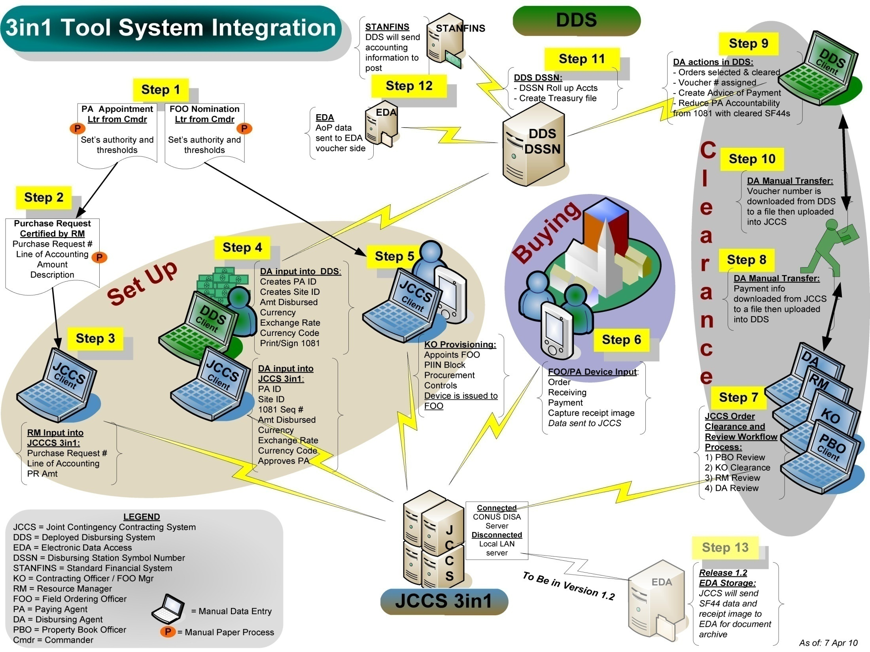
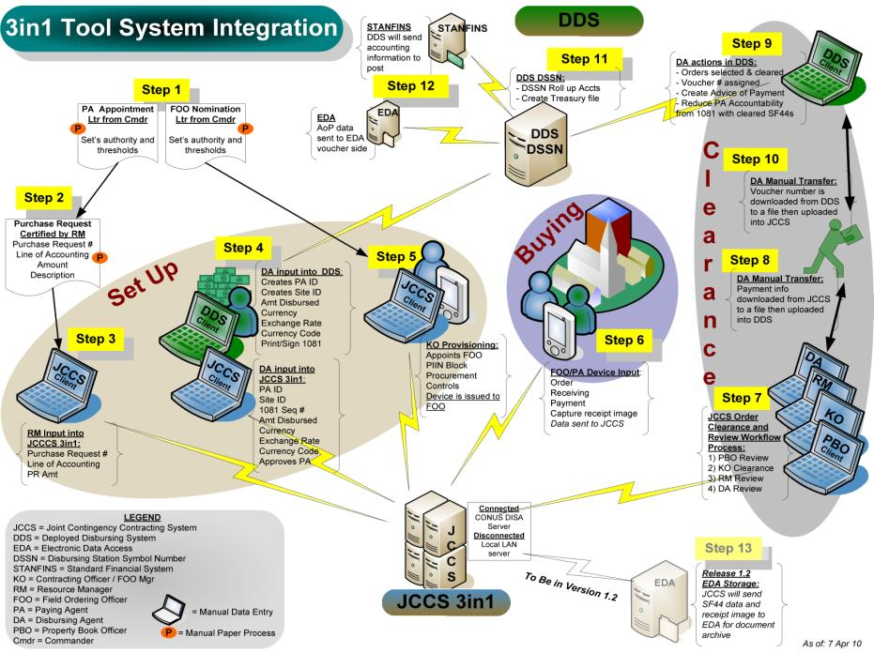

Slide 11
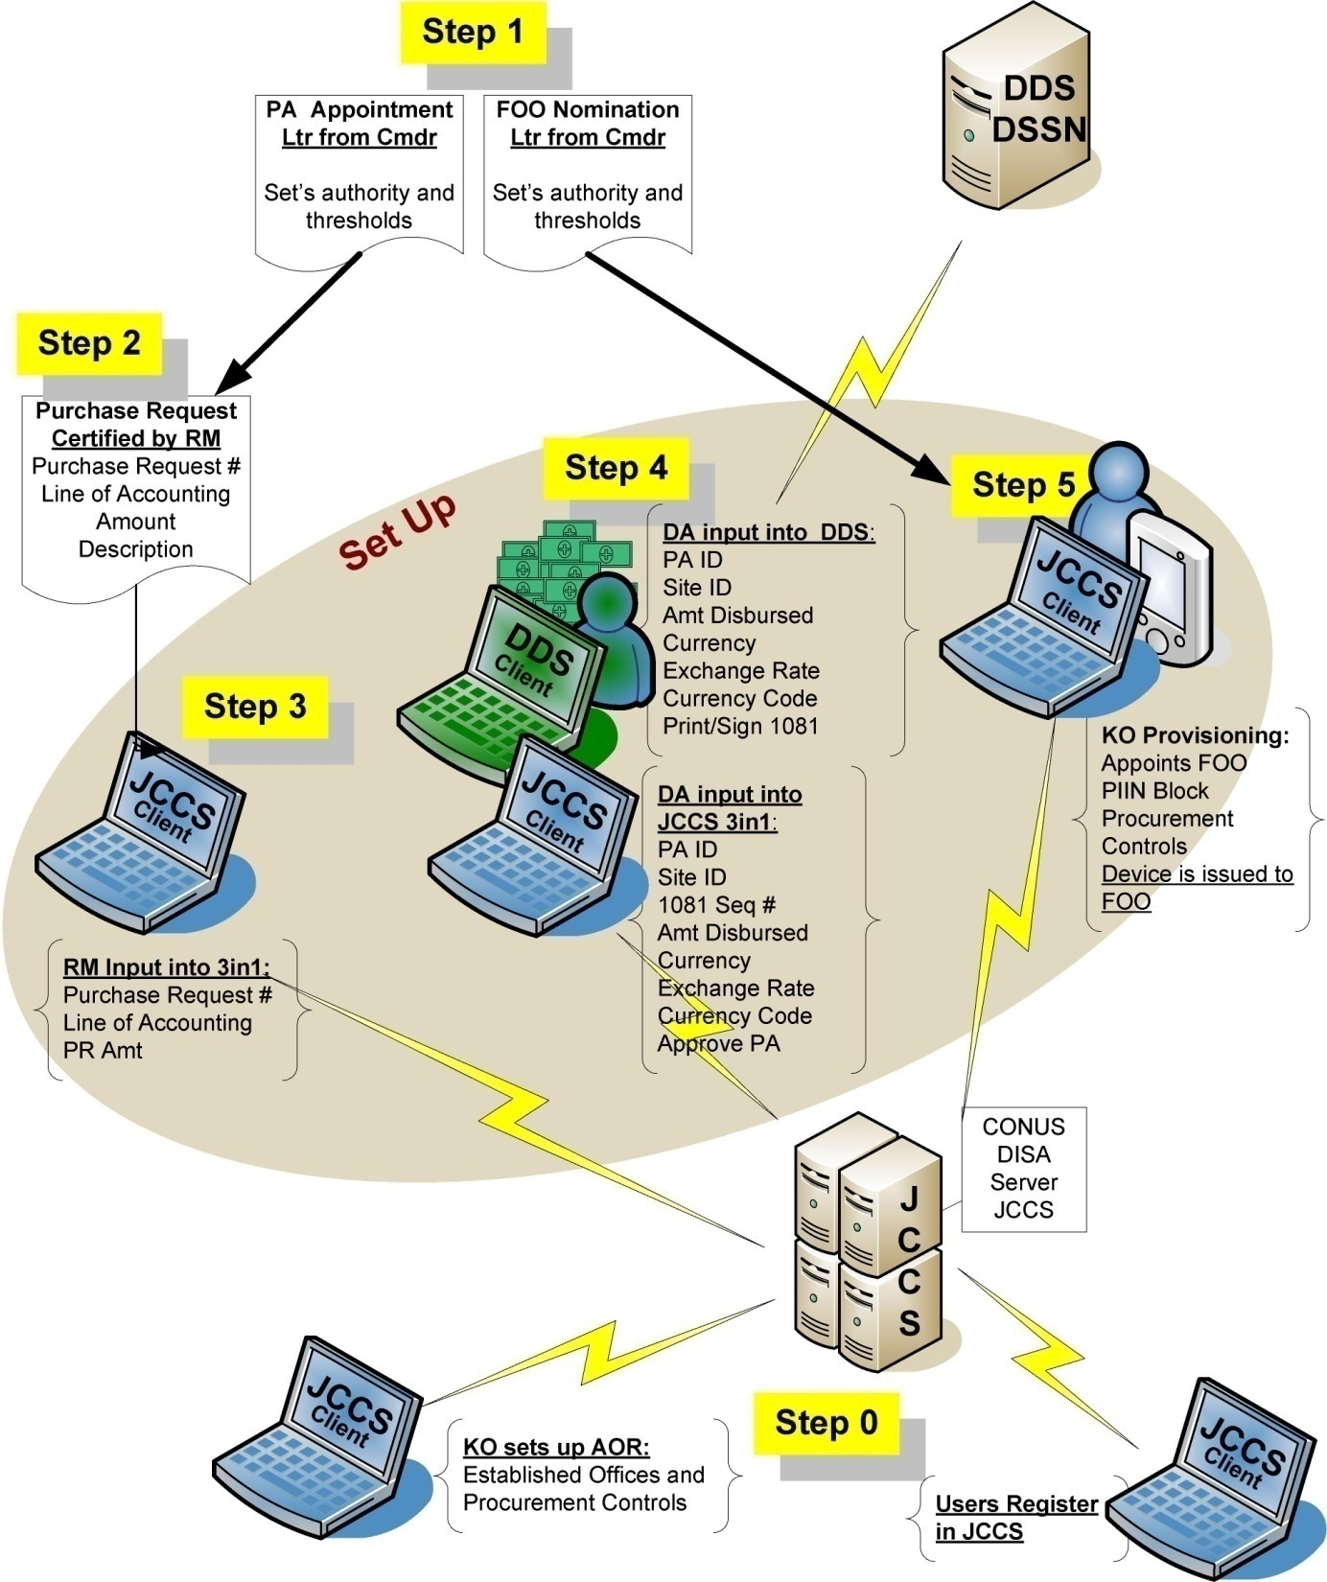
Set Up
AOR structure
User Registration
CC Letter & PR
Provisioning Set Up
  Resource Mgr--PR Info
  Disbursing Agent
    DDS execute disbursement
    JCCS input key disbursement info
  Contracting Officer
    Apts FOO
    Issues PIIN Block
    Assigns Controls
    Issues Device
Sync Device
    FOO and PA info

Slide 12
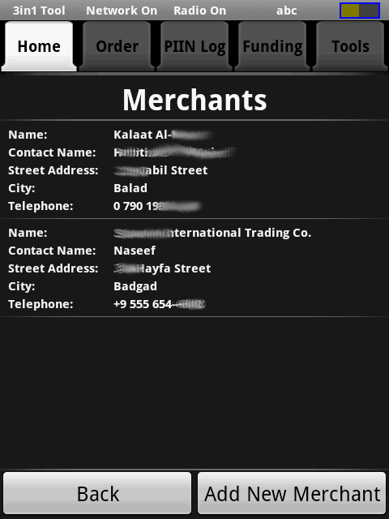
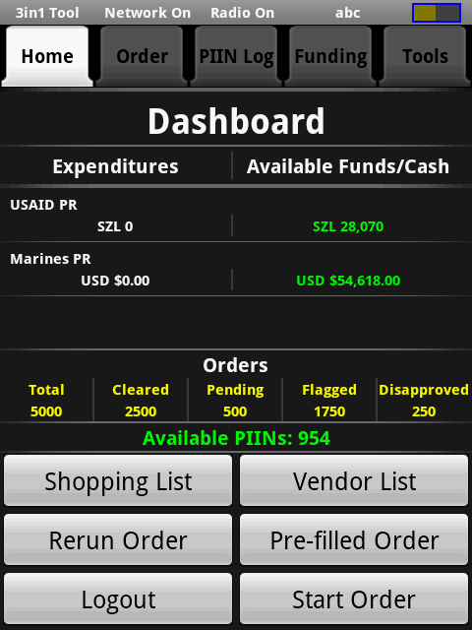
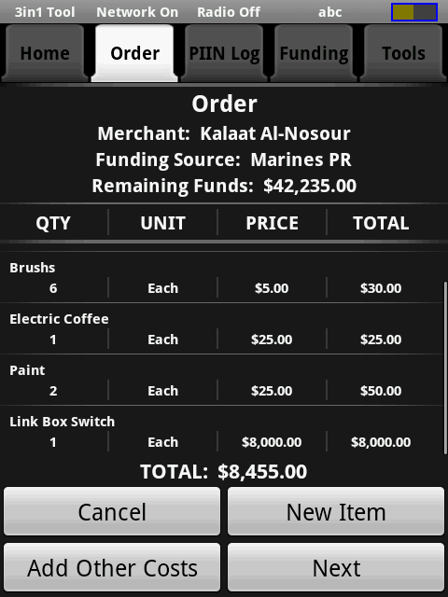
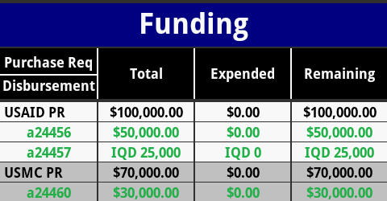
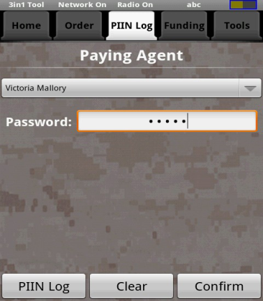
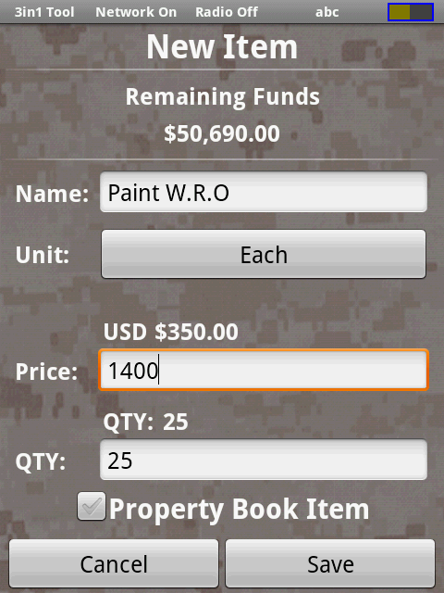
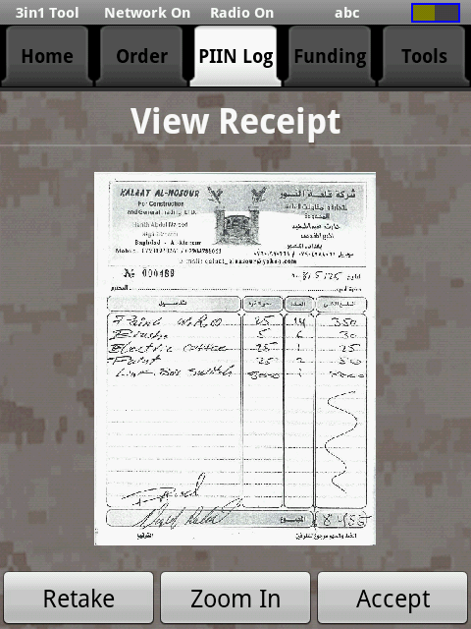


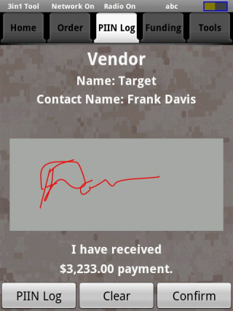
Field Purchases
FOO Places Order
Track Funds
Calculate Currency
Add comments to Order
Flags Property Book Items
Receive Goods
Vendor Creates Invoice
PA makes Cash Payment
Digitally records receipt
Prints SF44 from device
Digital Signature for PA & FOO
Physical Signature for Vendor & Receiver

Slide 13
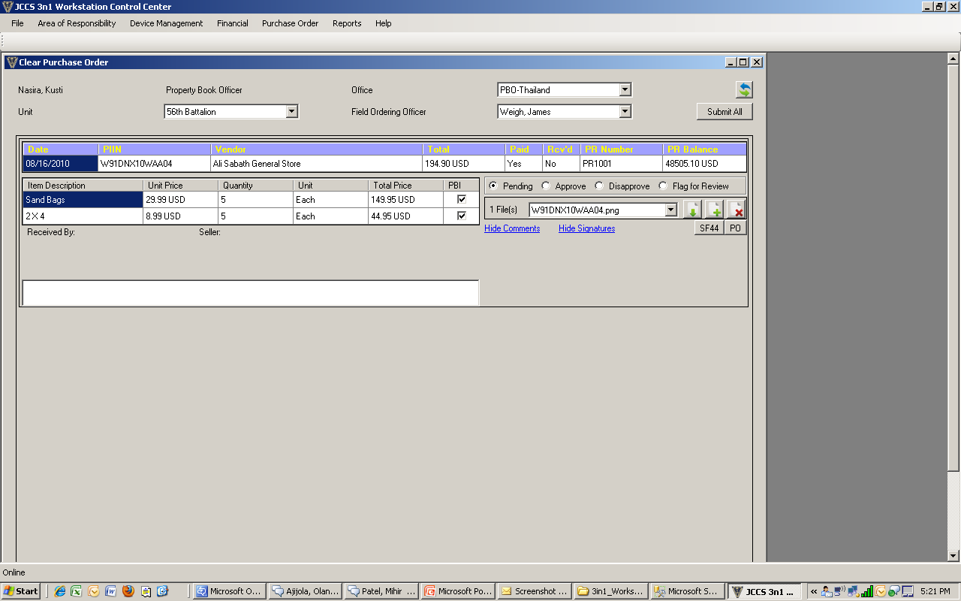
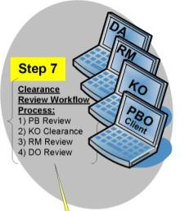
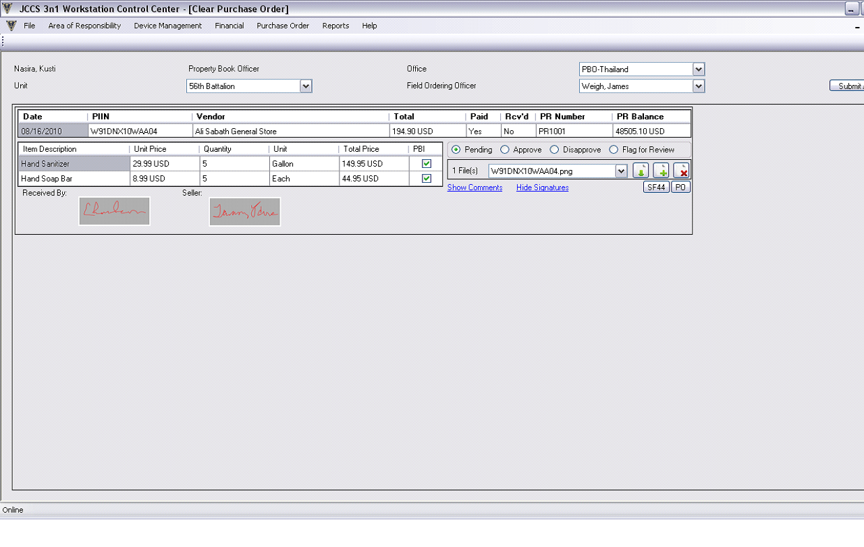
Order Clearance
Orders transmitted from device to JCCS for clearance
Reviewers can view all information from the SF44 and supporting documentation
  Approve, disapprove, or flag orders as required
    Comments from disapproved or flagged orders are sent back to the device where the FOO can reviewer and respond to comments/questions
Once approved, orders go to next review in the process

Slide 14
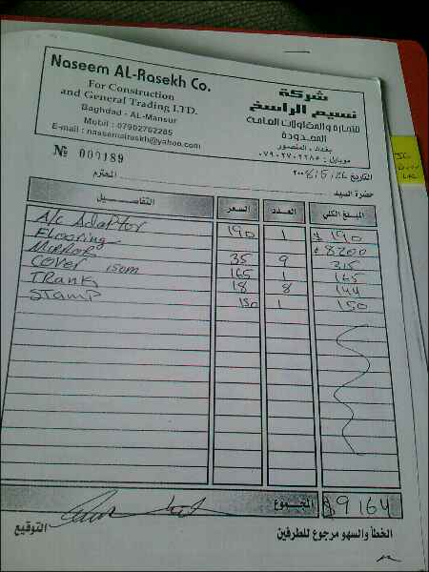
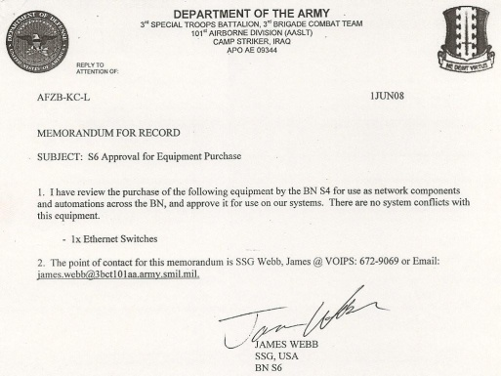
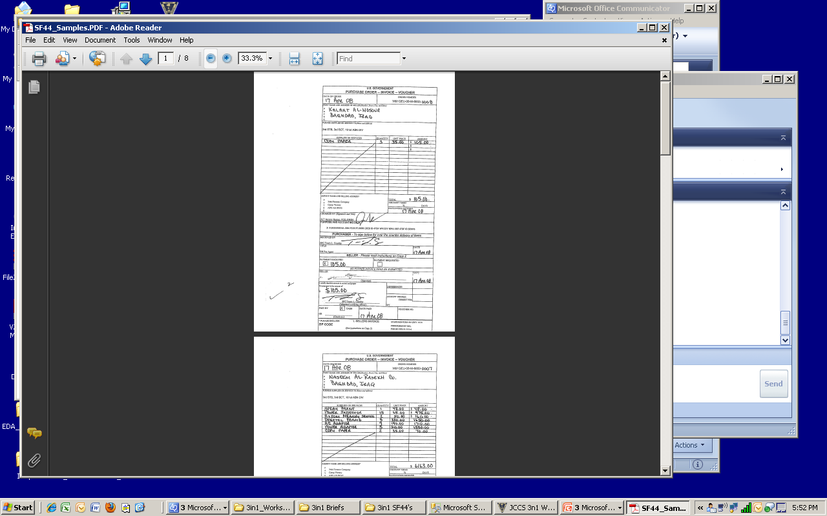
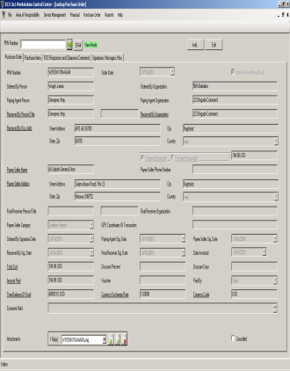
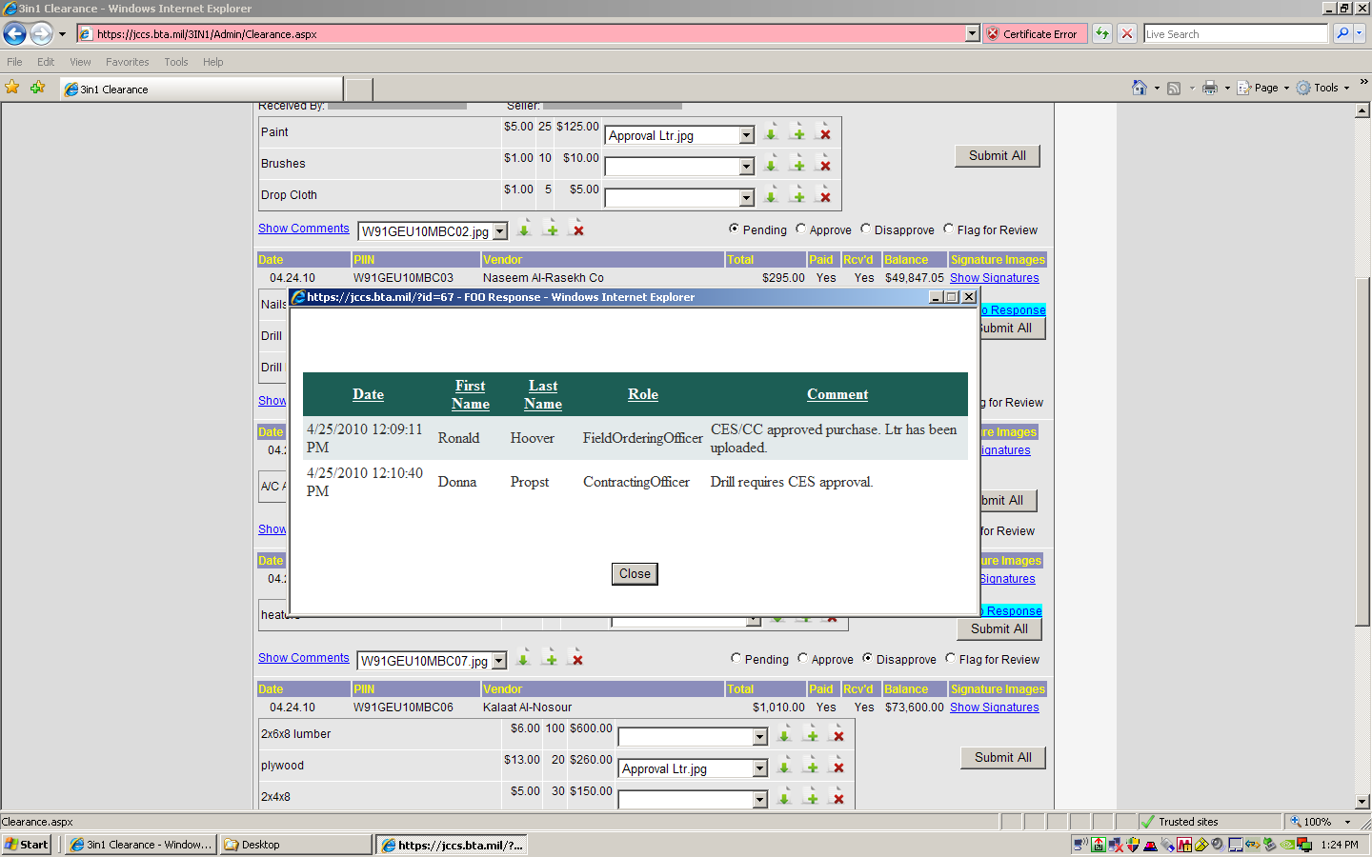
Clearance Screen
Select Clearance Criteria
View Order Info
Disposition Orders
View items Ordered
View Signatures from SF44
Enter Comments
View, Upload Documents including
View Comments between Reviewer & FOO
Receipts
Approval Letters
SF44s
POs

Slide 15
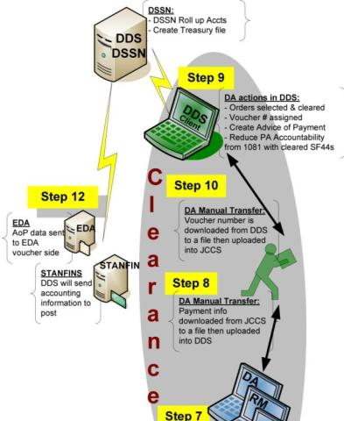
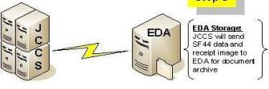
PA Clearance
& Data Transfer
DA downloads file from JCCS of cleared orders to a shared drive/CD
File uploaded into DDS
  Voucher number assigned
  PA 1081 accountability reduced
  Payment transmitted to STANFINS
  Print & sign 1081 for final PA clearance or issuing/returning cash
DA inputs SF44 voucher number in JCCS
  Either manually or via file transfer
Release 1.2: JCCS transfers SF44 & Receipt to EDA for document retention
PA only required to travel to FO to return/receive cash

Slide 16
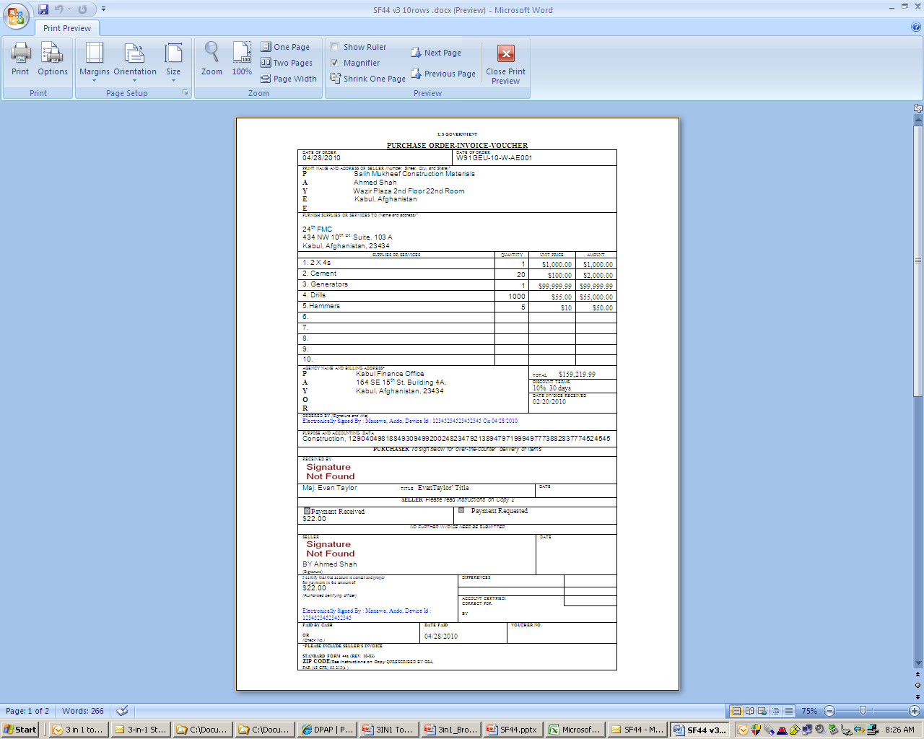
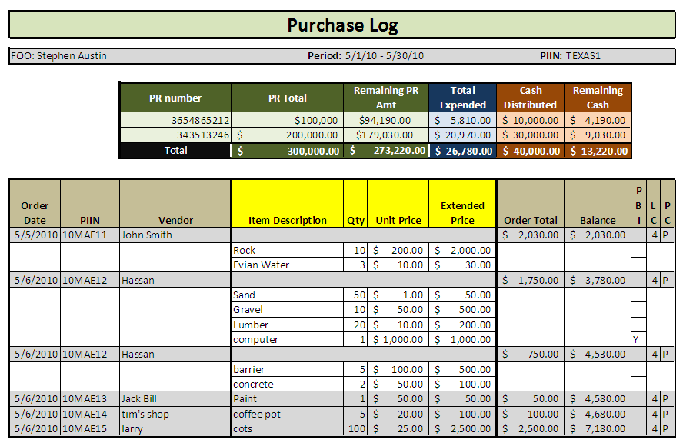
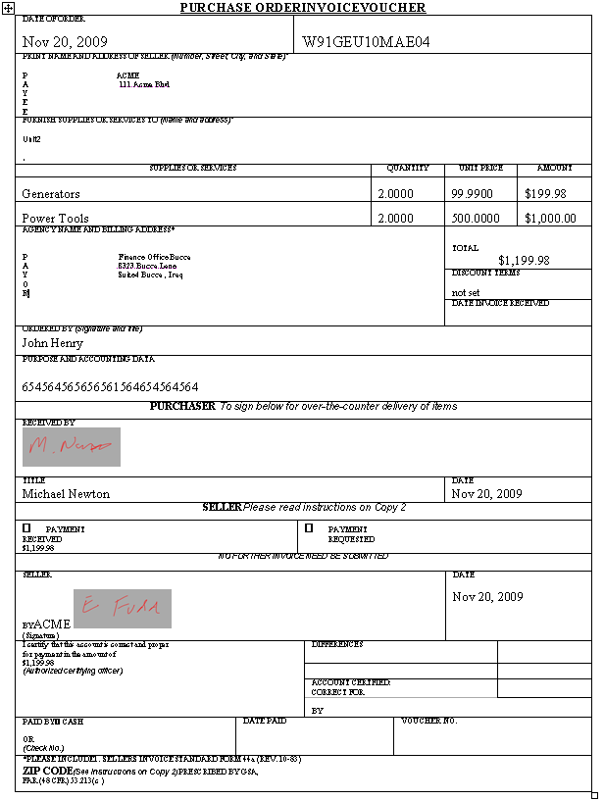
Reports
SF44
PIIN and Expense Logs
Management Reports
  Total Orders/Dollars (RCC, FO, AOR, FOO)
  Track FOO/PAs appointments
Pre-populate Hand receipt for PB items

Slide 17
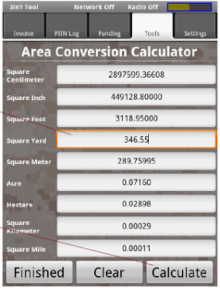
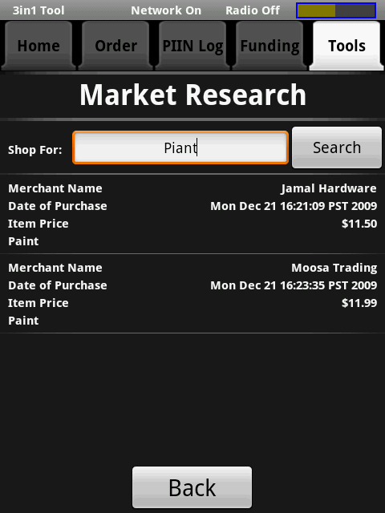
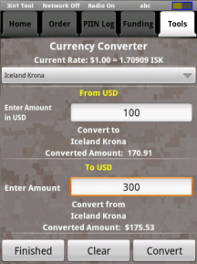
Additional Device Tools

Slide 18
System Support
3 Level Support Network
  In theater support
    Augment current JCCS support staff at large RCC
  CONUS reach-back Help Desk support
    Augment current JCCS support staff at BTA
    Provide hardware coordination and instruction/training material support
  Developer level support as needed

Slide 19
3in1 Tool System Features
2 part system:
  Handheld device record/stores SF44 data
    Ruggedized Light weight handheld device Mil STD 810
    2Gig storage capability
  Transmit to JCCS/3in1 Database for management/reporting
    Prime Database housed at DISA with off station COOP site
Current transmission method:
  Device stores data until connectivity is available to workstation or web
  Wireless: GSM or WiFi; Wired: USB or Ethernet (wireless can be disable)
  Stand alone workstation application stores data until connectivity restored
  Data size minimize to operate with limited bandwidth
Security (users register in JCCS then linked to device)
  CAC login to in JCCS, Strong Password login to device
  FOO & PA use digital signatures to sign SF44
  Data on device and in transmission is encrypted
  FIPS 140-2 Compliant
Stages of the order are locked once confirmed
SF44 and Log print capabilities from Workstation and Device

Slide 20
3in1 Tool User Features
All SF44 data captured/recorded/transmitted to JCCS
Record PR #, Amt, LOA -- ability to track multiple PRs
  Records Cash Disbursement Amt and Exchange Rate
Record Signatures
  Receiver/ Vendor physical signature
  Digital Signature of FOO and PA
Digitally record receipt image and link to order
Automatically calculates purchase total and currency exchange
Automatically tracks total obligations & available funds for orders
Warning messages notify FOO when purchase control is violated
  Device can also prohibit purchases beyond authorized thresholds
Online role based review/reconciliation process (PBO,KO,DA,RM)
  Information available daily without need for face-to-face clearing when cash exchange is not required

Slide 21
3in1 Tool User
Features (cont)
Market research capability by querying prior purchases on device
Ability to attach notes to orders
Upload/Store supporting documents for retention with SF44 e-file
  Commander's approval, Legal Review, C6 Coordination, Hand Receipt
  PR document to PR data
  Appointment Letter to FOO and PA
Management reporting capabilities on JCCS
  Track Expenditures, Purchases, Cash in the field, Obligations, Available funds
  Pre-populate forms such as hand receipts for property book items
Push financial/procurement updates/changes to device remotely
Allow for decreasing PRs & Disbursement amount for redeployment
Allow to transfer disbursed cash from one PR to another for change of fiscal year

Slide 22
3in1 Tool User
Features (cont.)
Track expenditure ledger by disbursement or line of accounting
Device Dash board easily tracks available funding and orders
Transmit SF44 and receipt to EDA for document retention
Transfer payment data directly to financial systems (DDS)
Rerun an order to quickly process a repeat order
Create a shopping list to select from when at the market
Return an items ordered if required
Account for change in fiscal year when issuing a PIIN
  Mass issue PIINS to expedite KO assignment of PIINs for new fiscal year
Allows messaging between clearance reviewer and FOO

Slide 23
3in1 Tool User
Features (cont.)
If a device is damaged, data can be retrieved from MicroSD card on another device
Data is backed up on Workstations
If a device is stolen, it can be deactivated from the system by the KO or Sys Admin
As a device back up, PIINs will be issued for manual orders with can be entered into the workstation and the SF44 scanned and loaded for automated clearing and processing

Slide 24

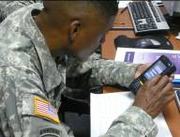

User Assessment Tests
Participants:
  Washington, DC: 19 Nov
    Air Force: 2 KOs
    Marines: 3 KOs, 4 DA
    Army: 1 FOO, 1 PA, 1 DA
  Ft Hood, Texas: 9-10 Feb
    Air Force: 1 KO, 1 FOO Mgr
    Marines: 1 KOs
    Army: 5 FOOs, 2 PAs, 3 FOO Mgr/KOs
    Navy: 1 FOO Mgr/KO/DA
User Assessment:
  Overwhelmingly positive response from experienced FOO/PAs and KO/DA
    "Excellent Idea and very much needed. Will solve many FOO/PA issues" "Simple to use" "Will reduce time to clear FOO and PA", "Great Force multiplier for LCEs" "Improved accountability"
  Identified needed capabilities for Increment 1 deployment
  Provided Enhancements for follow on development
"Awesome Tool! We need it in the field now!"

Slide 25
SF44 Process Improvements
No handwriting to decipher, illegible paperwork, lost receipts
Immediate visibility of transactions and payments
Improved data and purchase control
No travel required to clear when no cash replenishment
No excessive document reproduction, storage, or shipping
Eliminate redundant data entry
Enables analysis of expenditures and purchase activities
Improve cash management and tracking
Daily reconciliation without face to face meetings
Provide audit trail of all transactions in AOR
Reduce unmatched disbursements from SF 44 purchases
Eliminates Duplication of payment risk
Reduces time/work: procurement/accounting/reconciliation

Slide 26
Way Ahead
2-3 Aug Technical Readiness Review
31 Aug – 2 Sep: Operational Assessment Test
27 Aug: Obtain Interim Authority to Operate
Mid-Sep: Governance Board Material Release Decision and Theater Approval for Deployment
Mid-Nov: Pilot Deployment in Iraq (1-2 month test period)

Slide 27
Deployment Approach
Initial Deployment
  1 FOB with large on base user community for 1-2 months
    Recommended location: Bagdad area Camp/Bases
      Camp Victory: 225* assigned FOOs, average 20* orders per month (est ~4,000 orders*)
      CSD-IZ: 25* assigned FOOs, average 45* orders per month (est ~1,125 orders*)
  Deploy training team to conduct initial user training and implementation
    Training: FOO/PA Training and Reviewer Training
    Manpower: 1 military, 2 contractors (1 KTR from existing theater JCCS support on base)
    10% equipment excess on site for replacement
* Numbers based on RCC data call (1 Oct - 15 Mar 2010). Orders estimated, actual number of orders depend on current mission requirements.

Slide 28
3in1 Tool Level of Usage
  Users (AOR):
    Over 2,000 Devices in JCC I/A alone users: FOO and PA
    3in1 JCCS Module Users:
      Unit Level: Commanders, Resource Managers, FOO, PA
      Regional Users:
        JCC: Contracting Officer
        ARCENT: Disbursing Agent (FMC) and Property Book
  Key Tool for First Boots on the Ground
    Heavily used in most initial contingency/Humanitarian operations
  Worldwide Use: Katrina, Haiti, Horn of Africa
  Device/JCCS Module will be part of every units deployment kit
  Incorporated in all Exercises/Training

Slide 29
Questions
Point of Contact:
Lt Col Ann Christianson
703-699-3728 fiona.christianson@osd.mil
Information: http://www.acq.osd.mil/dpap/pacc/cc/contingency_tools.html

Slide 30
Back up Slides
To Provide additional information

Slide 31
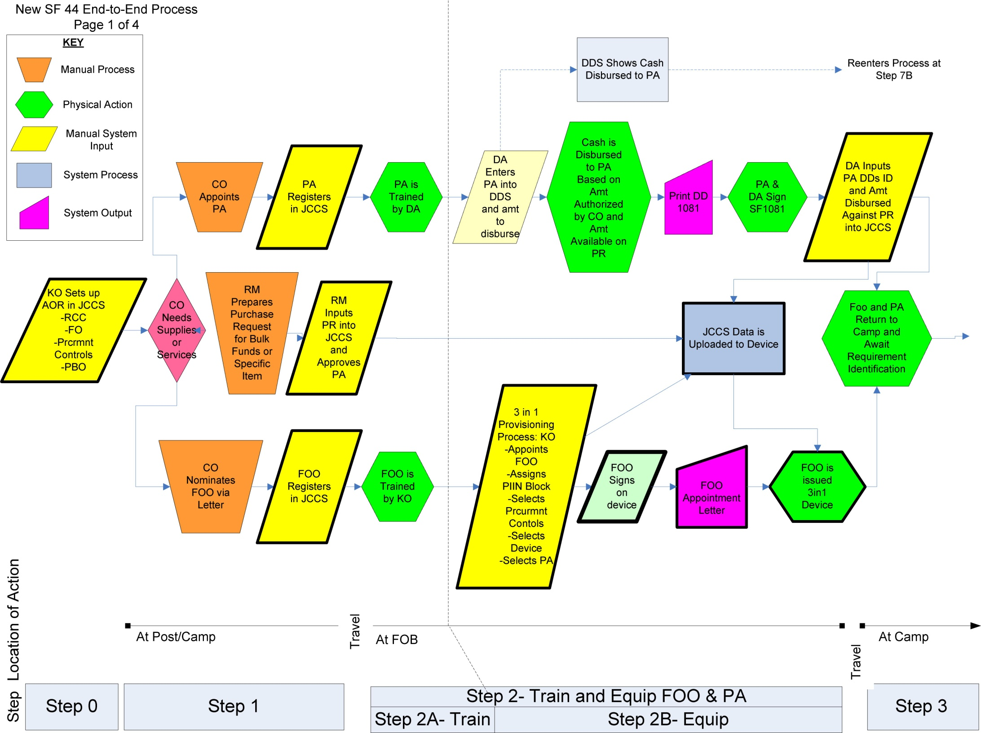

Slide 32
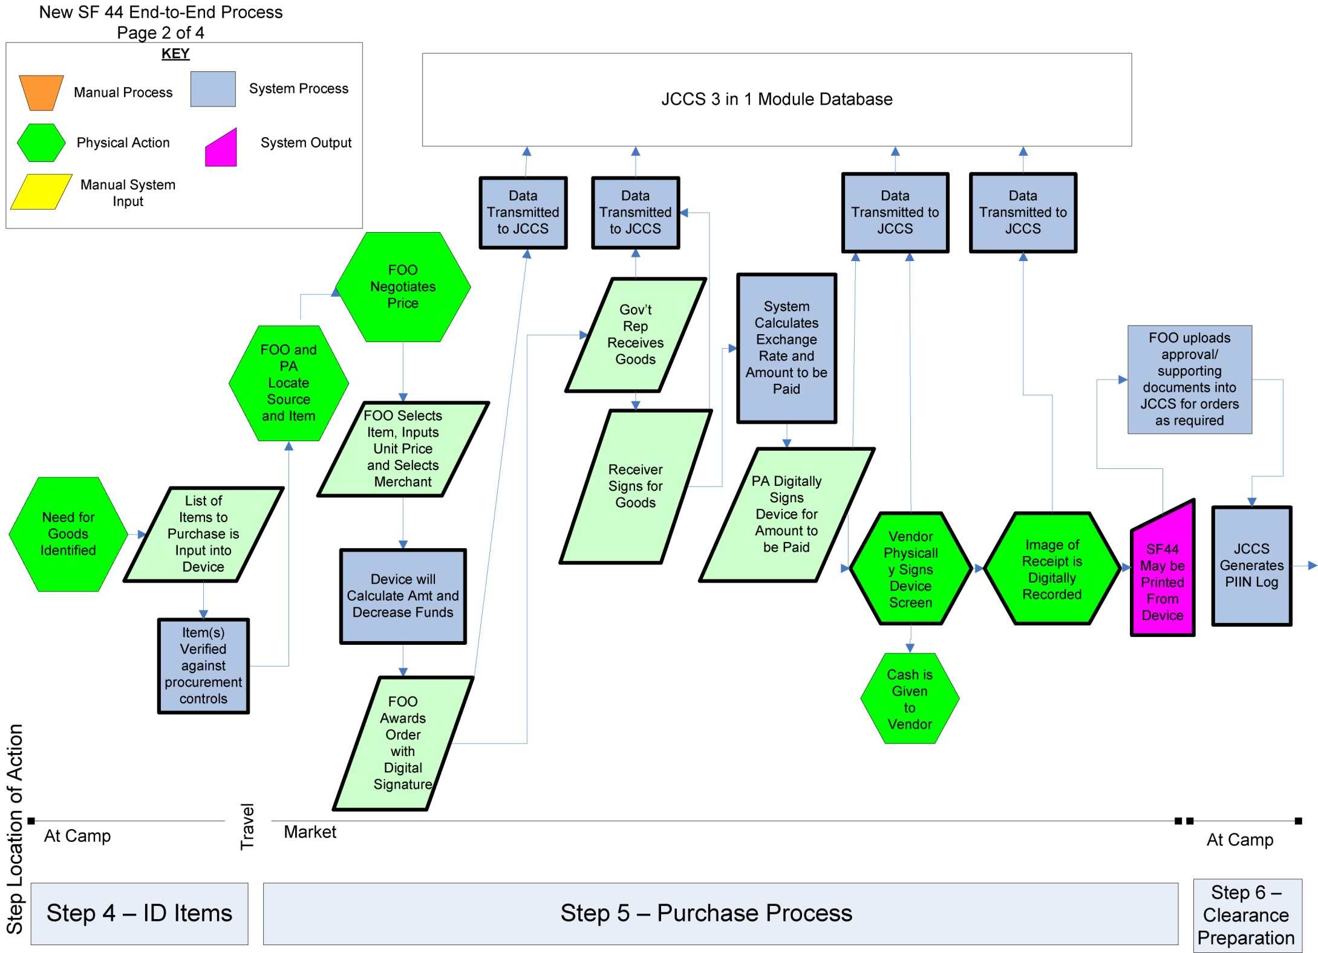

Slide 33
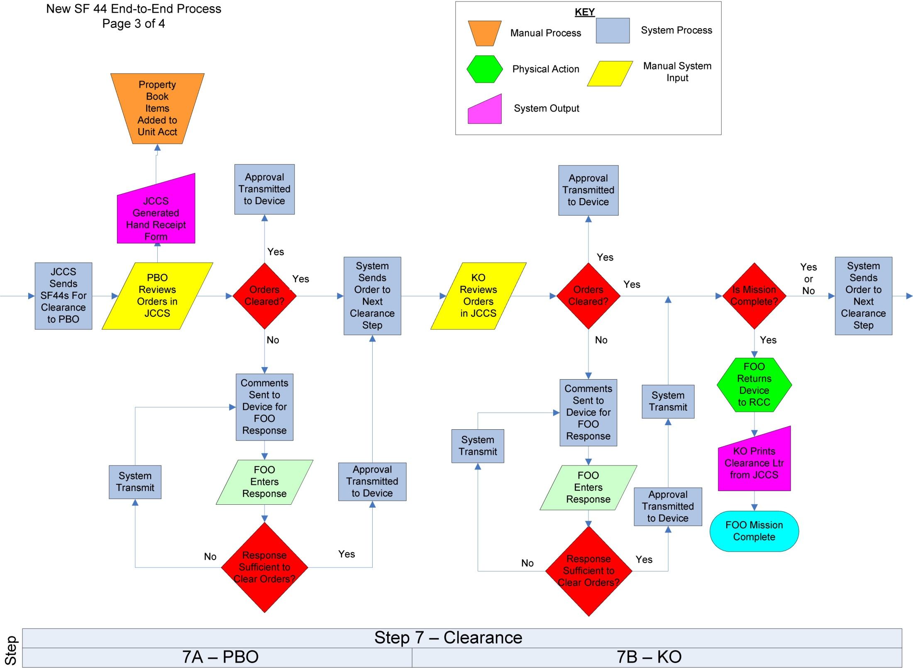

Slide 34
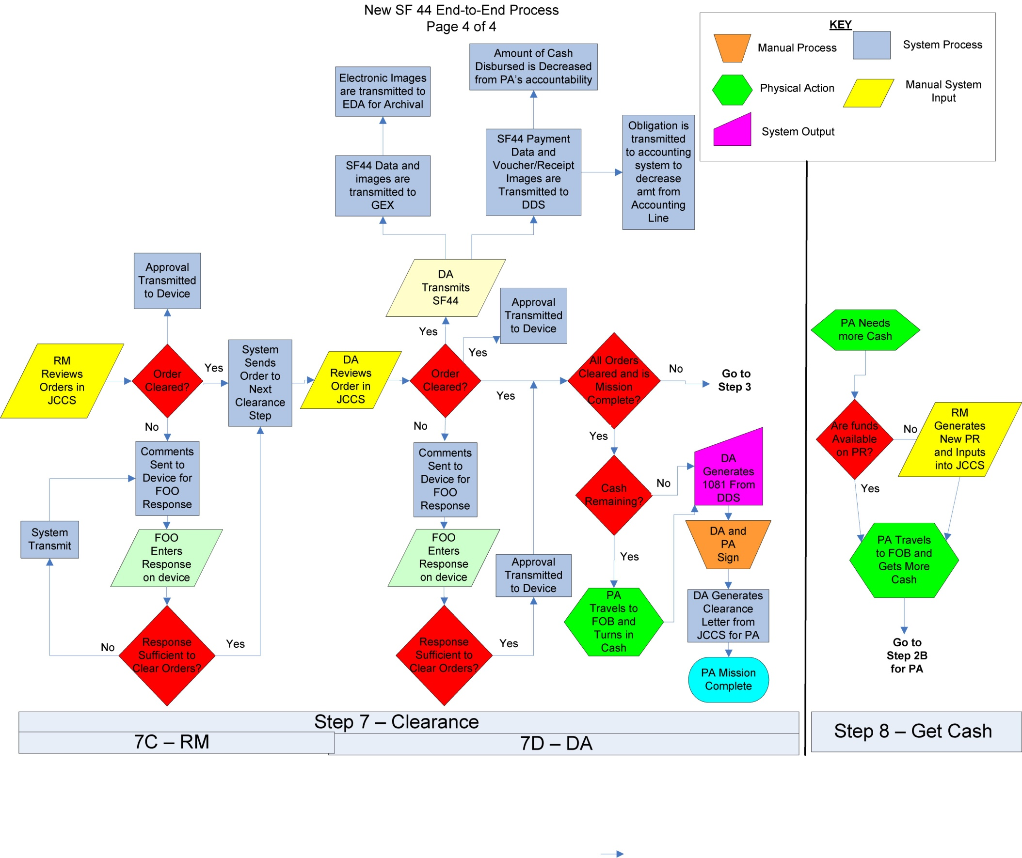

Slide 35
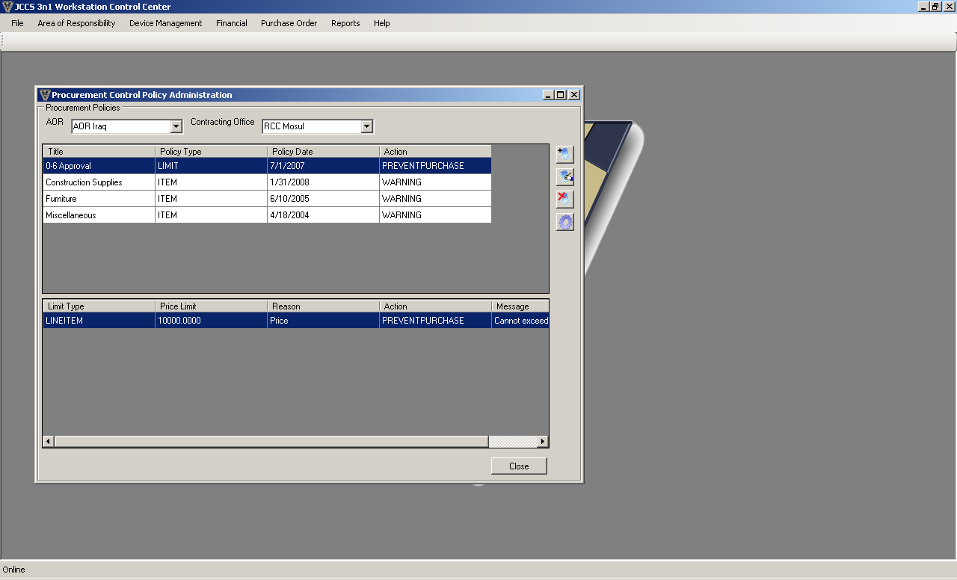
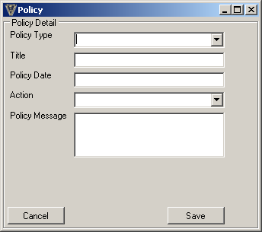
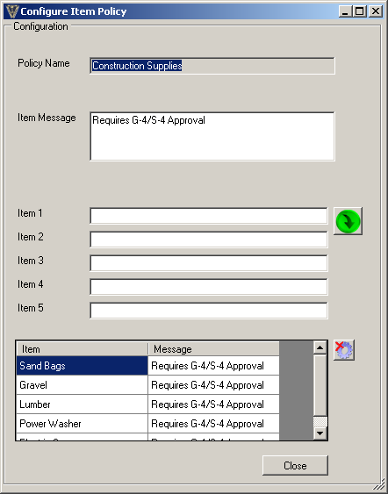
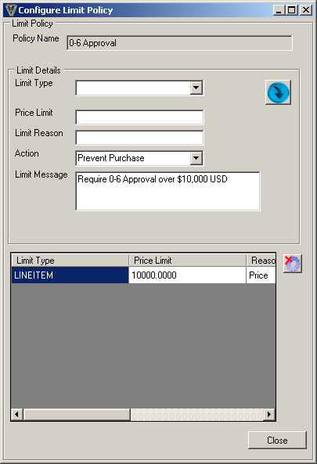
Procurement Controls
Procurement Control sends a warning message if an item being purchased requires special authorization or is prohibited.
Procurement Controls may also be established on line item value or total purchase amount to either warn of a violation or prevent a purchase.
1
2a
2b
1) Enter policy information
2a) Enter item description and warning message
2b) Enter Line item value to prevent purchase

Slide 36
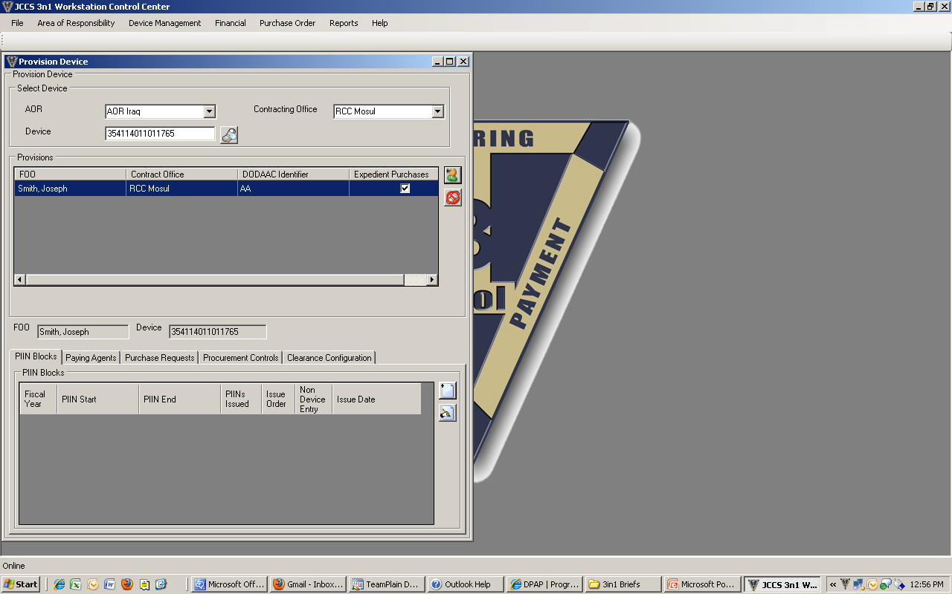
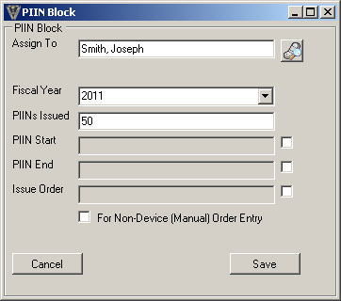
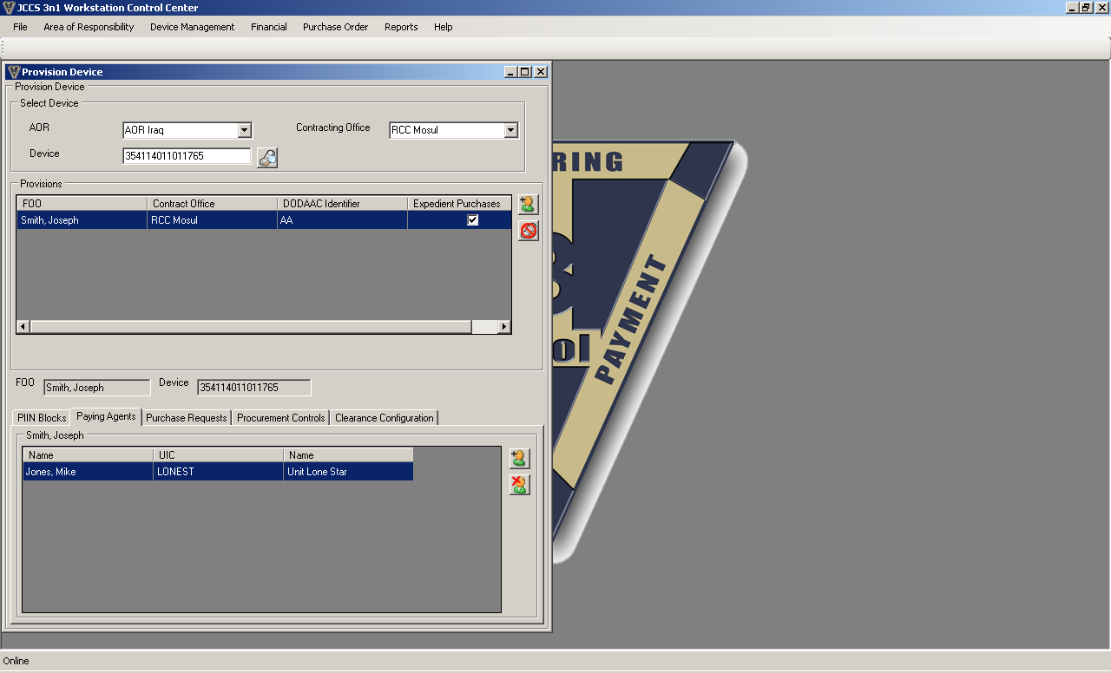
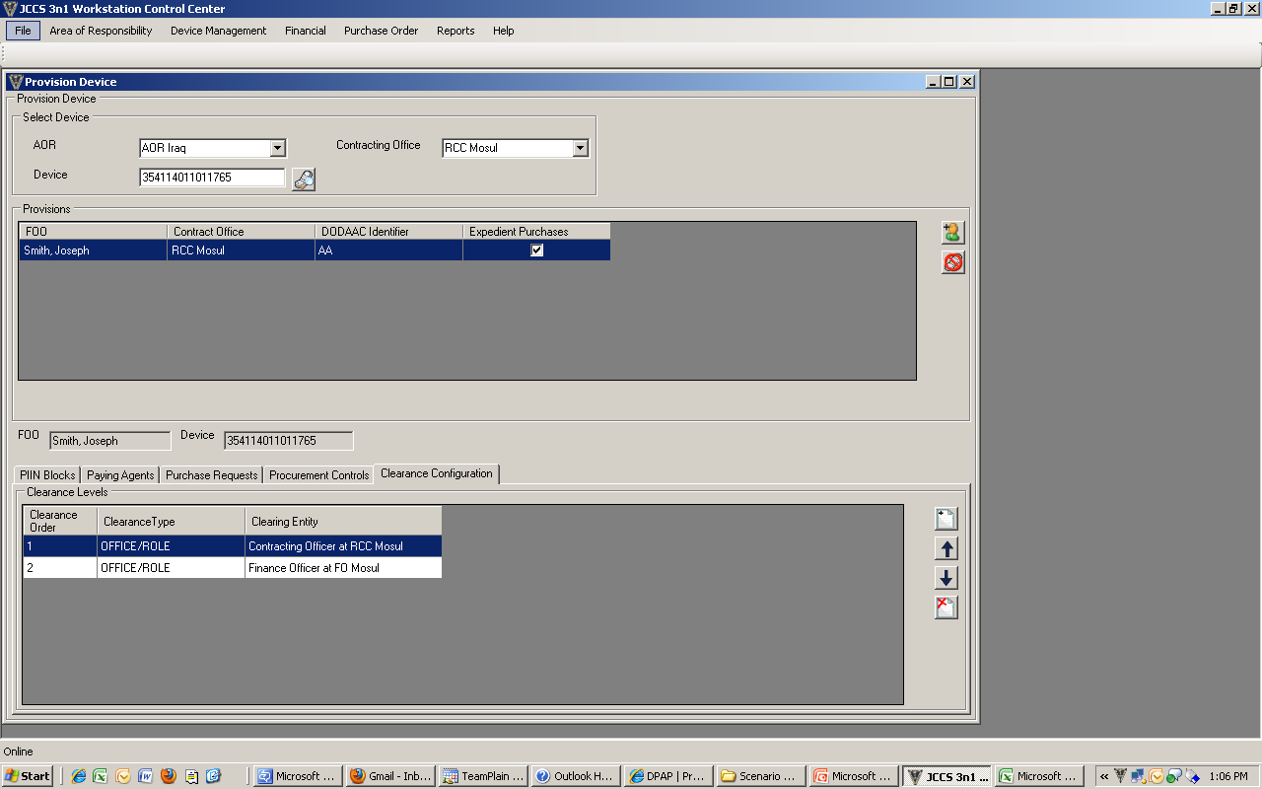
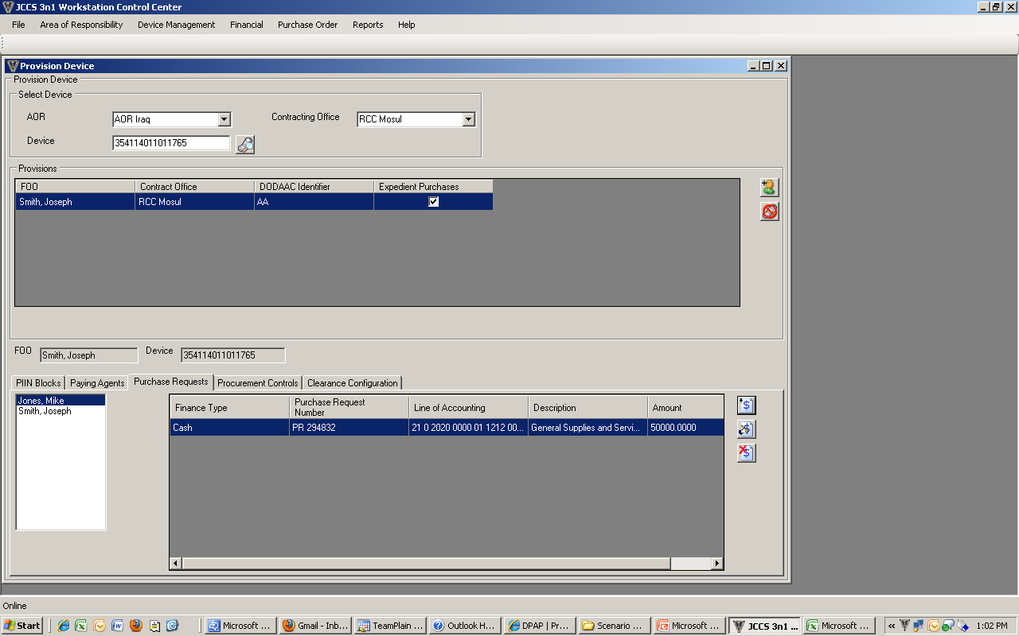
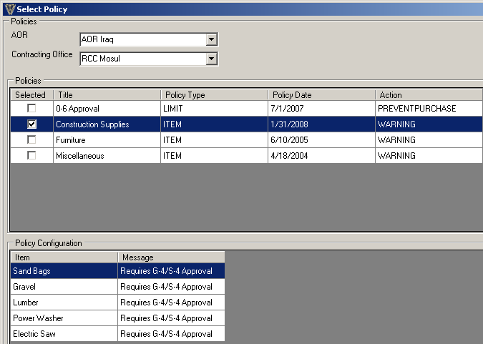
Set Up/Provisioning
Provisioning the device prepares the device for use by 1) associating a FOO to a specific device, 2) assigns PIIN blocks, 3) assigns paying agent, 4) assigns purchase request, 5) assigns procurement control policies, 6) assigns clearance configuration
1
2
3
6
4
5
Note: JCCS will determine PIIN #
W91B4N - 09 - M - AA 01
Contract
Type
M or W
FOO
ID
#
Purchase
Order #
PIINs
2,308 FOOs ♦ 1,155 POs per FOO ♦ 2.6M POs per DoDAAC

Slide 37
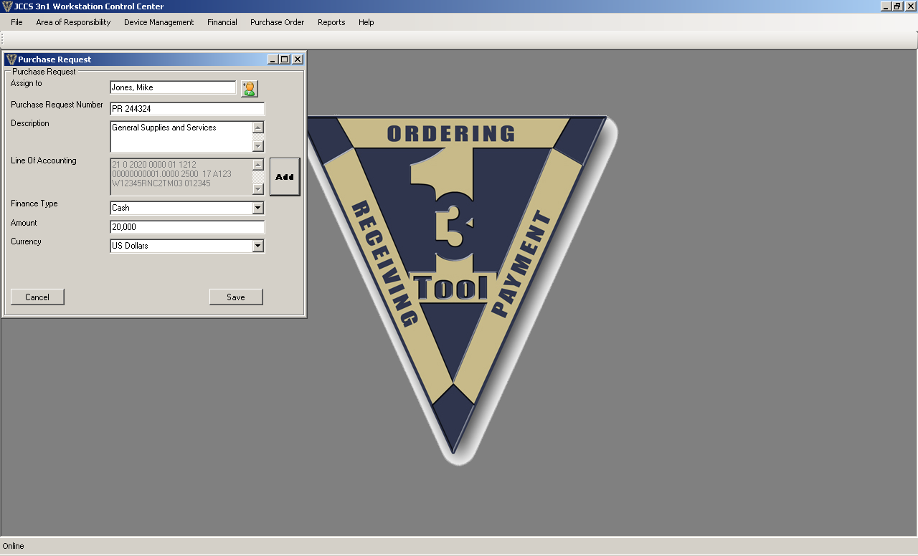
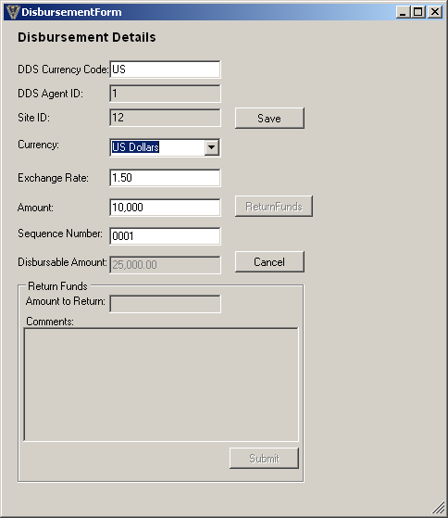
Financial Administration
Purchase Requests (PR)
Disbursements
Resource Manager (RM) prepares PR for bulk funds or specific item and inputs PR data
Disbursing Agent (DA) disburses cash based on authorized and available amount from the PR
1
2

Slide 38
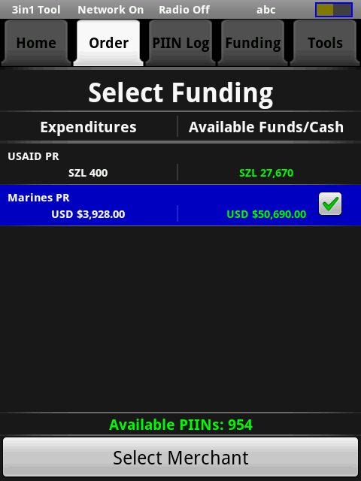
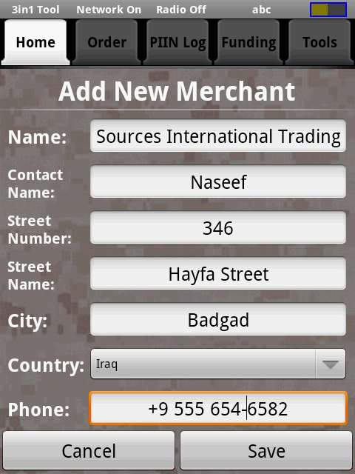
Placing an Order on Device
Orders are place using a wizard interface to walk the user through the process.
Or Select from a Vendor List
1
Select Funding
2
Enter Vendor

Slide 39
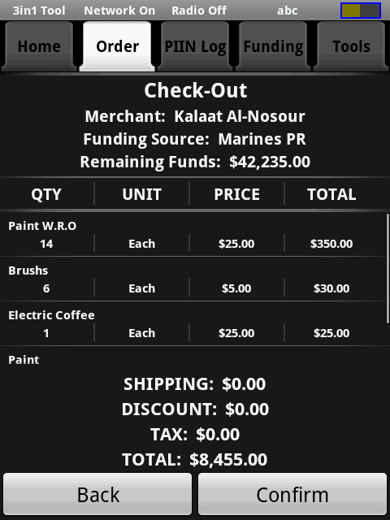
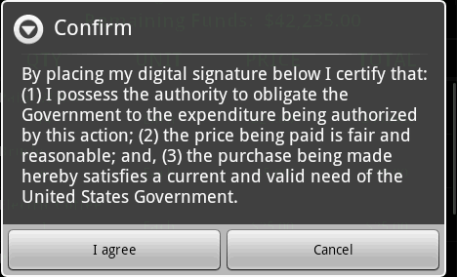
Enter Purchase Information
Warning message is displayed, if item violates controls
FOO confirms to Complete Order
Enter item, Qty, Price, and unit
4
3
Total price & currency exchange are automatically calculated
Items requiring property book accountability can be flagged
Order screen displays items purchased, total cost USD & local currency, vendor, & remaining funds

Slide 40
Completing Transaction
5
6
Purchase Wizard will step through the completion of the process: PA, Vendor, Receiver functions
7
8

Slide 41

Tracking
Dashboard tracks: Expenses, Available Funds, clearance status summary, available PIINs
PIIN Log: Clearance Status/Issue, order summary

Slide 42
Iteration 3
Extreme Latency or
Standalone network capability later merged with connected environment

Slide 43
Current SF44 Process
FOO/PA ASSIGNMENT
PA - FM
FOO - RCC
FOO: Assign PIIN
PA: Cash
Certification Memo
Designation Memo
Send E-mail Files
0-5 Memo
Recommendation
Sign-in
Label Folder
Fill-out Forms
45 Minute Block Of Instruction
Check on learning
FOO/PA CLEARING
IPBO
RCC
FINANCE
RM
Finance
Office
0-5 Clearing Memo
Copies of SF44 and Receipts
PIIN Log
PR&C
IPBO Clearing memo
Will place items on Property Book
MNF-I
MNC-I
Verifies Info
Check for legality of buys
Completeness
IPBO Clearing memo
Clearance Memo
Original SF44 and receipts
Clearance memorandum
43

Slide 44
Associate Roles/Functions
AOR
Contracting
RCC
RCC
RCC
RCC
RCC
FOO
FOO
FOO
FOO
FOO
FOO
IPBO
Unit
Unit
Unit
IPBO
Unit
Unit
Unit
IPBO
IPBO
PA
PA
PA
PA
PA
PA
FO
FO
FO
FO
FO
FO
FO
FO
Financial Management

Slide 45
JCCS Operational Graphic

Slide 46
JCCS System Systems/Services Interface Description

Slide 47
3in1 Tool Purpose & Benefits
Develop a technology-based solution to record and transfer data used by DoD agencies when conducting on-the-spot, over-the-counter, field purchases of supplies and non-personal services (cash and carry type purchases) in circumstances where use of the Government Commercial Purchase Card (GCPC) would generally be appropriate, but is not feasible. Specifically, it will capture necessary purchase, disbursement, and receiving information
  Reduce FOO time “outside the wire” and exposure in the marketplace with Pre-populated mandatory fields
  Reduce FOO’s exposure to travel in hostile areas by reducing trips to various offices by electronically sharing purchase information
  Reduce errors and increase accountability with electronic record-keeping and reconciliation between FOO and Contracting
  Provide Commanders bottom-to-top visibility of FOO items and near real-time accountability of FOO expenditures with data mining/report generation capability
    What FOOs are procuring and where?
    How much money FOOs are pushing into the local economy?
    What items should be cut/added to the supply chain based on local procurement?

Slide 48
Phase 2 Development
32 Development items Identified (input from User Test)
  Complete Stand Alone Laptop application of JCCS functions
  Ability to adjustable Clearing workflow/workload mgt process during setup
  Transmit SF44 and receipt to EDA for document retention
  Transfer payment data directly to financial systems
  Ability to pre-fill orders to minimize time entering data in the market
  Ability to create a shopping list to select from when at the market
  Direct print capabilities from the device
  Pre-populate forms as required (DD250, 1081, 1034, hand receipt)
  Automated purchase clearance process to JCCS
    Highlight possible split disbursements, highlight violations, clearance sorting functions
  Push system/software updates to the device via JCCS
  Input SF44 order/payment into JCCS when manual process is required
  Add dashboard for Status of FOO/Status of PA accounts for FOO Mgr or DO

