Slide 1



Defense Procurement and Acquisition Policy
and
Business Transformation Agency
3in1 Tool Program Information Brief
Lt Col Ann Christianson
Program Manager
Updated: 10 Feb 2011

Slide 2
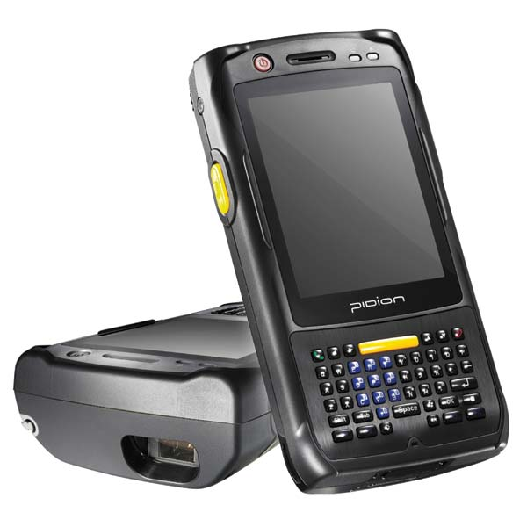

Outline
Requirements
3in1 Tool
Equipment
End-to-End Process
Set Up
Field Purchases
Clearance
Data Transfer
Reporting
Testing
Training/Support
Improvements

Slide 3
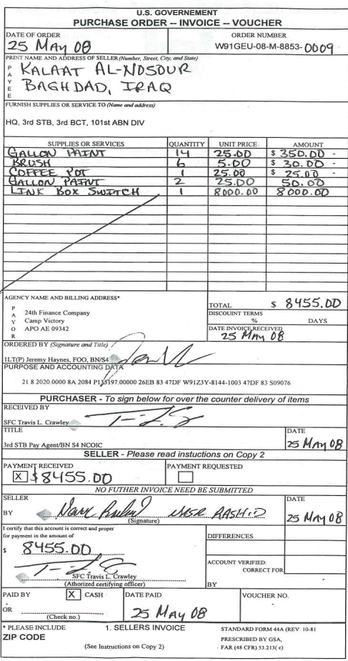
Requirements Overview
Process: Contingency Micro-purchases processed manually using SF44s
To conduct on-the-spot, over-the-counter, purchases of supplies & services when GPC is not available
FY09 Iraq/Afghanistan: 2,664 Soldiers executed 36,600 orders, total $82.5M
Manual SF44 Identified Problems:
Purchase Order
Unnecessary risk due to travel Unmatched documents requiring manual tracking to resolve No Theater wide visibility Delayed oversight/visibility of purchases/cash control Illegibility of SF44/Receipts Lost documents Wasted time Duplicating data entry Excessive Paper Reproduction 7 copies required of all documents Traveling to Clear Errors: typos, calculation of order or ledger totals or exchange rate
Receiver
Vendor
Invoice
Payment
Notes:
The purpose of this quad chart is to quickly and concisely describe who the customer/user is, what the operational (not technical) requirement is, what the requirement means in terms of data files that are transmitted, and how the requirement currently is being met. This slide should NOT discuss the proposed solution in any way.
NOTE: If desired, please follow this slide with a graphic depiction of your mission requirement – not the technical solution.
ORGANIZATION & MISSION
Name the organization(s) and briefly state the mission in two or three bullets. DSAWG members do not need a detailed mission description to assess the community risk of an interconnection or waiver request.
Specifically identify allied, coalition, multinational, or non-governmental participants.
Identify training exercises or military operations and provide the start and end dates.
OPERATIONAL REQUIREMENT
The requirement should be completely solution independent and written in terms of Information Exchange Requirements. Do not mention or discuss the proposed technical solution in this quadrant.
Examples:
CORRECT: Mission planning, intelligence, and logistics files, documents, and images must be exchanged between US and coalition partners during Operation Save The Whales.
INCORRECT: Require a Secure Mail Guard to send email from the US LAN to the Coalition LAN.
CORRECT: Internet connectivity is required to distribute river level and flow rate data, geothermal data, seismic data, and other engineering data to non-DoD entities, including state and local governments, industry, and educational institutions.
INCORRECT: Require a DSL connection to provide 24/7 unclassified connectivity.
DATA FORMATS
Describe the data that is exchanged between security domains or via the non-DISN (e.g., ISP) connection.
For cross-domain data exchange, identify the format of the data that is exchanged.
If a specific bandwidth or throughput is required, mention it here.
CURRENT SOLUTION
Describe Current Process (i.e., air gap, hard copy, keyboard entry, etc.) ; use a diagram if necessary. If current solution is very complicated, use an additional slide.
EXAMPLE: Current transfer is via manual CD-ROM/ZIP disk data transfer.
EXAMPLE: Current Internet access is via 56K dial-up connection.
Describe Impact in terms of timeliness, operational impact, vulnerability, or other perspective.
EXAMPLE: Commander’s operations orders are delayed up to 4 hours because of current CD-ROM transfer.
EXAMPLE: Public access is available only during normal business hours; data is not available on weekends and holidays.

Slide 4
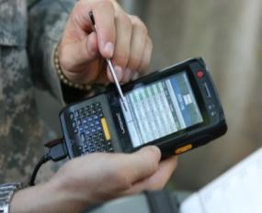
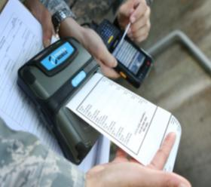

3in1 Tool
3in1 Tool automates field ordering, receiving & payment functions
3in1 Tool is comprised of 3 key components
Handheld Device
Used by FOO/PA to make purchases & capture receipt
Maintains purchase and expenditure logs
Calculates currency exchange
Stores purchase data & transfers it to Prime Database
Prints SF44 on portable printer
3in1 Prime Database Module loaded on Joint Contingency Contracting System (JCCS) And Hard Client 3in1 Workstation
(JCCS is a fielded system used by contracting for vendor & contract tracking, and the COCOMs to track ACSA Agreements)
Manage device and FOO/PA access authorization
Transfers data to/from device
Stores purchase and payment data
Clears orders online
Provides management reports
Transmits to other Business Systems

Slide 5
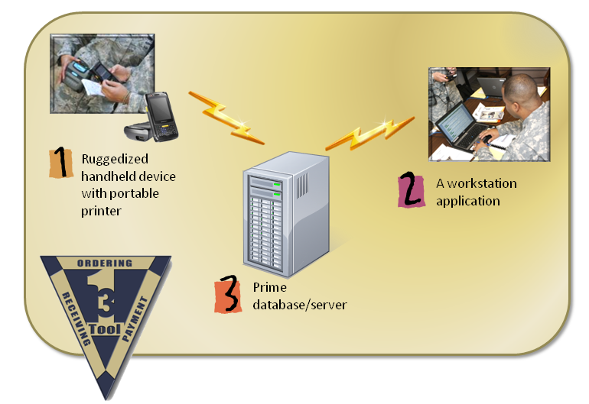
3in1 Tool
Operating Environment
Wired to Laptop
USB, Crossover Cable
GSM, WI-FI
Ethernet to LAN

Slide 6
3in1 Tool System Features
2 part system:
Handheld device record/stores SF44 data
Ruggedized Light weight handheld device Mil STD 810
2Gig storage capability
Small ruggedized printer used to print SF44 in the field
Transmit to 3in1 Prime Database for management/reporting
Prime Database housed at DISA with off station COOP site
Current transmission method:
Device stores data until connectivity is available to workstation or web
Wireless: GSM or Wi-Fi; Wired: USB or Ethernet (wireless can be disable)
Rel 2 stand alone workstation application stores data until connectivity restored
Data size minimize to operate with limited bandwidth
Security (users register on 3in1 Prime Database then linked to device)
CAC login Workstation establish strong password for login to device
FOO & PA use digital signatures to sign SF44
Data on device and in transmission is encrypted
Device storage is FIPS 140-2 compliant
Stages of the order are locked once confirmed
SF44 and Log print capabilities from Workstation and Device

Slide 7
3in1 Tool User Features
All SF44 data captured/recorded/transmitted to Prime Database
Record PR #, Amt, LOA -- ability to track multiple PRs
Records Cash Disbursement Amt and Exchange Rate
SF44 Signatures
Receiver/ Vendor physical signature recorded on touch screen
FOO and PA use Digital Signatures
Digitally record receipt image and link to order
Automatically calculates purchase total and currency exchange
Automatically tracks total obligations & available funds for orders
Warning messages notify FOO when purchase control is violated
Device can also prohibit purchases beyond authorized thresholds
Online role based review/reconciliation process (PBO,KO,DA,RM)
Information available daily without need for face-to-face clearing when cash exchange is not required

Slide 8
3in1 Tool User Features (cont)
Market research capability by querying prior purchases on device
Ability to attach notes to orders
Upload/Store supporting documents for retention with SF44 e-file
Commander's approval, Legal Review, C6 Coordination, Hand Receipt
PR document to PR data
Appointment Letter to FOO and PA
Management reporting capabilities on Workstation
Track Expenditures, Purchases, Cash in the field, Obligations, Available funds
Pre-populate forms such as hand receipts for property book items
Push financial/procurement updates/changes to device remotely
Allow for decreasing PRs & cash advance amount for redeployment
Allow to transfer disbursed cash from one PR to another for change of fiscal year

Slide 9
3in1 Tool User Features (cont.)
Track expenditure ledger by Cash Advance or Purchase Request
Device Dash board easily tracks available funding and orders
Transfer payment data directly to financial systems (DDS)
Transmit SF44 and receipt to EDA for document retention
Rerun an order to quickly process a repeat order
Create a shopping list to select from when at the market
Return an items ordered if required
Account for change in fiscal year when issuing a PIIN
Mass issue PIINS to expedite KO assignment of PIINs for new fiscal year
Allows messaging between clearance reviewer and FOO

Slide 10
3in1 Tool User Features (cont.)
If a device is damaged, data can be retrieved from MicroSD card on another device
Data is backed up on Workstations
If a device is stolen, it can be deactivated from the system by the KO or Sys Admin
As a device back up, PIINs will be issued for manual orders with can be entered into the workstation and the SF44 scanned and loaded for automated clearing and processing

Slide 11
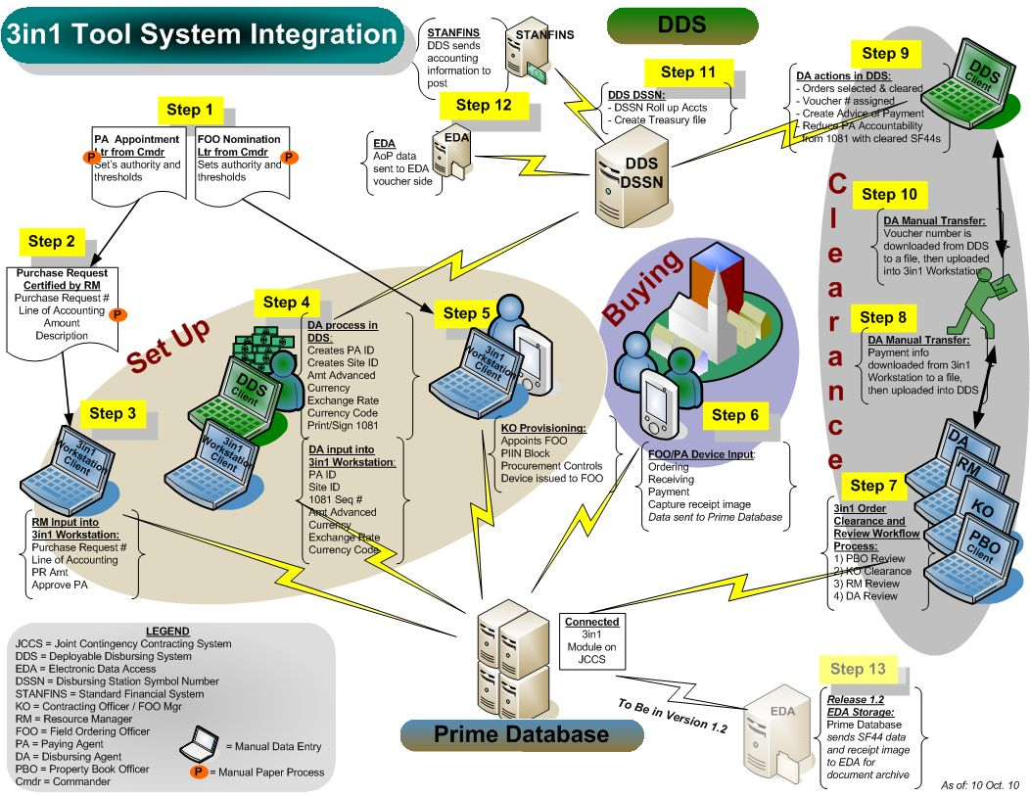

Slide 12

Set Up
AOR structure
User Registration
CC Letter & PR
Provisioning Set Up
Resource Mgr-PR Info
Disbursing Agent
DDS: Execute Cash Advance
3in1: Input Cash Amt
Contracting Officer
Associates FOO/PA
Issues PIIN Block
Assigns Controls
Issues Device
Sync Device

Slide 13
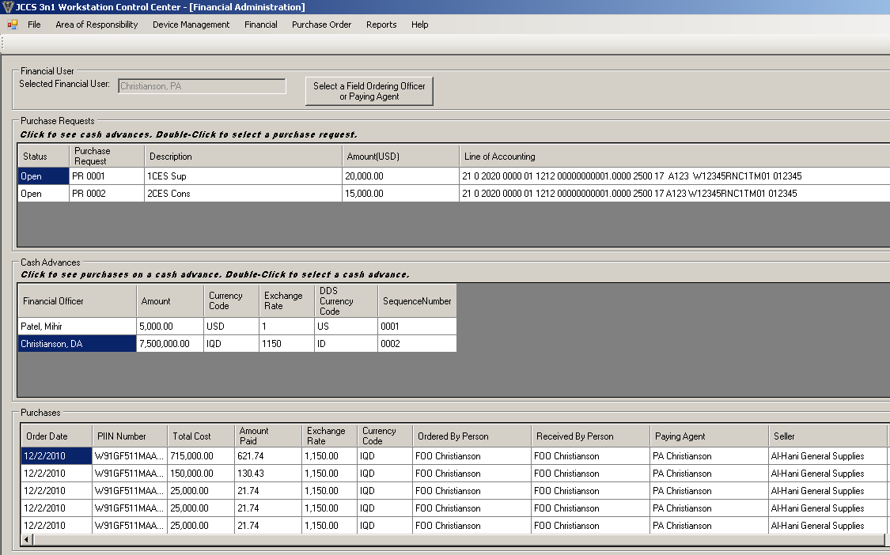
PR=f
Financial Management Screen
PR = Purchase Request
PR
Cash Advance
Orders

Slide 14
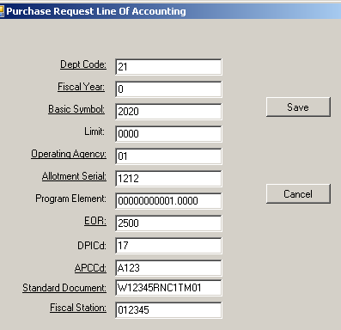
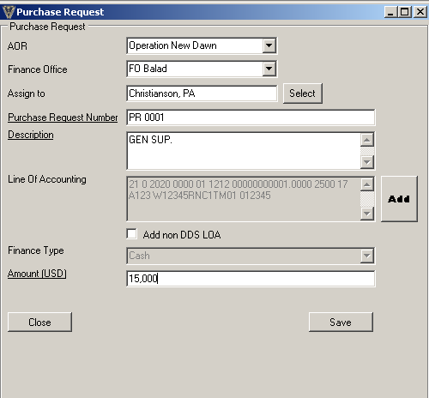
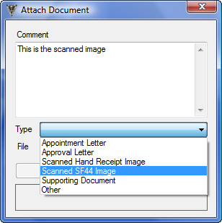

Add
RM/DA: Add Purchase Request
Enter LOA
Add PR number and amount
2
1
3
Upload Scanned PR
RM = Resource Manager / DA = Disbursing Agent
PR = Purchase Request / LOA = Line of Accounting

Slide 15
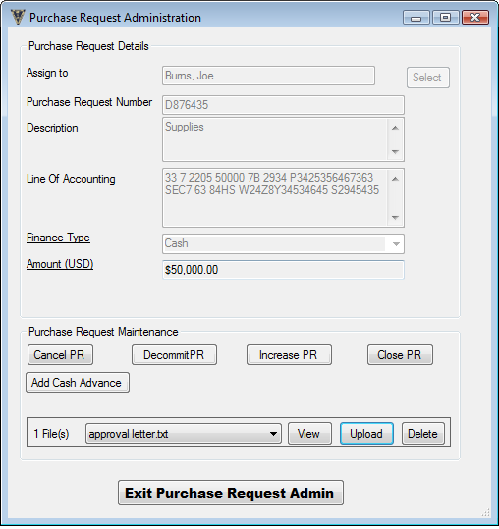
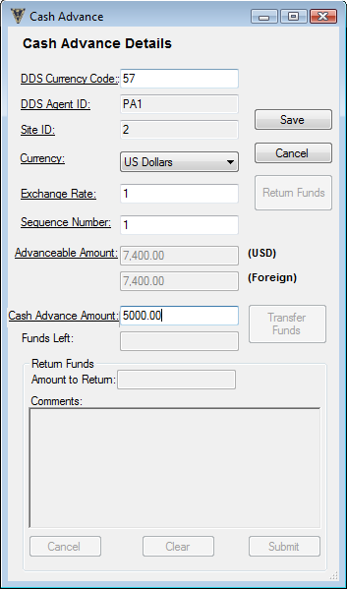
Add
DA: Add Cash Advance
Select PR
Add Cash Amt
1
2

Slide 16
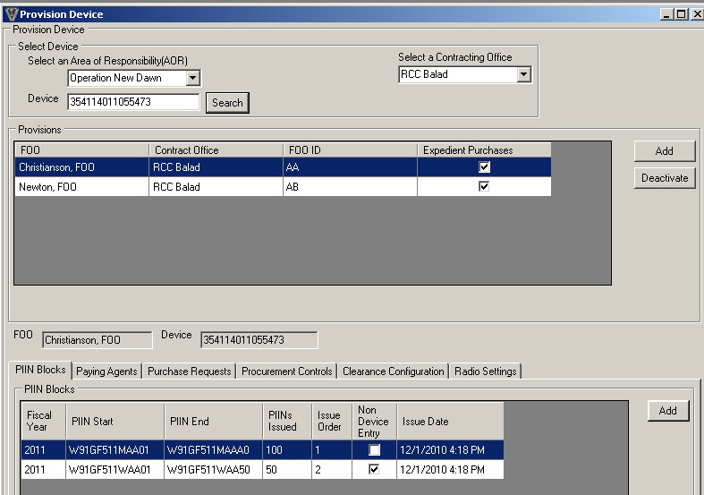
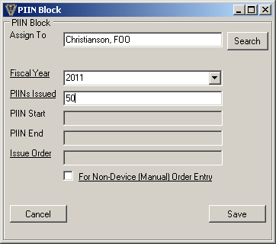
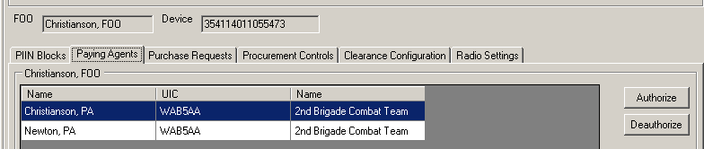
Add
KO: Device Provisioning
W91B4N - 11 - M - AA 01
Assign Device to FOO
Contract
Type
M or W
FOO
ID #
Purchase
Order #
PIINs
2,308 FOOs ♦ 1,155 POs per FOO ♦ 2.6M POs per DoDAAC
1
Assign Block of PIINs
2
Associate PA
3

Slide 17
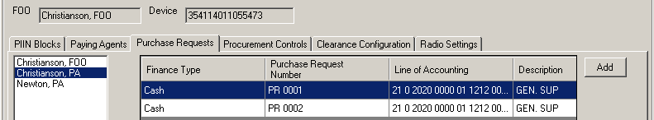
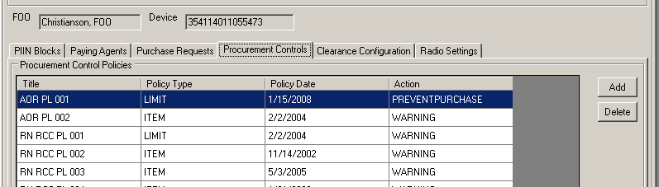
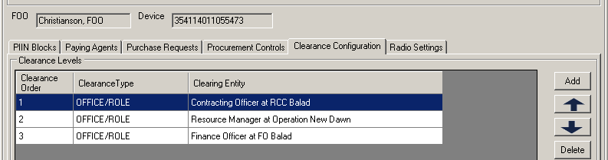
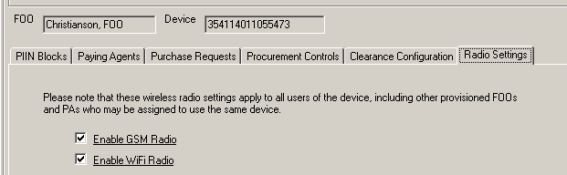
Add
KO: Optional Provisioning Modifications
Purchase Request
Procurement Controls
Clearance Confirmation
Radio Setting

Slide 18
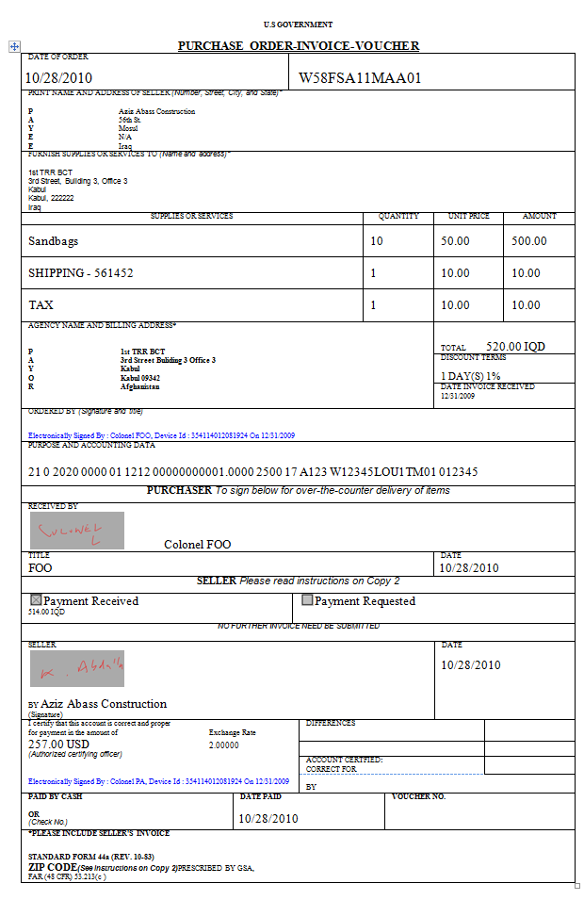
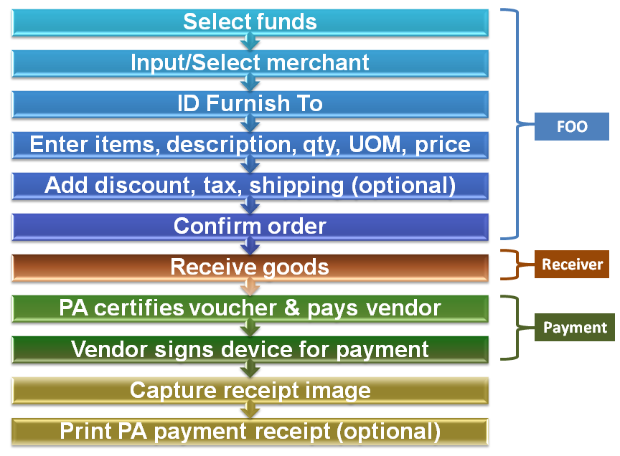
Device Ordering Process
Device Wizard Walks User Thru Process

Slide 19



Slide 20
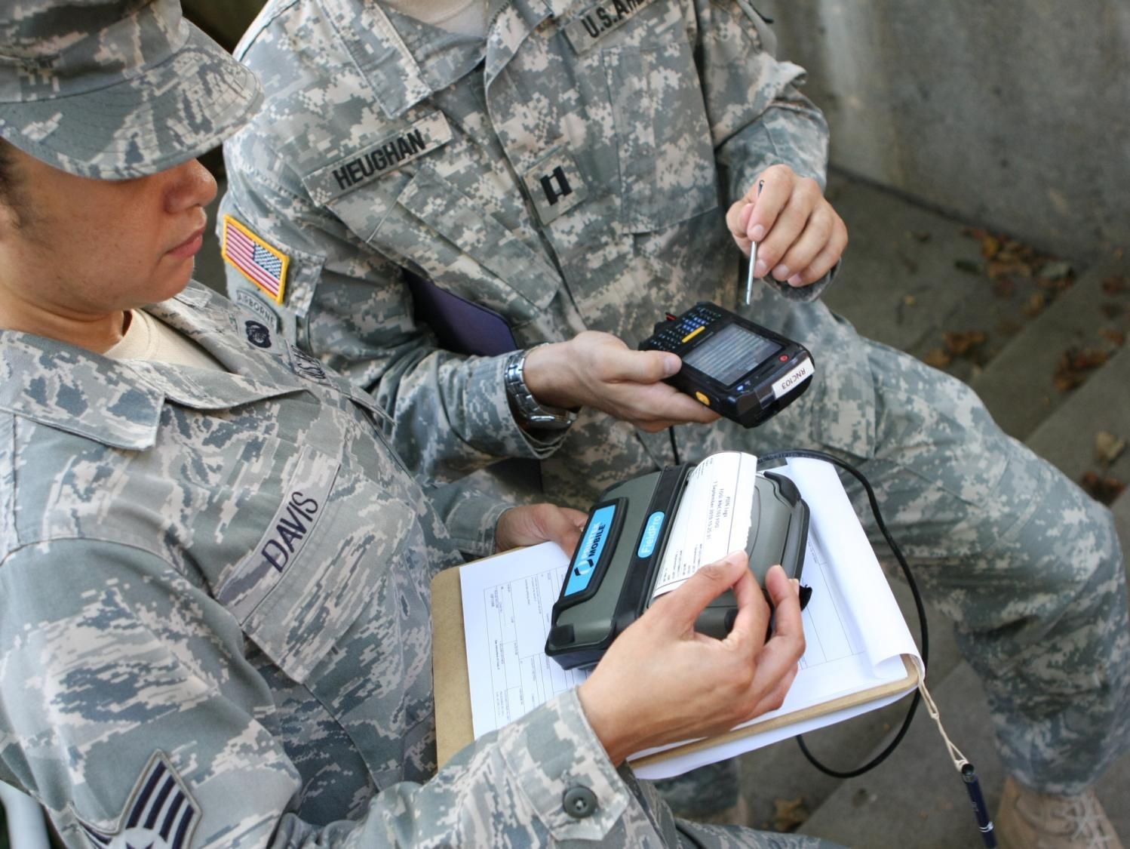

Slide 21

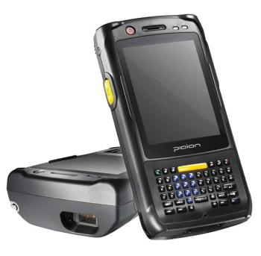
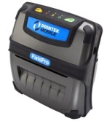
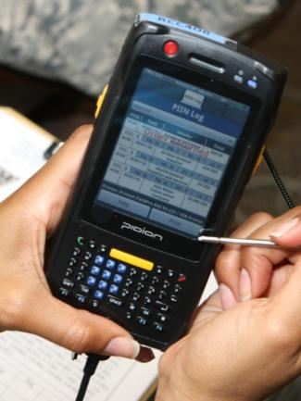
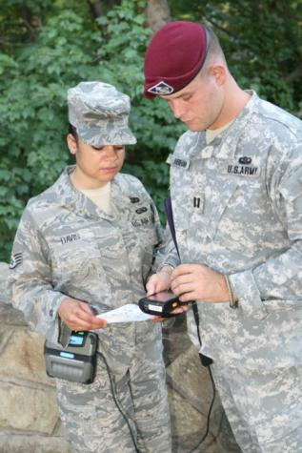
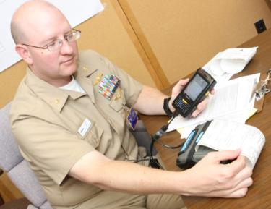
Field Purchases
Device
FOO Places Order & PA makes Payment
Receiver and Vendor signatures physically recorded on touch screen
Device Tracks Obligations and Remaining Funds by Purchase Request and Cash Advance
Calculates Currency Exchange
Adds Comments to Order
Flags Property Book Items

Slide 22
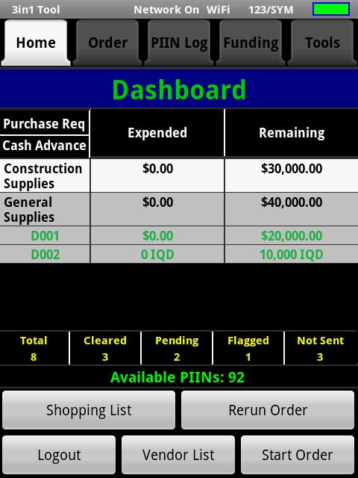
Add
FOO/PA: 3in1 Tool Device
Purchase Request
D001
$5,540.00
$14,460.00
D002
1,900IQD
8,100IQD
Cash Advances
Status of orders
Create a Shopping List
Maintain a Vendor List with GPS coordinates and Comments

Slide 23
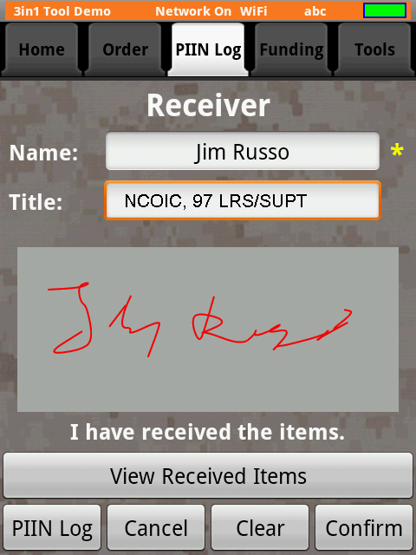
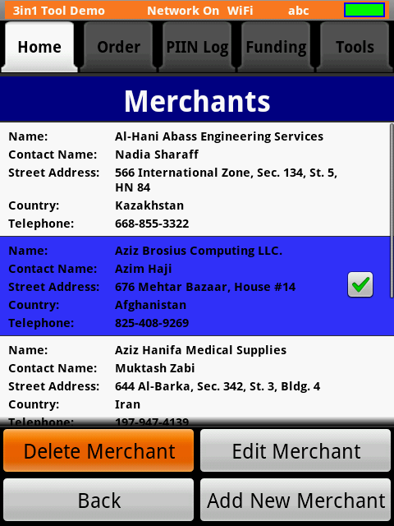
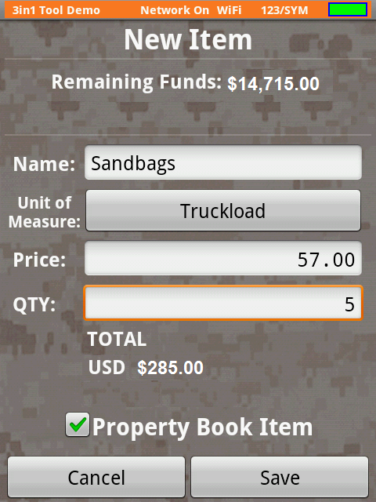
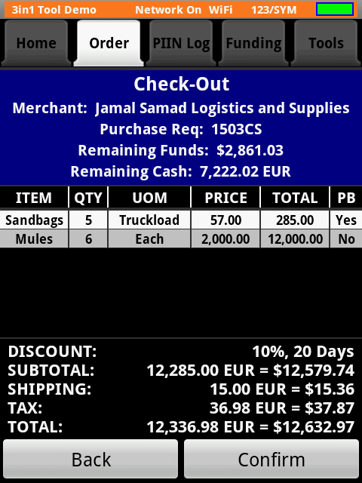
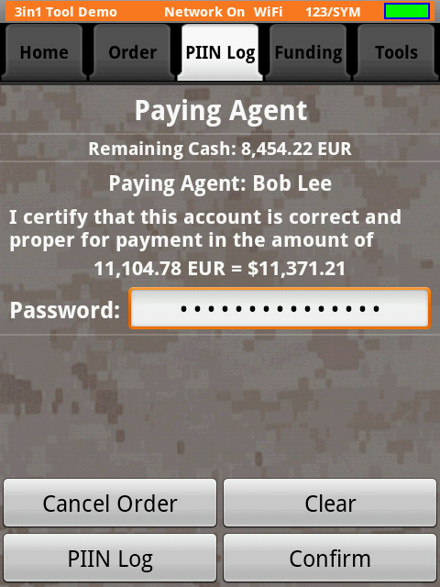
Add
FOO/PA: Placing Orders on the Device
Vendor & Receiver Sign
Select:
Funds
Vendor
Enter item Qty Price
FOO Confirms Order
PA Digitally Signs

Slide 24
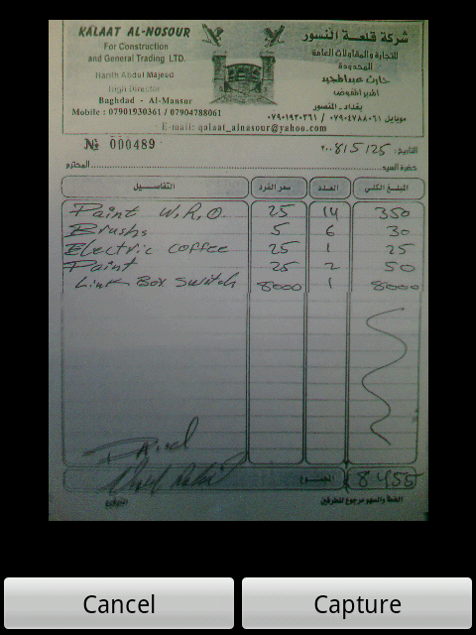
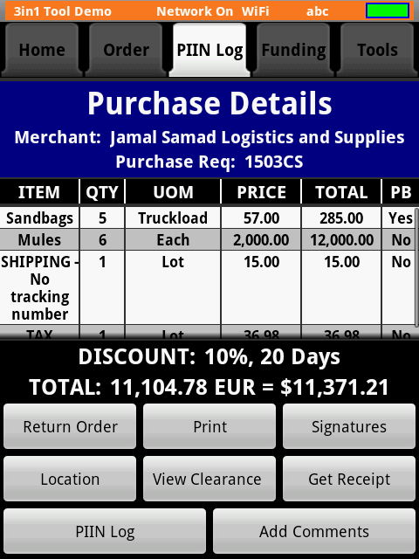
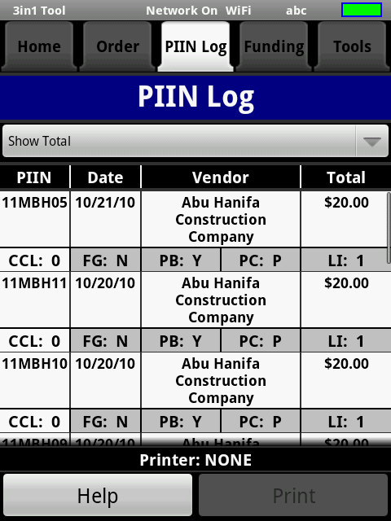
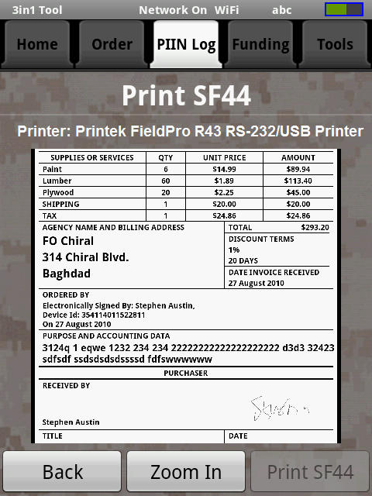
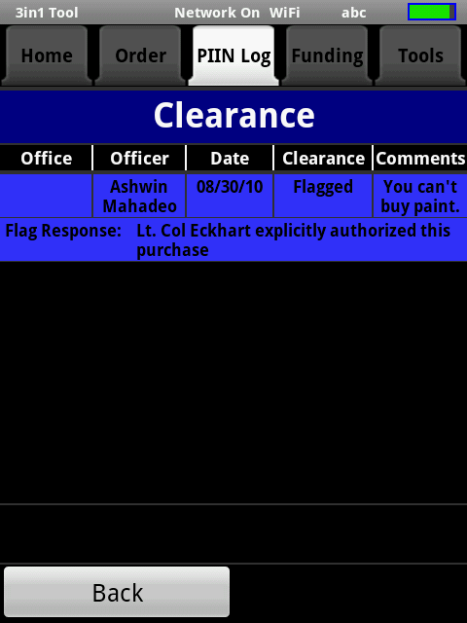
Add
FOO/PA: Orders on the Device
1 Order
Completed Clearance Level
Property Book
# of
Line Item
Flagged
Status of Purchase

Slide 25
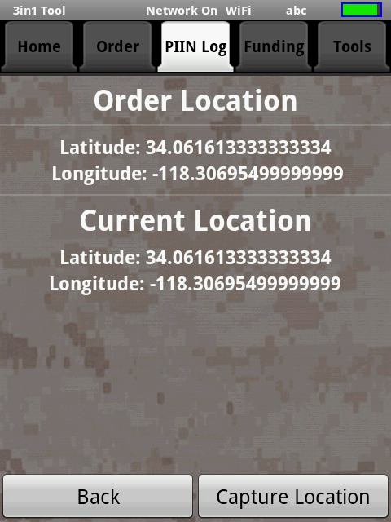
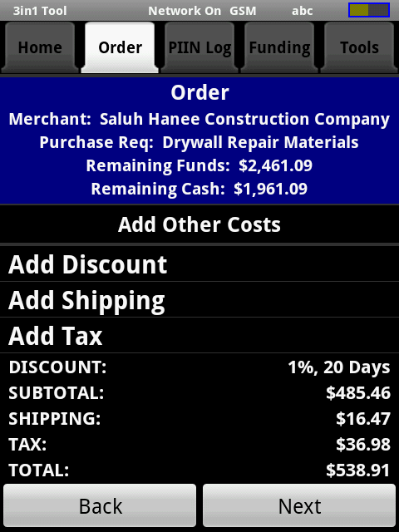
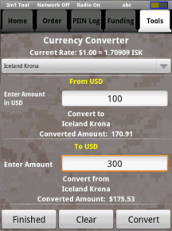
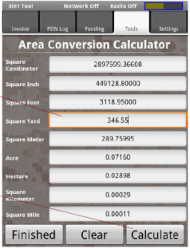
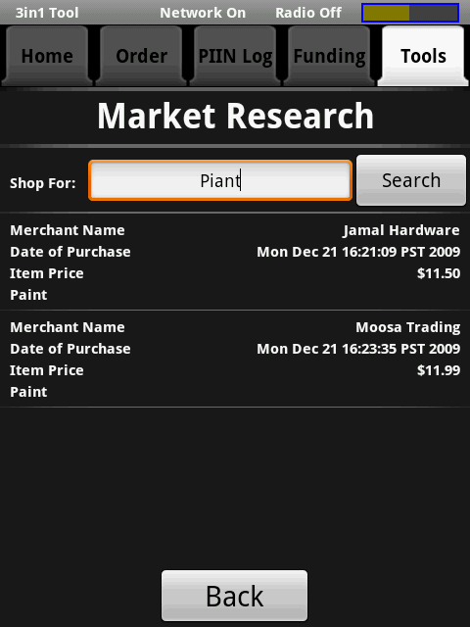
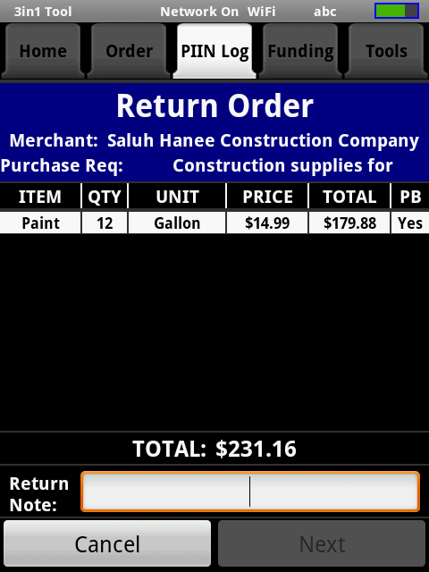
Add
FOO/PA: Other Device Features

Slide 26
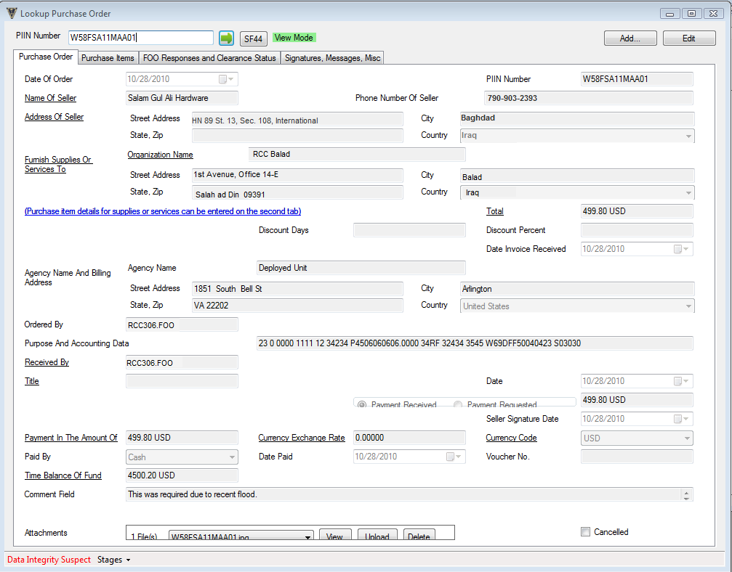
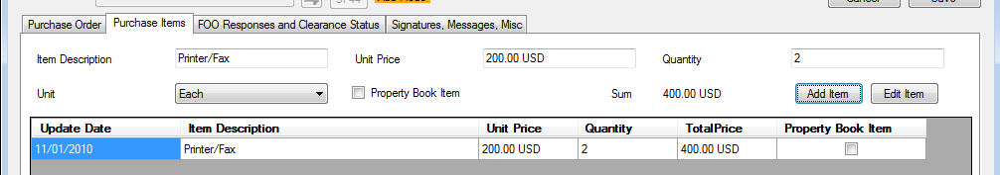
Add
View Orders
Look up Order
View order details
View Clearance Approvals
Upload Supporting Documents
Approval Ltr
Legal Review
Input Manual Orders to continue electronic process

Slide 27
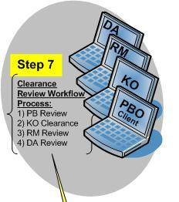
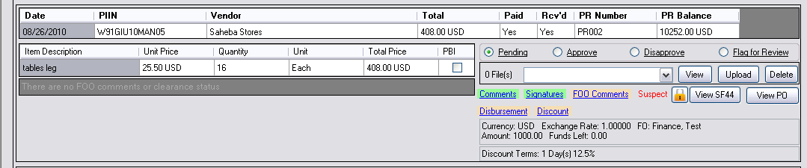

Order Clearance
Orders transmitted from device to 3in1 Prime Database for clearance
Reviewers can view all information from the SF44 and supporting documentation
Approve, disapprove, or flag orders as required
Comments from disapproved or flagged orders are sent back to the device where the FOO can reviewer and respond to comments/questions
Once approved, orders go to next review in the process

Slide 28
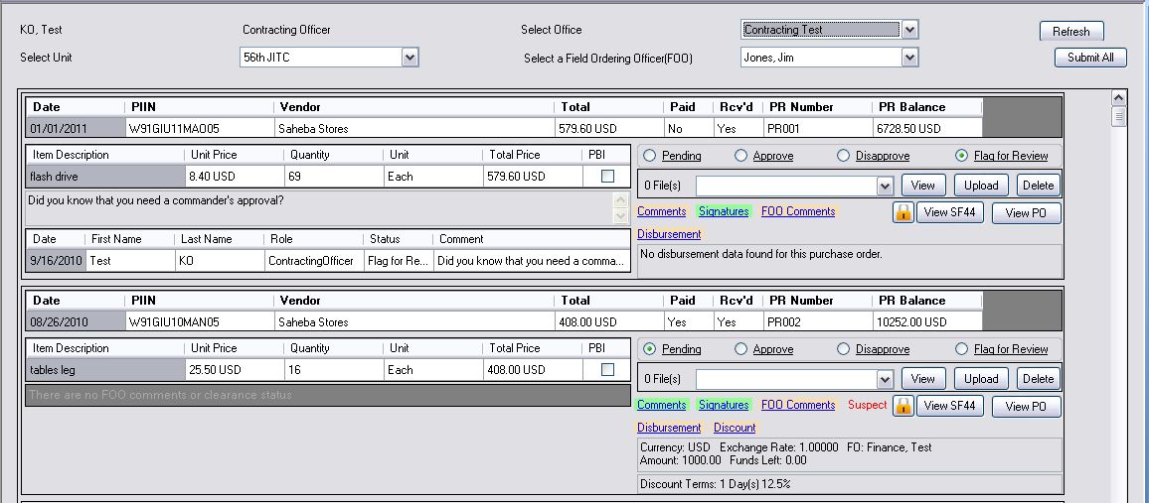
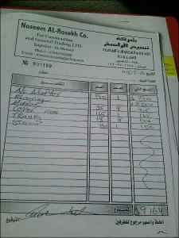




Clearance Screen
Add
Select Clearance Criteria
Order Info
Items ordered
Enter Comments
Disposition Orders
View Signature from SF44
View, Upload Documents including
Payment Info
View Comments between Reviewer & FOO
Receipts
Approval Letters
SF44s
POs

Slide 29


PA Clearance & Data Transfer
DA downloads file from Prime Database of cleared orders to a shared drive/CD
File uploaded into DDS
File uploaded like any other CAPS file
Voucher number assigned
PA 1081 accountability reduced
Payment transmitted to STANFINS
Print & sign 1081 for final PA clearance or issuing/returning cash
DA inputs SF44 voucher number in the Prime Database
Either manually or via file transfer
Release 1.2 = 3in1 Module transfers SF44 & Receipt to EDA for document retention
PA only required to travel to FO to return/receive cash

Slide 30




Add
Decommit Purchase Request
2
Select PA & PR
1
Enter Amt
4
Device Confirms Decommittment
3

Slide 31


Add
Returning Cash
Select PA & Advance
2
1
Enter Amt Turned In

Slide 32

Add
KO: Mass PIIN Issue
Enter FY and Qty to automatically issue a block of PIINs to all selected FOOs

Slide 33


Reports
SF44
Purchase Log
Expense Ledger
Management Reports
Total Orders/Dollars (RCC, FO, AOR, FOO)
FOO Activity Report
Total Active FOO, FOOs Cleared (Order Amt/Qty)
List of cleared FOOs (Order Amt & Qty), date last cleared
FOO Termination report
DA’s PA Advance Report
List of PAs with cash, amt obligated, amt advanced, date advanced, contact info
Provisioning Report
SF44 & Receipt Batch Download by FOO/PA or PR

Slide 34

Add
Reports: Accounting Log

Slide 35




Testing
Testing
Conducted 2 user assessments with 24 recently returned FOO/PA/KO/DA
Overwhelming support for continued development/fielding
Successfully Completed Fielding Assessment Test conducted by JITC
Met standards of Requirements Traceability Matrix
50 Participants: KO/FOO/PA/DA from USA/AF/USN
450 Orders, 24 PRs and disbursements, FY10 and FY11 PIINs, Simulated FY change, 30 transfers from 3in1 Workstation to DDS
IT Approvals
DSAWG approved IATC
BTA approved IATO / USF-I approved IATT
Pilot at VBC Iraq– 15 Dec – 28 Feb
15 Dec Phase 1: 4 FOO/PA Teams, 3 USF-I RMs,
3 TPBOs, 2 KOs, 2 FMD
27 Jan Phase 2: 6 FOO/PA Teams, 1 USD-C, BN XO

Slide 36
Training & System Support
Training Material
Classroom instructional training material
Role based training video (ECD: April 2011)
Role based quick reference books
Role based short cut sheets (similar to USA GTAs)
3 Levels Support Network
In theater support
Augment current JCCS support staff at large RCC
CONUS reach-back Help Desk support
Augment current JCCS support staff at BTA
Provide hardware coordination & instruction/training material support
Developer level support as needed
Hardware warranty and CONUS repair
RCC will control and issue devices to FOOs
Extra devices and peripherals will be provided for field replenishment

Slide 37
SF44 Process Improvements
No handwriting to decipher, illegible paperwork, lost receipts
Immediate visibility of transactions and payments
No travel required to clear when no cash replenishment/turn in
Improved data and purchase control
No excessive document reproduction, storage, or shipping
Eliminate redundant data entry
Enables analysis of expenditures and purchase activities
Improve cash management and tracking
Daily reconciliation without face to face meetings
Provide audit trail of all transactions in AOR
Eliminates duplication of payment risk
Reduces time/work: procurement/accounting/reconciliation

Slide 38
Questions Point of Contact: Lt Col Ann Christianson 571-256-7011 fiona.christianson@osd.mil Information: http://www.acq.osd.mil/dpap/pacc/cc/contingency_tools.html

Slide 39
Back up Slides To Provide additional information

Slide 40
Security Controls
Users
Users register with CAC on 3in1 Prime Database and create a DoD Strong Password for device login
FOO & PA use digital signatures to sign SF44
FOO&PA assigned to specific device
Data
Data on device and in transmission is encrypted
Device data--stored on FIPS 140-2 Compliant MicroSD Chip & bound to device
Order data locked by device
Transmission
Devices are registered with 3in1 Prime Database by System Administrator
Device comes with self signed certificate verified during registration
Unique ID assigned to Device by Prime Database
Certificate and ID used to authenticate all transactions between device and workstation
Device
Remote deactivation by system administrator if lost/stolen

Slide 41


Add
Orders on the Device – FOO/PA
Only primary screens are displayed

Slide 42


Add
Orders on the Device – FOO/PA

