Slide 1
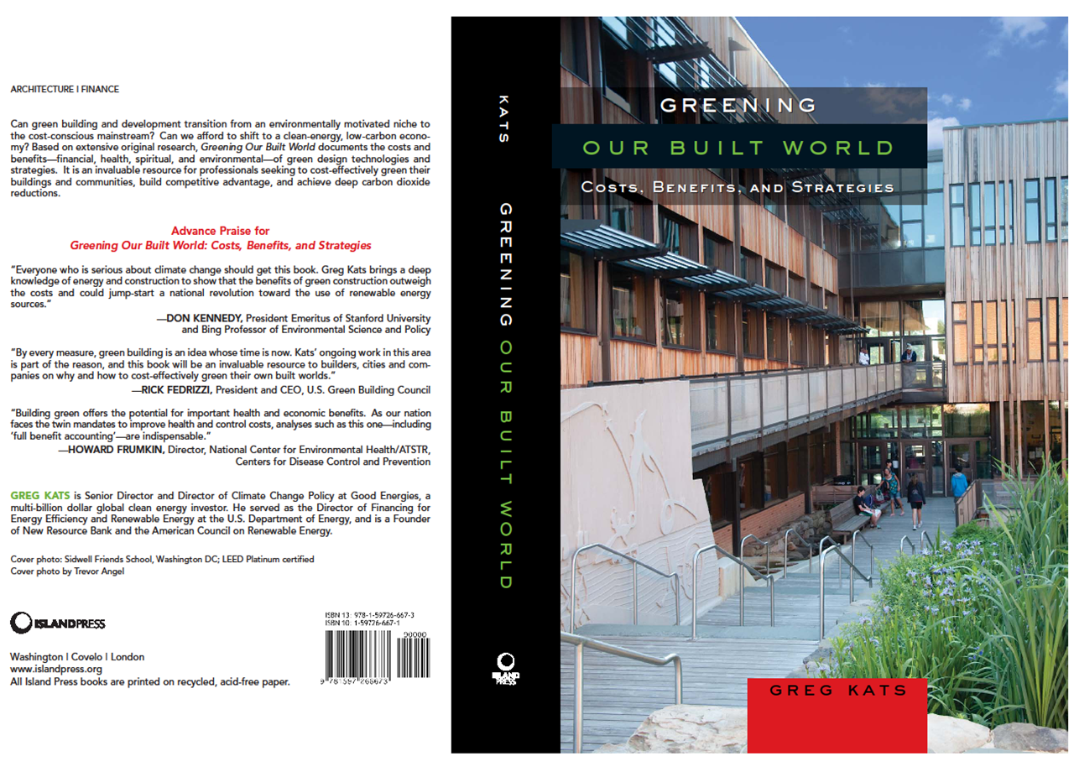
Greening Our Built World
Greg Kats, Capital –E, May 2010

Slide 2
Study/Book Sponsors
American Council On Renewable Energy
American Institute of Architects
American Public Health Association
BOMA International
Enterprise Community Partners
Federation of American Scientists
National Association of State Energy Officials
National Association of Realtors
Real Estate Roundtable
US Green Building Council
World Green Building Council

Slide 3
Cost of Building Green

Slide 4
Green Building Cost Premium

Slide 5
Green Building Benefits:
Increased Rent, Sales & Occupancy
1st Quarter 2008 | Non-LEED | LEED Certified Offices | Difference | % Change
Occupancy rates | 88% | 92% | 4% | 5%
Rent ($/SF) | $31 | $42 | $11 | 35%
Property value ($/SF) | $267 | $438 | $171 | 64%
1st Quarter 2008 | Non-Energy star | Energy Star Offices | Difference | % Change
Occupancy Rates | 88% | 92% | 4% | 5%
Rent ($/SF) | $28 | $31 | $3 | 11%
Sale Price ($/SF) | $227 | $288 | $61 | 27%
Source: CoStar analysis, 2008

Slide 6
Costs and Benefits

Slide 8
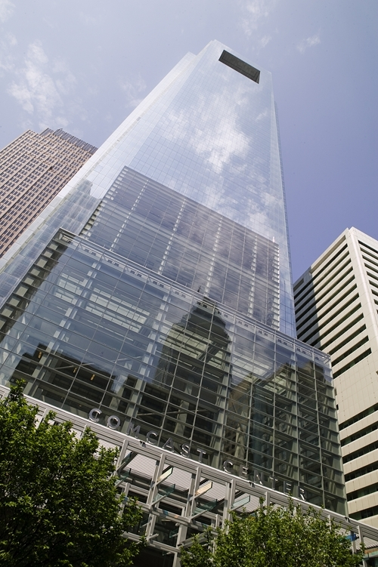
Comcast Building
Liberty Property Trust

Slide 9
Brand Impact of Greening
Greening Impacts: Three Sources of Brand Equity
Increased brand awareness (e.g., free media exposure)
Greater preference due to specific attributes (e.g., better IEQ)
General non-attribute preference (e.g., association with quality, lower risk)

Slide 11
Potential Value Of 20 Years Of CO2 Reductions in Green v. Conventional Buildings

Slide 12
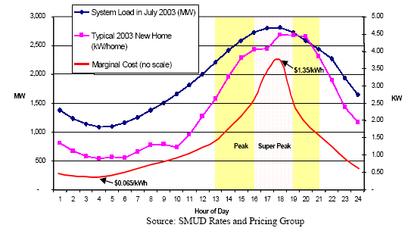
Residential Load

Slide 13
Rapid Cleantech Investment Increase Required
Total Global New Clean Energy Investment
Estimated Clean Energy Annual Investment to 2030, US$ Billions
5%
Growth
59%
Growth
4ºc
2.5ºc
2ºc
58%
Growth
68%
Growth
~x°c Equivalent increase in global temperature per scenario
Shortfall is potentially in excess of $350 billion per year
Source: IEA WEO 2008, New Energy Finance
13

Slide 14
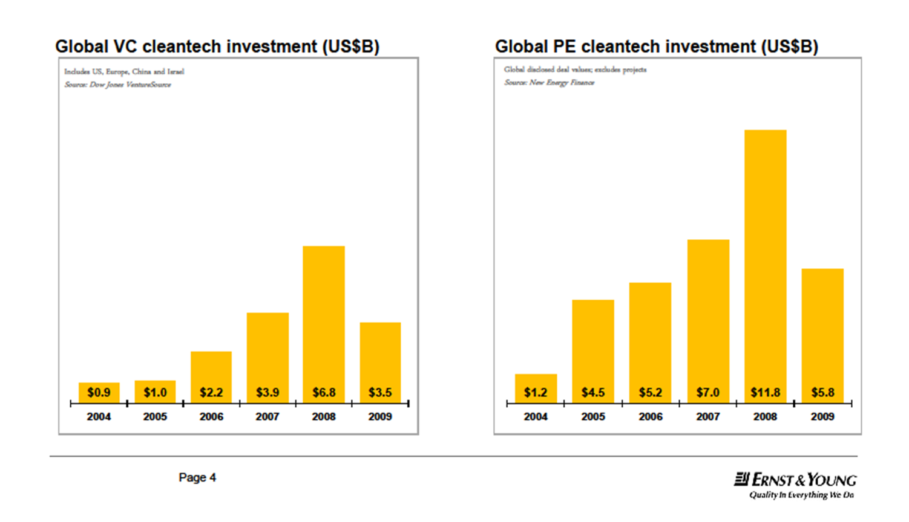
Global Cleantech Investment Landscape

Slide 15

Performance Comparison
0.60
Tinted
0.50
Low-e2
0.40
SageGlass® EC
Solar Heat Gain Coefficient
0.30
Tinted Low-e2
0.20
Reflective
0.10
0.00
10%
20%
30%
40%
50%
60%
70%
80%
Visible Light Transmission

Slide 16
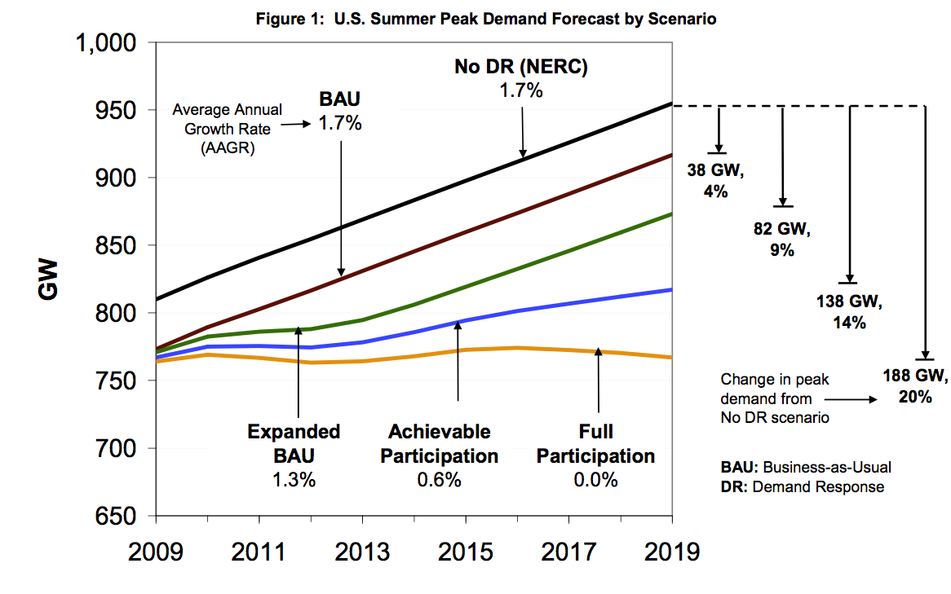

FERC REPORT: Demand Response Potential
source: FERC Assessment of Demand Response & Advanced Metering 2009
assumptions: smart meters, dynamic pricing default, enabling technologies

Slide 17
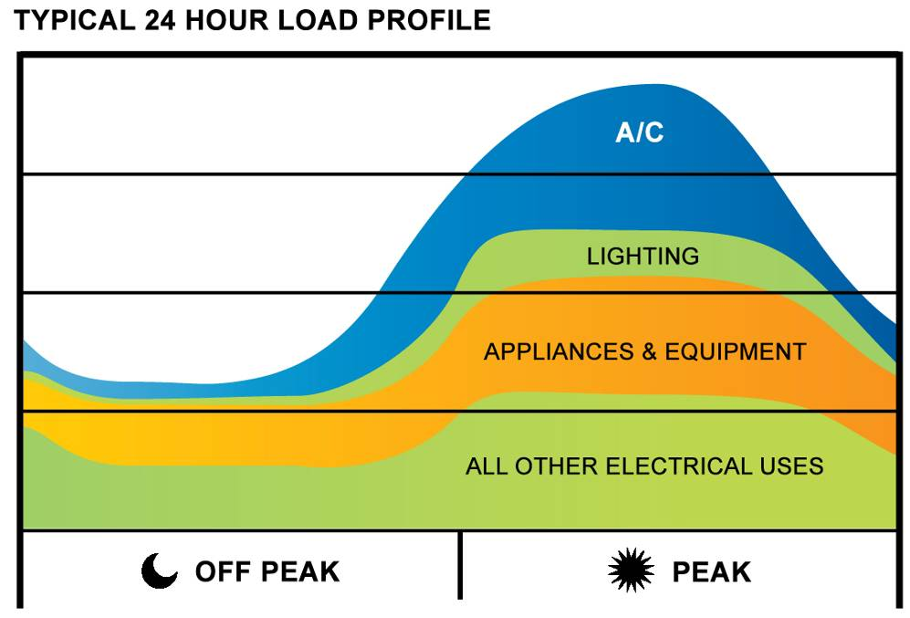
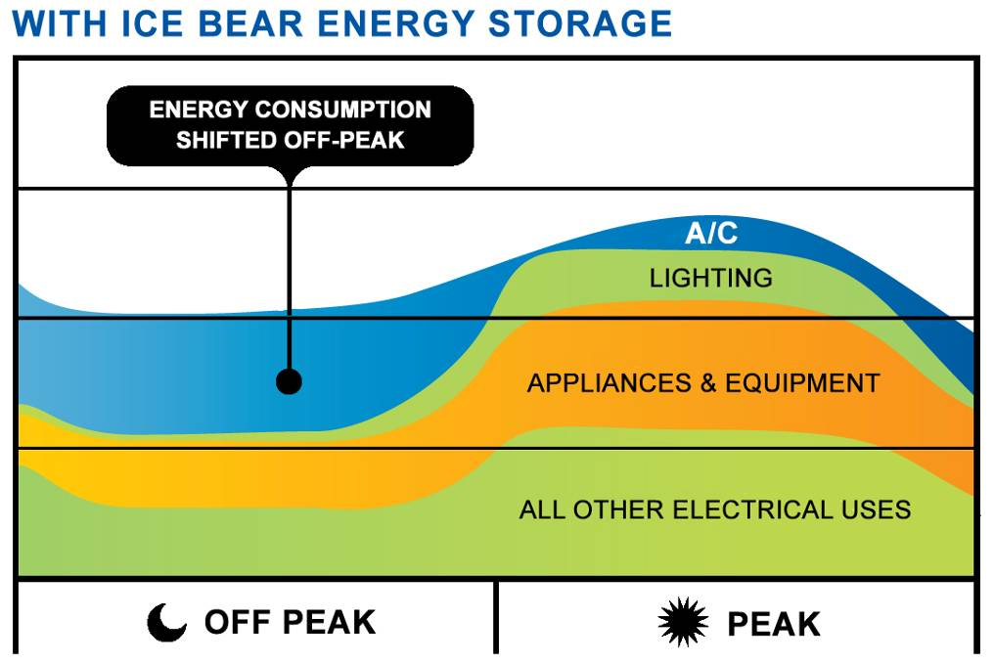

Ice Bear® Distributed Energy Storage
6 hour on peak resource
Insulates Utility Assets From Hot Weather Related Events
Low Capacity Factor
High Capacity Factor

Slide 18
CO2 Impact

Slide 19
Greening = Wealth and Jobs Creation

Slide 20
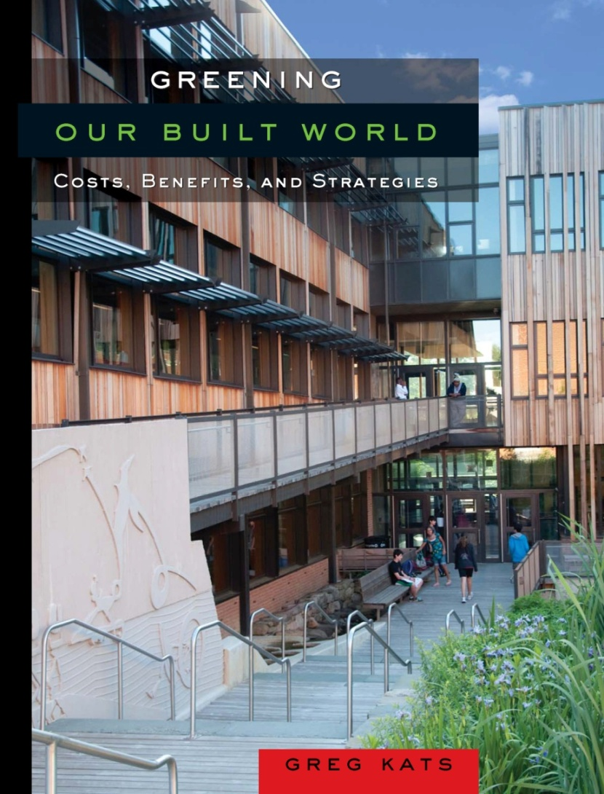
For more Information:
www.cap-e.com for additional data and downloads.
www.islandpress.org/Kats
Greening Our Built World is on Amazon (please write a 5 star review!!!)
www.goodenergies.com
Thank you

