Slide 1


Control Compliance Suite: Aligning security and compliance objectives To achieve Information Risk Management
Bill McClanahan – Principal Business Consultant
LPS Integration

Slide 2

Symantec Enables Confidence
Fast Facts:
World’s fourth largest independent software company
Independence: Delivers solutions across multiple platforms
Insight: Broad knowledge about the Internet and infrastructure
Trusted leader in Windows protection
Named to FORTUNE’s 2006 America’s Most Admired Companies list
Founded in 1982, IPO in 1989
More than 17,000 employees in 40 countries
Launched 100 new products and services in FY06
Highest R&D Spend in the Industry (17%)
Shipped nearly 23 million boxes of consumer product in FY06
Serves 99% of the 2006 FORTUNE 1000 list
Fortune 500 company
$5 billion in revenue in FY06
72% enterprise revenue
Notes:
As a global leader in infrastructure software we have the depth, breadth, and global reach to enable you to have confidence in a connected world.

Slide 3

Regulatory Landscape
HIPAA
ISO 27001
NERC
SOX
NIST
Circular A-123
Basel II
CFR
CIS
NSA SNAC
ISO 17799
PCI
World Bank Technology Risk Checklist
CIP
GLBA
FFIEC
FISMA
COBIT
ITIL
ISO 27002
COSO
Notes:
Today's regulatory landscape is made up of a myriad of government regulations, frameworks and security best practices such as
HIPAA – 1996 GLBA - 1999
SOX – 2002 Circular A-123 – 2004
Basel II – 2004
COBIT -
ISO 17799 - 2005
And the list goes on
In the last 10 years there have been so many new regulations and frameworks that many company's and government organizations where sent scrambling to get all these new rules, processes, and practices understood and under control.
This has caused a dramatic shift in the IT Governance efforts as organizations ramp up their compliance programs.
With this shift has come many challenges- manual processes & controls, cumbersome reporting, little or no visibility into health of controls, configurations, and a way to match against standards

Slide 4
IT Compliance Best Practices
Reduce control objectives (policies)
Increase controls
Increase the assessment of controls
Automate repetitive activities
250
Days between
control assessments
200
150
Number of procedural
and technical controls
100
50
Number of control
objectives (policies)
0
Annual data losses/thefts
Compliance deficiencies
12 or more 3 to 6 2 or less
16 or more 3 to 15 2 or less
Number of controls, control objectives, days between control assessments
Notes:
This chart brings four key findings together that should help customers understand the value of what we’re talking about.
Building a holistic approach to managing compliance. - Reduce the number of policies. Have one security policy, have one access rights policy, etc.
While minimizing the number of policies a company has, they should increase the number of appropriate controls. Eliminate duplication and increase those controls that are necessary.
IT control self assessment is critical. The more often you test your IT controls the more effective your compliance program.
Automation is key. Without automation it is impossible to cost effectively accomplish the first three items.
Result: Those that minimize the number of policies, increase the number of controls, and the frequency of IT controls assessment can reduce annual data losses and thefts by 6X or more. Those that automate the process can actually reduce their current spend on compliance.
The data represented in this slide is based on talking to over 200 enterprise class companies.

Slide 5
Key Automated Activities
Procedures
and controls
Ongoing
monitoring and
reporting
20.0%
19.7%
20.2%
Assessment of
compliance
with IT policies
Remediation
and change
management
20.9%
19.2%
Collection of
audit-related
data
N: 704
Source: IT PCH, 2008
www.itpolicycompliance.com
Notes:
There are five key areas where automation is critical and can pay the most dividends. These five areas were identified by the same research with regards policy compliance best practices. Those that are leaders and have held or reduced their operational costs have put equal weighting into these five areas.

Slide 6
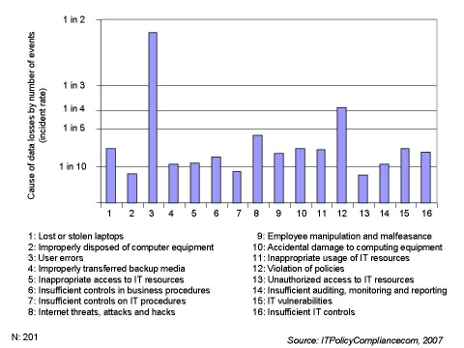
The Sore Spots An academic view
Notes:
In this 2007 report from ITPolicyCompliance.com there is a list of the top 16 issues that IT mangers face.
While none of these risks can be completely eliminated, all of these issues can be mitigated by implementing good sound IT governance practices such as policies, procedures, and controls.

Slide 7
Symantec Control Compliance Suite Automates key IT compliance processes.
Policies
Standards
Entitlements
Response Assessment
Notes:
Introduce the modules of CCS.

Slide 8
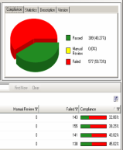
Control Compliance Suite
Policy
Standards
Entitlement
Response
Define/manage written policies
Distribute policies & track exceptions
Demonstrate coverage
Display evidence
Create/Select standard
Assess controls
Detect deviations
Remediate deficiencies
Gather effective permissions
Translate permissions into human readable format
Route entitlements to data owner for review & approval
Assess non-programmatically assessable controls
Report with risk weighted model
Centralize view of procedural controls
Data Protection Policy
Endpoint Policy
Malware Policy
PCI
SOX
GLBA
FISMA
Cobit
ISO
NIST

Slide 9
Recap of Control Compliance Suite – A Unified Solution
Create
Map
Publish
Assess
Fix
Written Policy
Corporate Policies
Info Security
Access Control
Termination
SOX
PCI
COBIT
Basel II
Exception
ISO
NIST
Scoped by Risk Level
Procedural Controls
Technical Controls
Control self assessment
Questionnaire responses
Risk-based prioritization
Entitlements review
Group\file permission
Classify & assign owners
Approval workflow
Configurations
Security best practices
Remediation
Vulnerabilities
Non-credentialed checks
Credentialed checks
Patch Mgmt
Notes:
The IT Compliance Process has three key stages – Define, Control and Govern (CCS)
1. (Define) The first step in getting there is defining what your policies should be thru policy creation
We help you understand exactly what best practice recommends and external mandates require
And manage this policy creation process with approval workflow and version control
2. (Define) Now organizations must show coverage of external mandates based on mappings from written policies. This needs to be done for both TECHNICAL and PROCEDURAL controls.
We provide a visual mapping canvas and use patent pending capabilities to help link internal policies to external mandates
This means you can provide an auditor a report that shows your policies and exactly how they map to external mandate control objectives
3. (Define) Once a policy has been approved and published, it must be distributed to end users
End users can log in through a web portal and see only the policies that impact them
They can approve, deny, ask for clarifications or ask for exceptions to policy
Exception mgmt is critical. This allows for a two way dialogue with end users to ensure that created policies can be complied with, and if they cannot, that management has a way of providing mitigating controls for these accepted risks – instead of remaining blind to them and having end users just route around internal policies when they cannot comply with them for business reasons.
4. (Control) The final step is to prove that the policies you have written are, in fact, in place.
There are two kinds of IT controls from where evidence of compliance must be gathered
The first kind of evidence comes from technical controls. These controls include platform hardening, patch analysis, and vulnerability mgmt
The second kind of evidence comes from procedural controls. These controls are not programmatically assessable like ‘did the badge ID get taken for a terminated employee’. These controls require human attestation of compliance, but need to be retained in a single store, alongside programmatically accessible information.
5. (Govern) Now that you have defined your policies and assessed compliance, unfortunately there will often be deficiencies. We can help you not only detect those problems, but also to remediate the deficiencies.
In some cases, of course, what may be required are new kinds of controls and our best practice guidance will help you reshape your policies accordingly.
In others, like procedural controls, the requirement will be to notify end users of non-compliance.
And in the case of infrastructure controls we will provide detailed remediation guidance, integration to change ticketing for remediation AND\OR the ability to take immediate corrective action for appropriately privileged users.
NO OTHER SOLUTION INTEGRATES POLICY MANAGEMENT WITH TECHNICAL & PROCEDURAL ASSESSMENT IN ONE PLACE

Slide 10

Thank You!
Presentation based off of a Symantec presentation by
Steve Smith – Symantec Principal System Engineer
© 2006 Symantec Corporation. All rights reserved.
THIS DOCUMENT IS PROVIDED FOR INFORMATIONAL PURPOSES ONLY AND IS NOT INTENDED AS ADVERTISING. ALL WARRANTIES RELATING TO THE INFORMATION IN THIS DOCUMENT, EITHER EXPRESS OR IMPLIED, ARE DISCLAIMED TO THE MAXIMUM EXTENT ALLOWED BY LAW. THE INFORMATION IN THIS DOCUMENT IS SUBJECT TO CHANGE WITHOUT NOTICE.

Slide 11
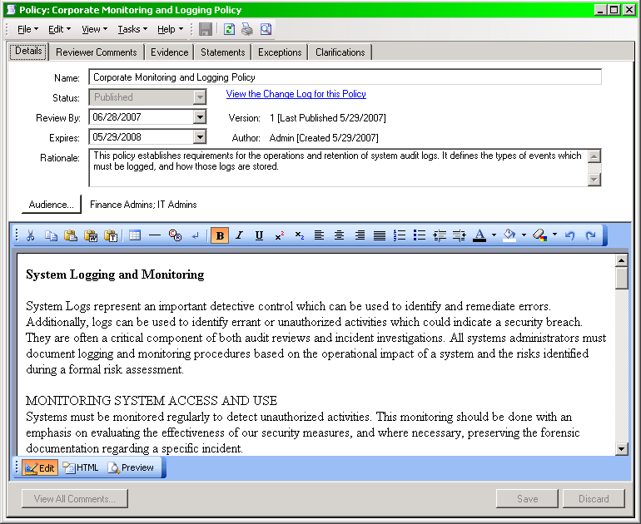

Policy Module – Policy Details

Slide 12
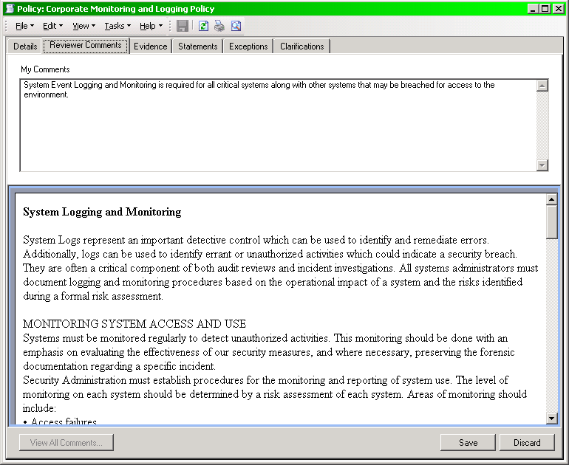
Reviewer Comments (Document)

Slide 13
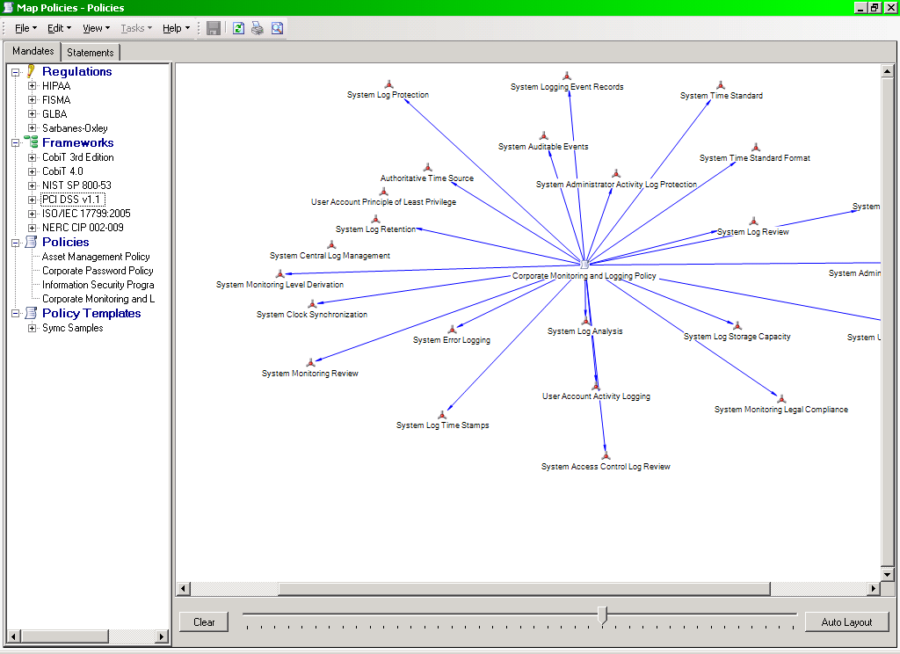
Policy Mapping

Slide 14
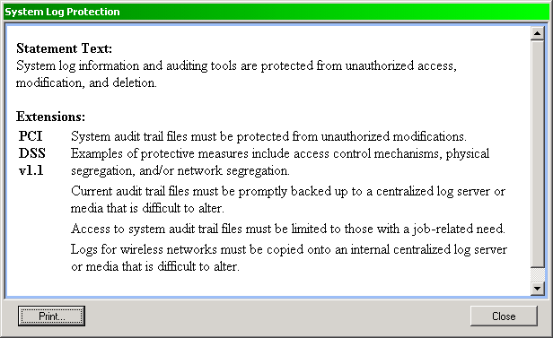
Regulatory Definitions
Detailed Regulatory Definitions Help Assure Understanding.

Slide 15
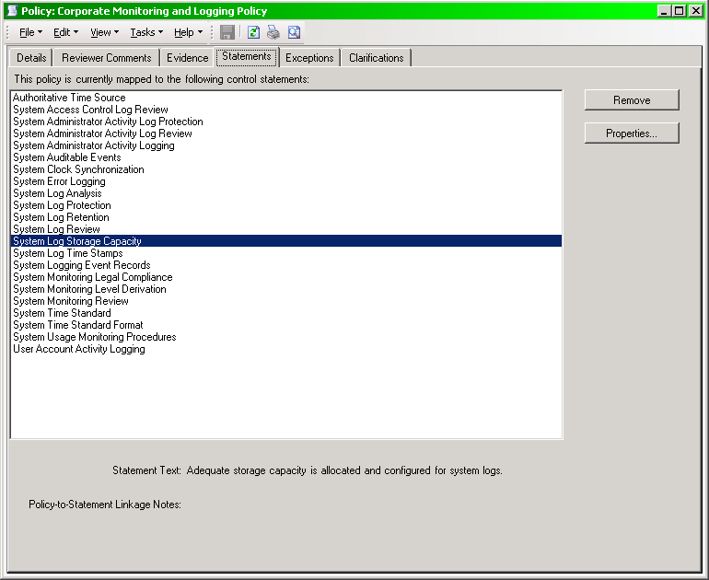
Policy Mapping to Regulations, etc.

Slide 16
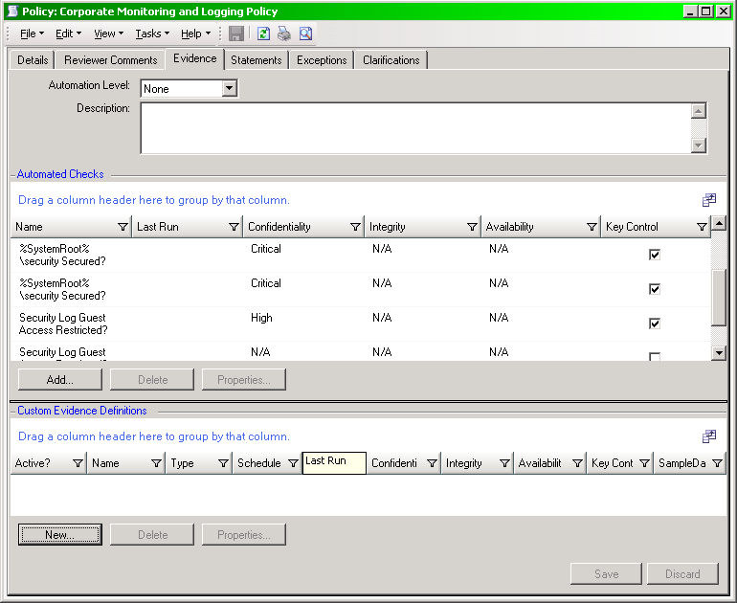
Policy Module Evidence
Evidence (Automated and Custom) should map to Control Statements.
Covers requirements of Policies and Regulations.

Slide 17
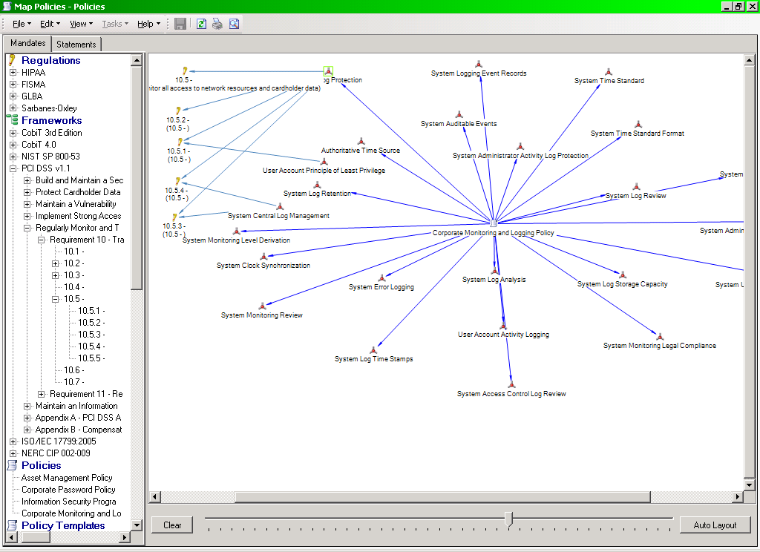
Policy Mapping – Related Information
Policy Mapping may be expanded to other related Regulations and Frameworks to help visualize coverage.

Slide 18
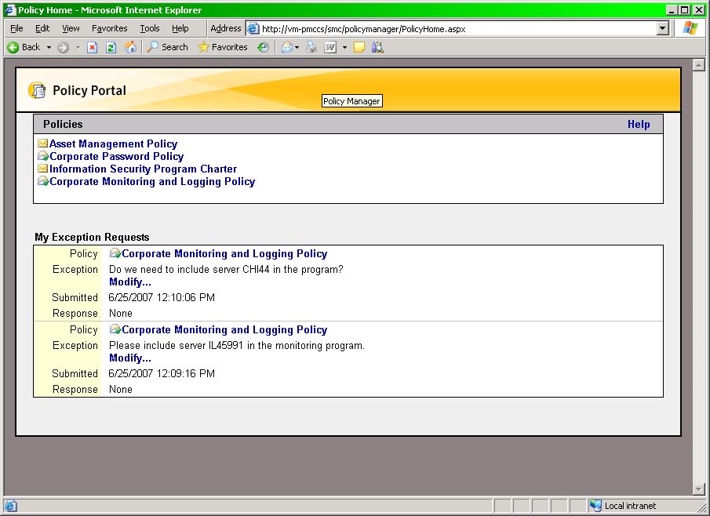
Policy Module – User Experience

Slide 19
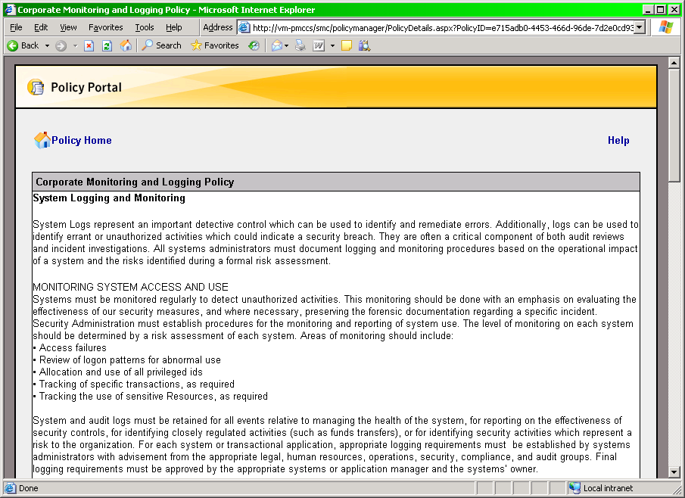
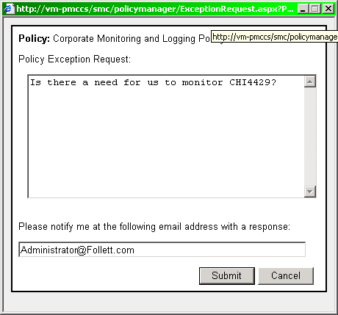
Policy Module – User Experience

Slide 20
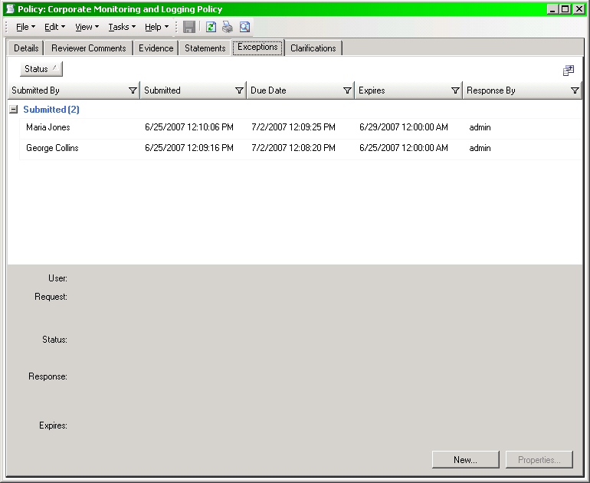
Policy Exceptions & Clarifications

Slide 21
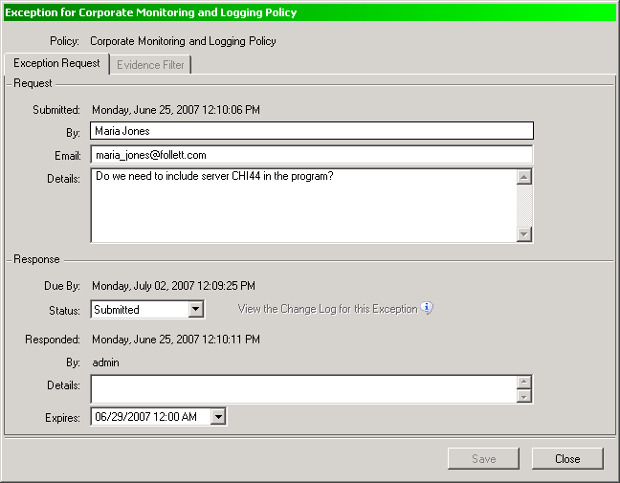
Policy Exceptions & Clarifications

Slide 22
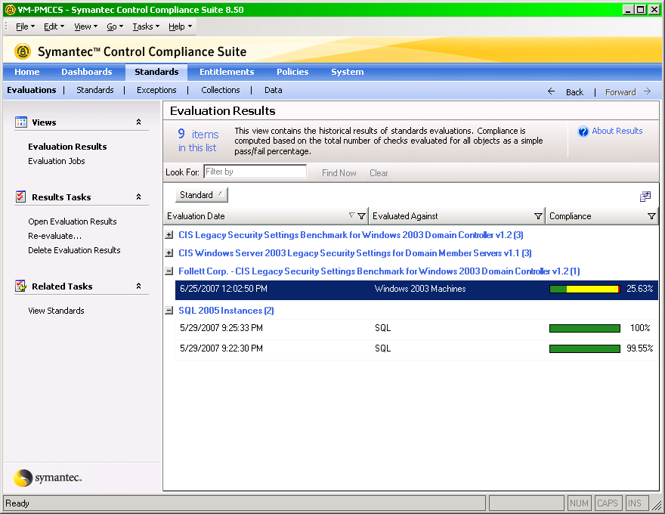
CCS Standards Module Evaluation

Slide 23
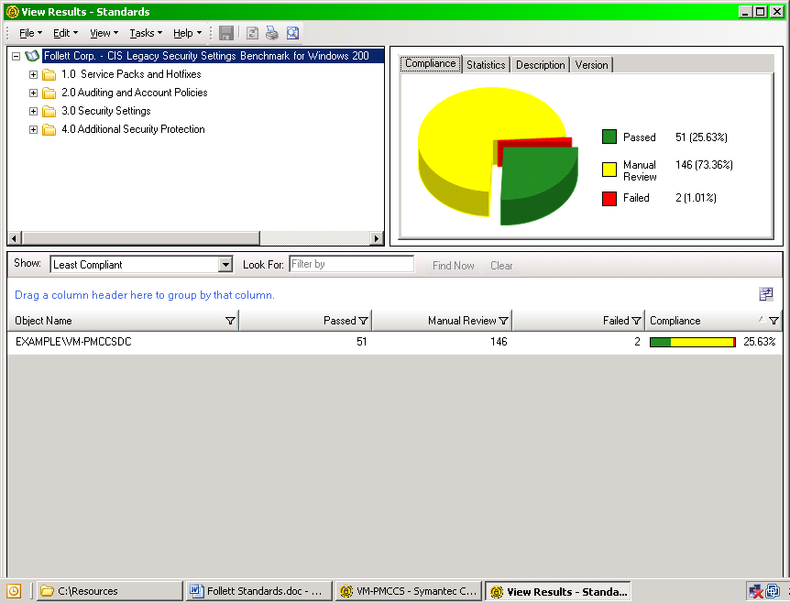
CCS Standards Evaluation

Slide 24
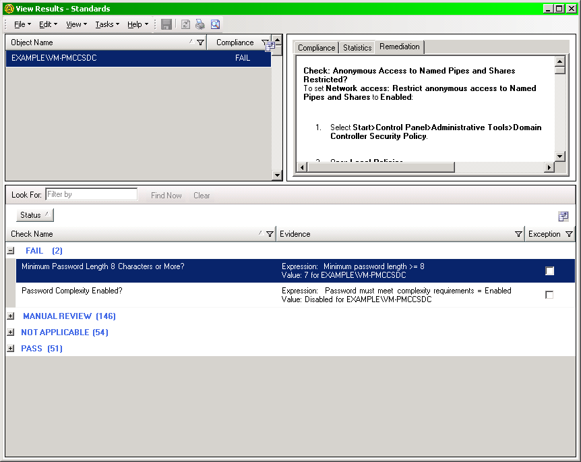
CCS Standards - Remediation

Slide 25
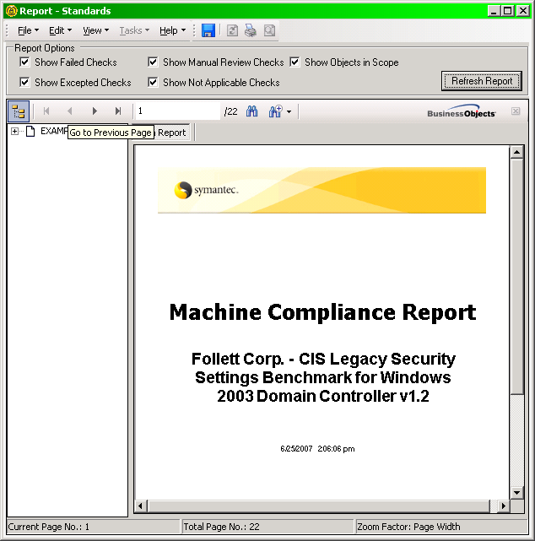
CCS Standards Compliance Report

Slide 26
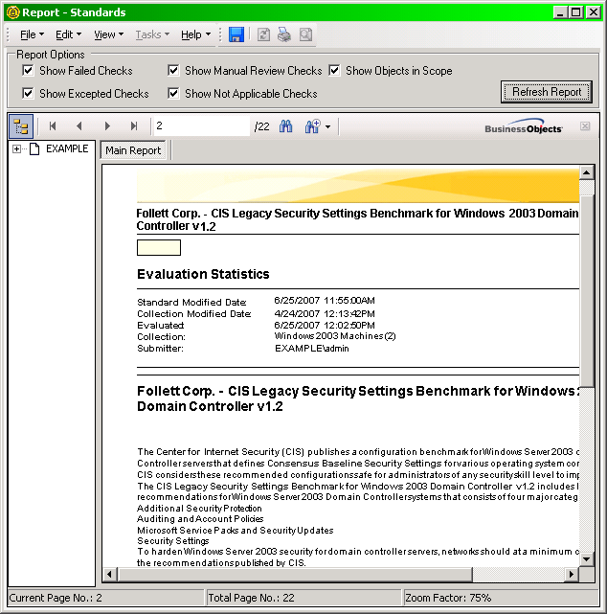
CCS Standards – Compliance Detail

Slide 27
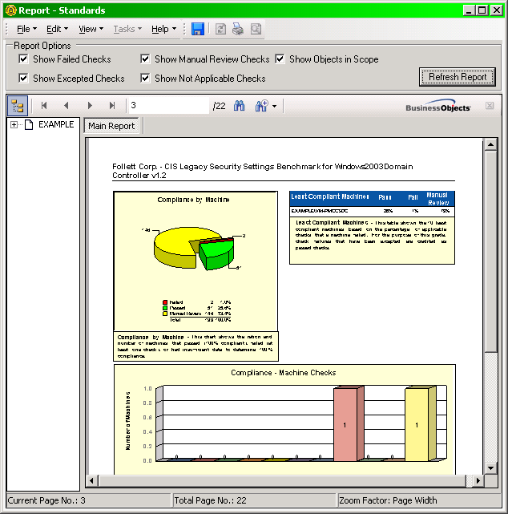
CCS Standards Report

Slide 28
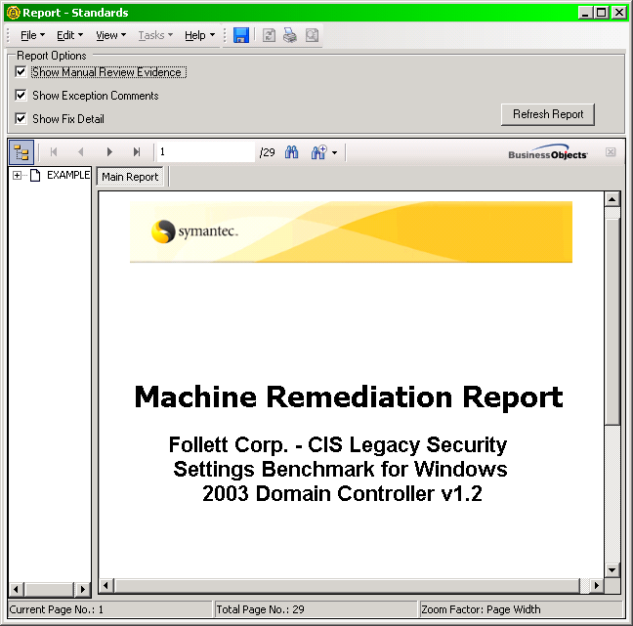
CCS Standards – Remediation

Slide 29
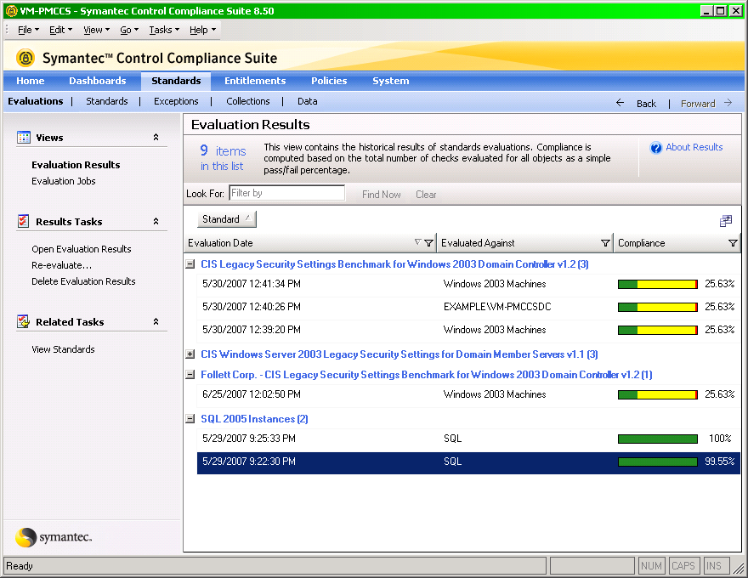
CCS Standards - Trending

Slide 30
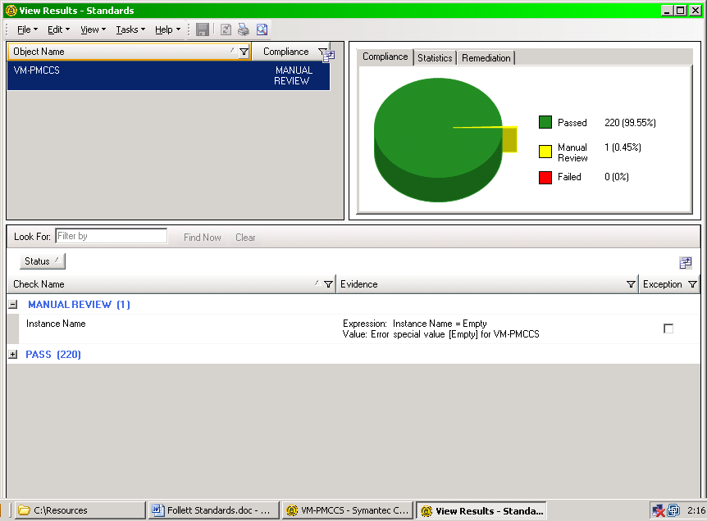
CCS Standards - Exceptions

Slide 31
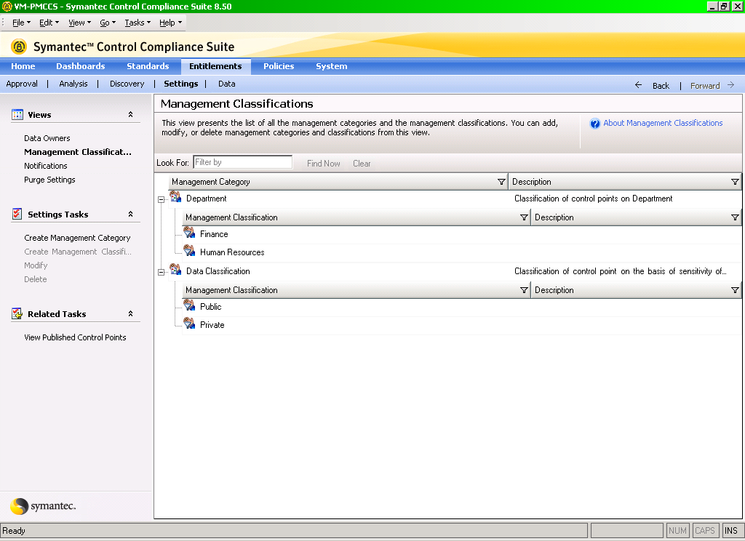
CCS Entitlement Classifications

Slide 32
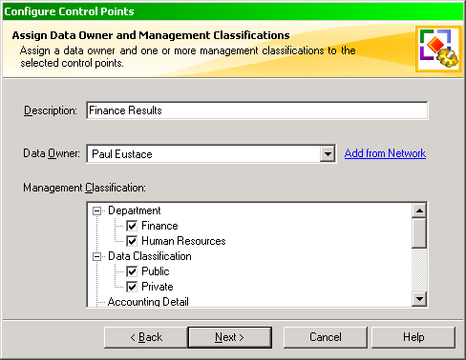
CCS Entitlement Data Owner Classes

Slide 33
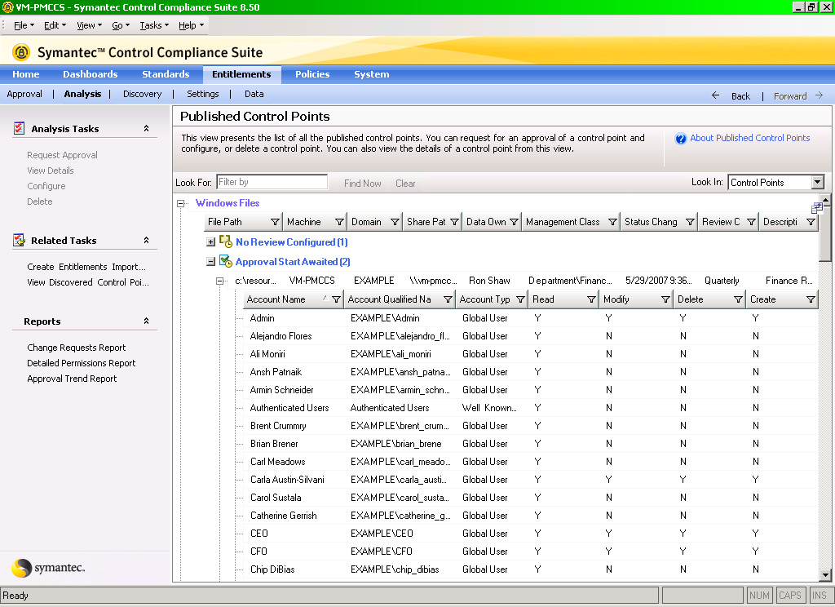
CCS Entitlement Control Points

Slide 34
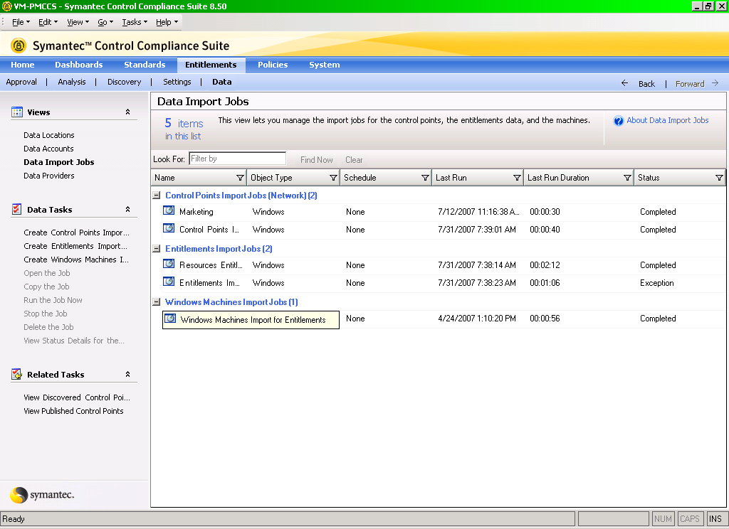
Scheduled Jobs = Data Currency

Slide 35
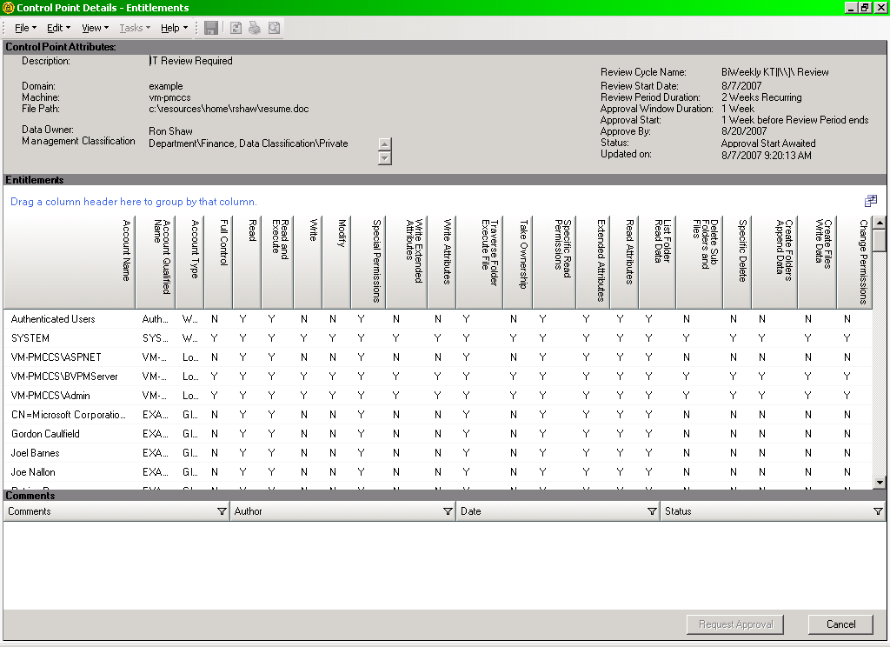
Executive-readable Entitlement Reports

Slide 36
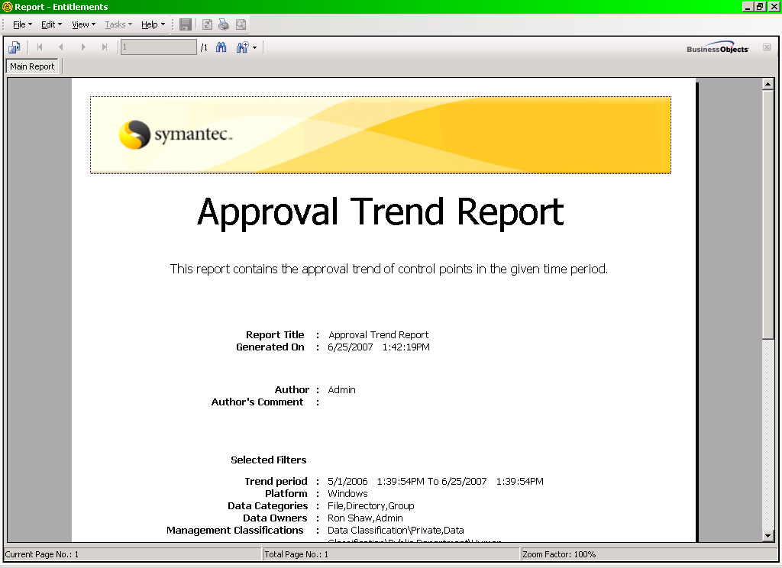
CCS Entitlement Approval Report

Slide 37
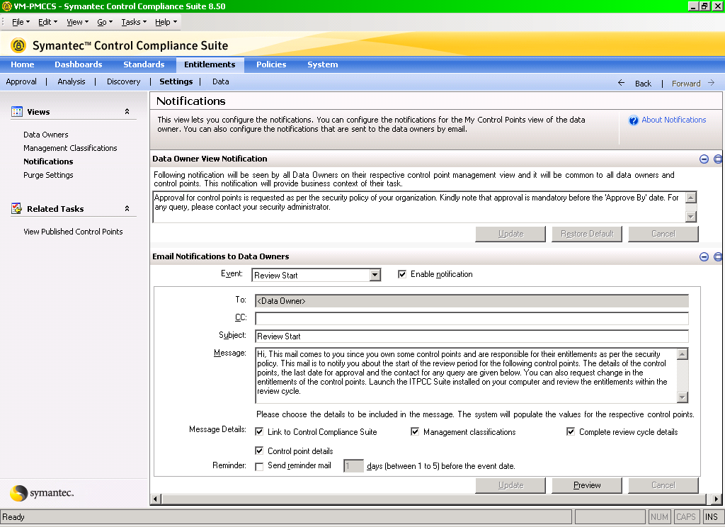
Automated Email Notifications

Slide 38
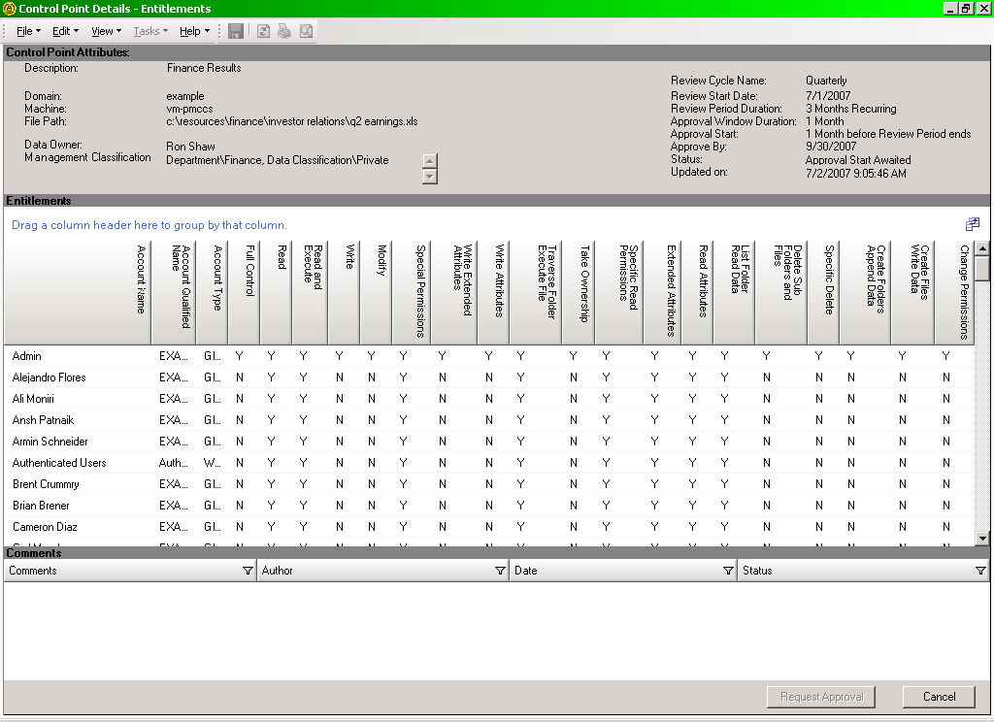
Targeted Entitlement Reports

Slide 39
Response Assessment Module
Basics:
Provides automated surveys and manual assessments to capture and track procedural controls
Enhances CCS’ ability to centralize and control the information affecting risk management, regulatory compliance and security
Advanced Analysis capabilities assist understanding
Evidence (documents, spreadsheets, computerized information) may be submitted with the survey questions

Slide 40
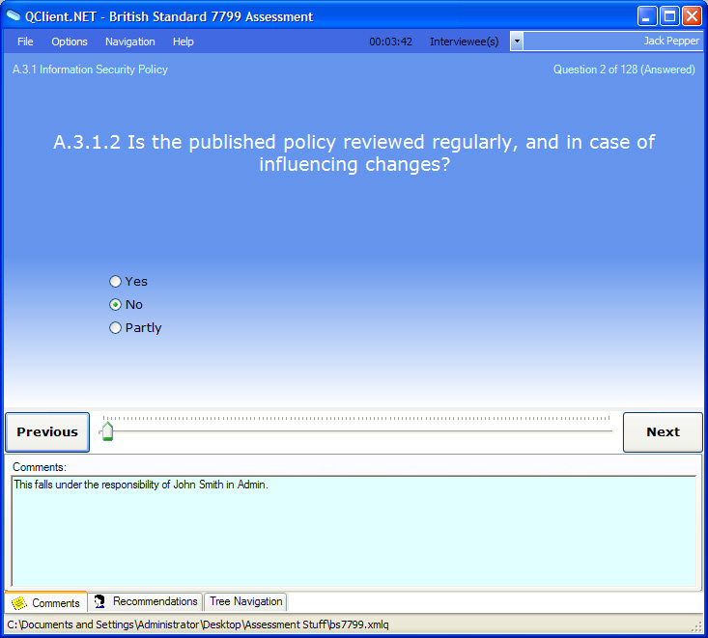
Response Assessment Module
Provides a comprehensive set of questionnaires
Allows for individual weighting of survey questions
Dramatically adds to our regulatory content
CobIT, FISMA, ISO, NERC and PCI and custom designed surveys

Slide 41
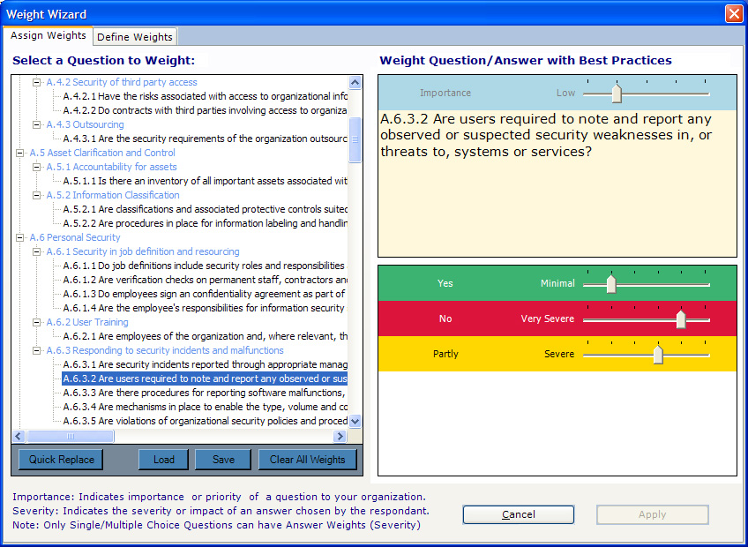
Customized Response Weights
Provides a comprehensive set of questionnaires
Allows for individual weighting of survey questions
Dramatically adds to our regulatory content

Slide 42
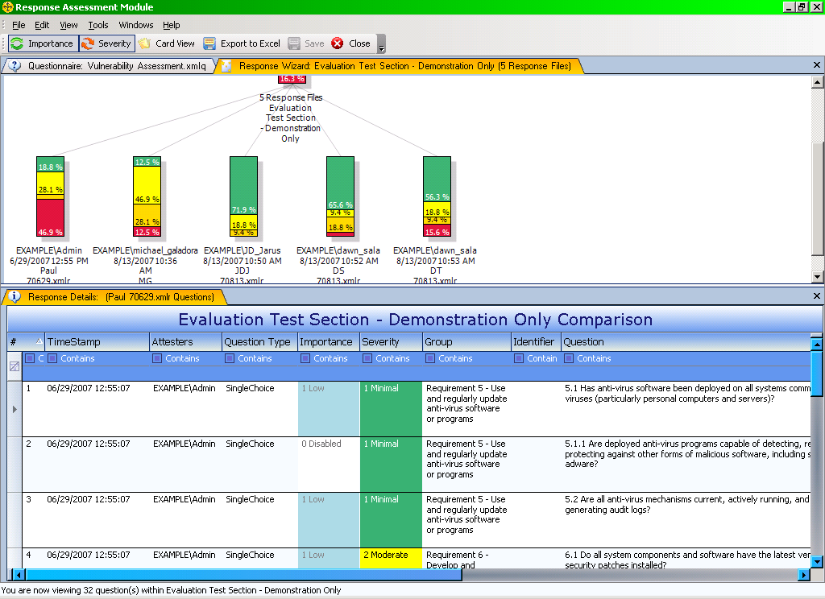
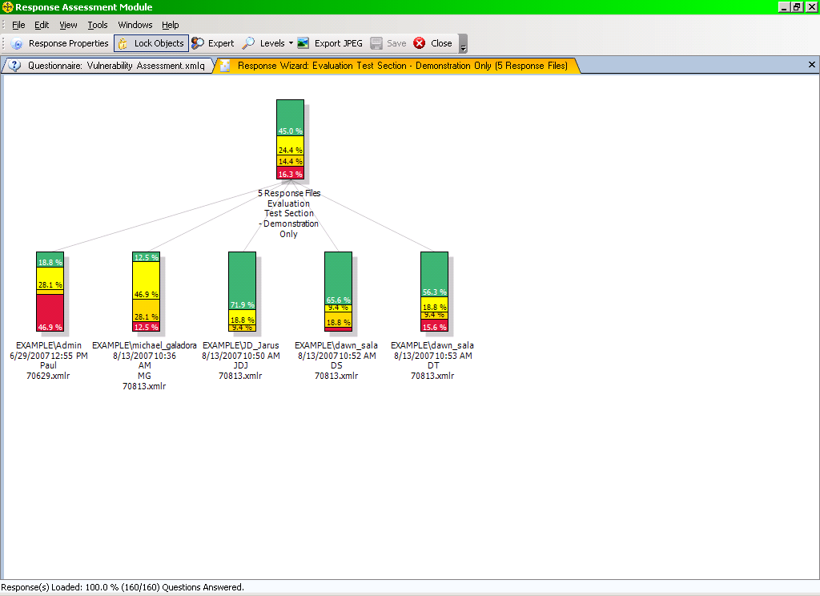
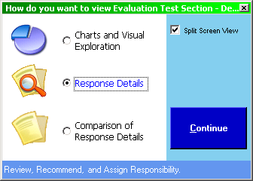

Detailed Analysis

Slide 43
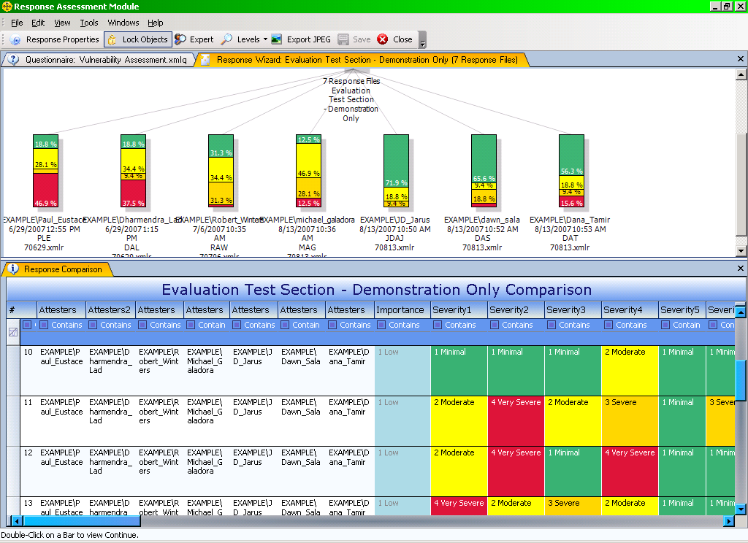
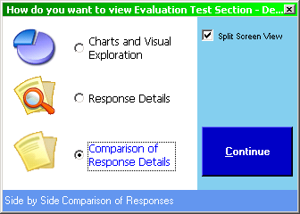

Side-by-side Comparisons

Slide 44
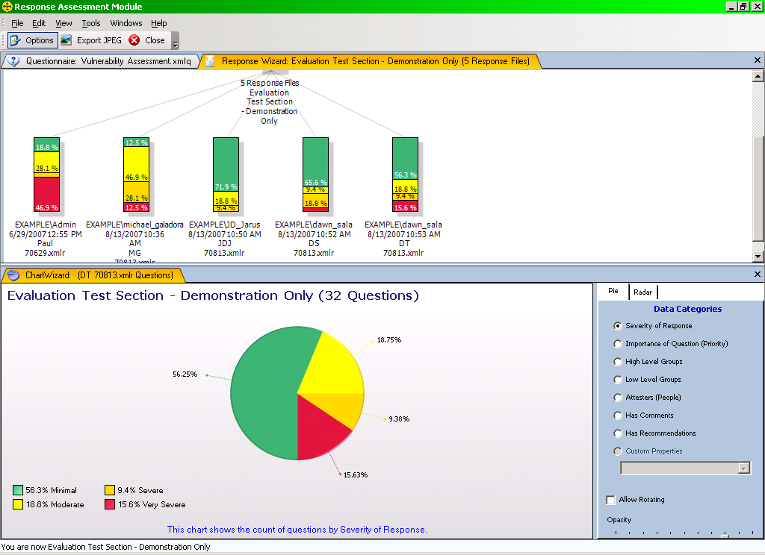
Detailed Categorical Analysis

