Slide 1


Slide 2
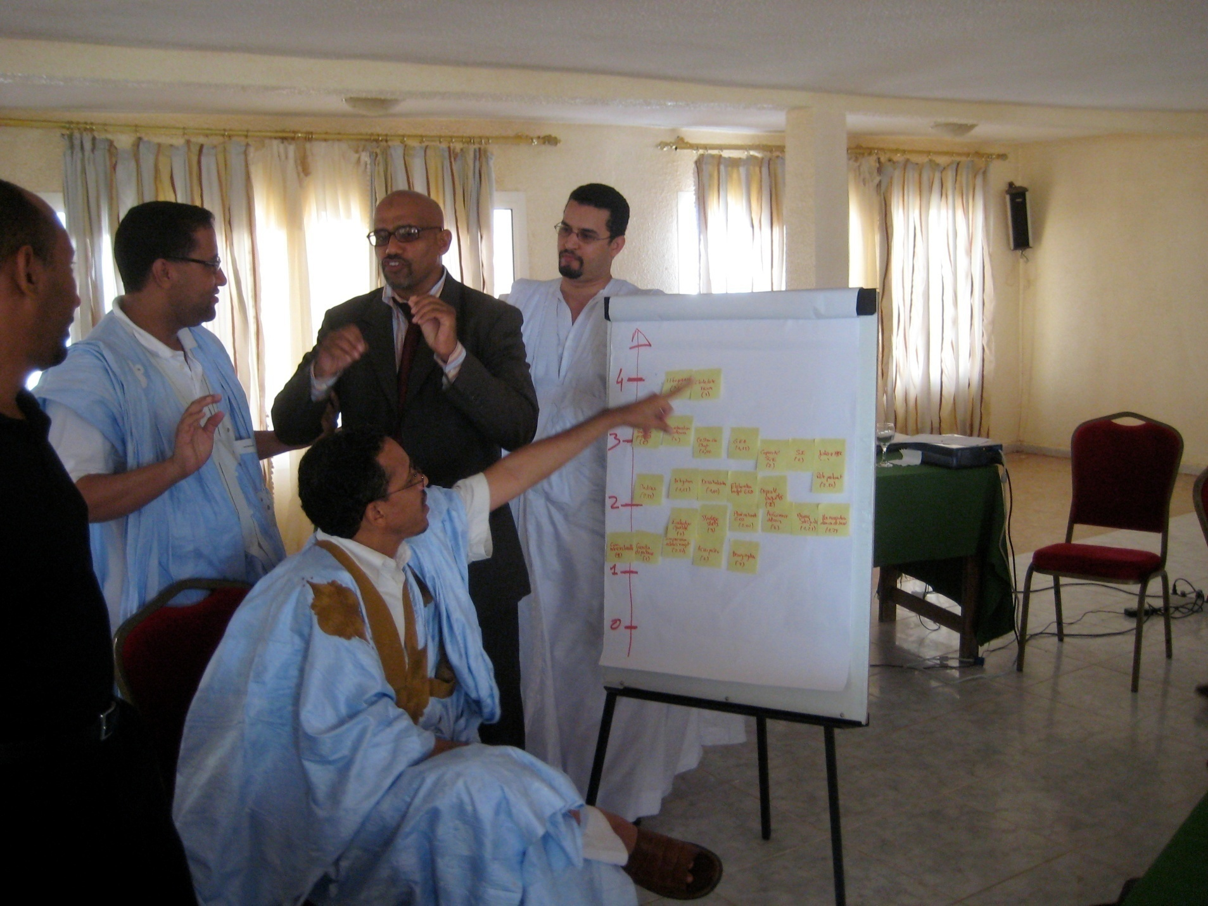
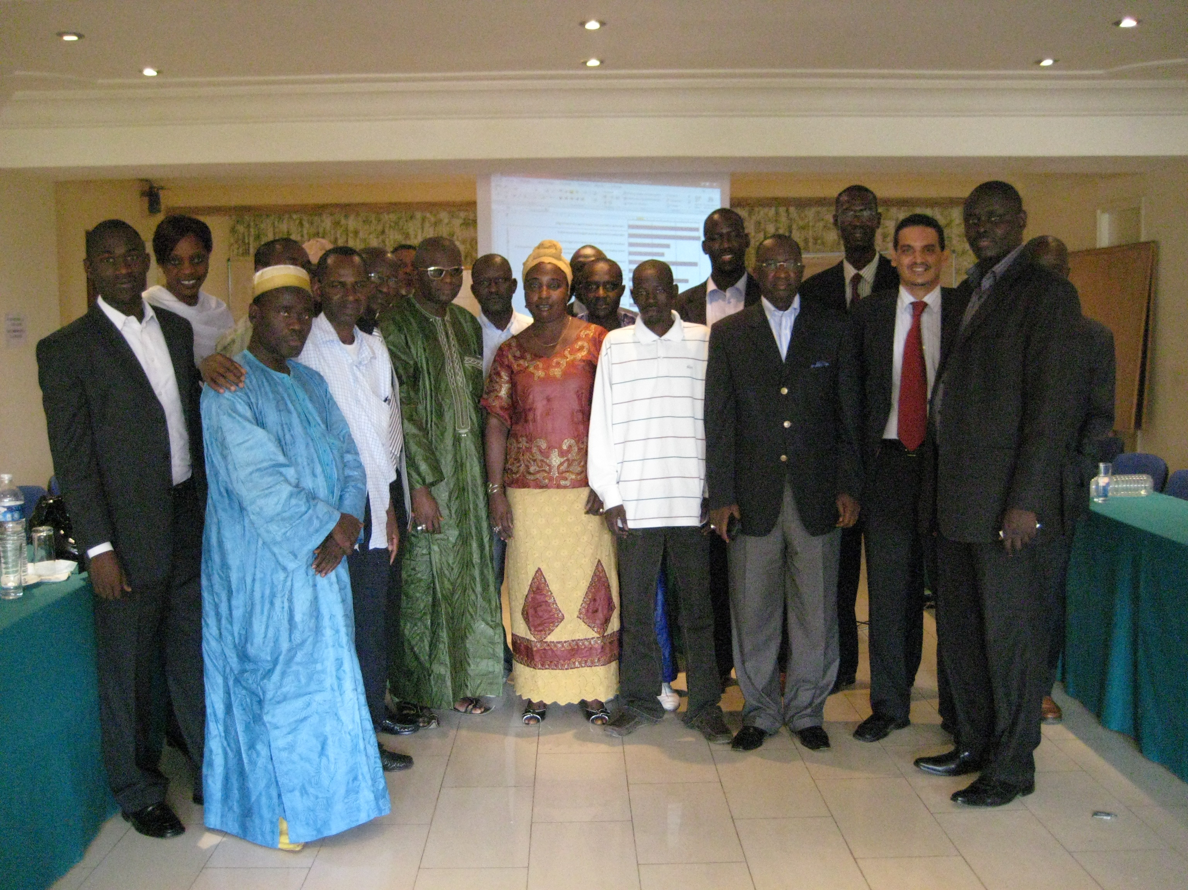
MfDR CAP-Scan
www.MfDR.org/capscan - capscan@mfdr.org
Ingwell Kuil - World Bank
Abdel Aziz Ould Dahi - Mauritania
Civil Service College, Singapore 2009

Slide 3
Guiding Principles
South-South knowledge sharing
Ongoing improvements to methodology
Theoretical: How it works
Practice: How to get it done
Realistic: Continuous effort in country

Slide 4
Managing for Development Results
Development of a results culture
Shift from focusing on inputs to performance
Evidence-based decision making
Clear goals, monitoring and evaluation
Accountability to deliver results

Slide 5
A global urgency to focus on Results
Improve development outcomes and results on the ground
Improve country systems to Manage for Development Results
Implement Results Based approaches
MDGs, Paris Declaration, Accra Agenda for Action
Korea 2011 4th High Level Forum

Slide 6
Development of CAP-Scan
Roundtable on MfDR in Hanoi (2007)
OECD/DAC Joint Venture on MfDR
Working group of AsDB, AfDB, CIDA, EC, IADB, MSI, MCC, UNDP, USAID, World Bank, partner countries
Methodological sources: UNDP: Capacity Assessment Tool; CIDA: Capacity self-assessment tool; EC: Institutional Assessment and Capacity Development; WB: PEFA; Etc.
Experiences in Mauritania, Niger, Senegal

Slide 7
CAP-Scan instrument
Broad-based, high-level, short-term, low-cost self-assessment by governments to identify strengths and capacity needs, develop actions to address resource needs, and target donor support:
A framework on development performance
Evidence-based decision-making tool
Simple and practical tool for strategic planning, risk management, and monitoring and evaluation of results

Slide 8
Scope
Focus on the five MfDR pillars:
Leadership,
Evaluation & Monitoring,
Accountability & Partnerships,
Planning & Budgeting,
Statistics

Slide 9
Matrix
Notes:
9
Here we walk through one “row” of the CAP-Scan. Read through it with the group (maybe have different folks read different cells) and explain the logic of the progression. This is to get participants thinking in the logic of the rows.

Slide 10
Process
Scope tasks
Implement improvement
Identify participants
Plan improvement
Craft process
Prioritize improvement
Adapt tools
Identify emerging & advanced aspects of MfDR
Collect data
Analyze / present results
Notes:
10

Slide 11
Products

Slide 12
Benefits for the client
Raise government consciousness of MfDR, in the local context
Help government chart its own path to MfDR
Facilitate cross-organizational cooperation
Promote participation and consensus
Map a prioritized plan for improvement with focused follow-up
Measure progress against the plan
Link with other tools
Introduction to a broad intervention post CAP-Scan

Slide 13
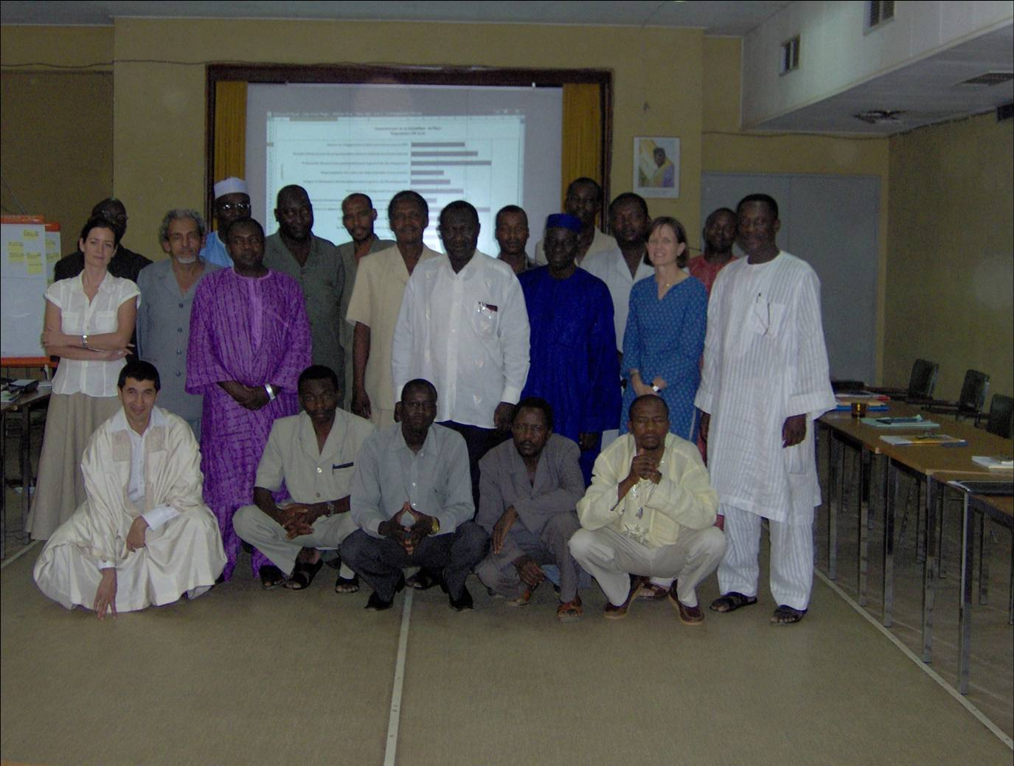
Niger

Slide 14
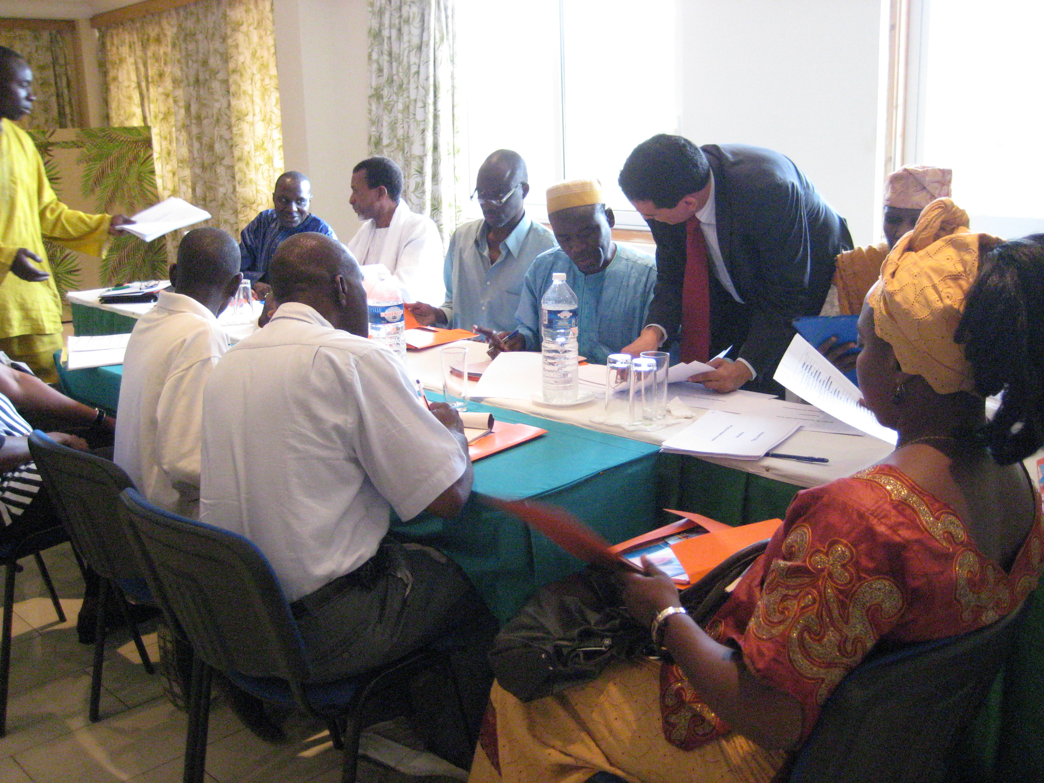
Senegal

Slide 15
Mauritania

Slide 16
Lessons learnt
Quality Assurance Team
Benchmark with non-governmental actors
Action Planning
Link to implementation
Link to other initiatives
Increasing cooperation with Regional CoPs on MfDR
Establishment of Advisory Committee

Slide 17

Rationale
Inter-sectoral character of capacities adds complexity to the search for solutions
Capacity Building was identified as a long-term goal
The CAP-Scan is an opportunity to develop an improvement plan
Self-assessment by senior government officials
Cross-cutting groups
Setting capacity building priorities
Concrete action plan that integrates existing efforts
Notes:
17

Slide 18
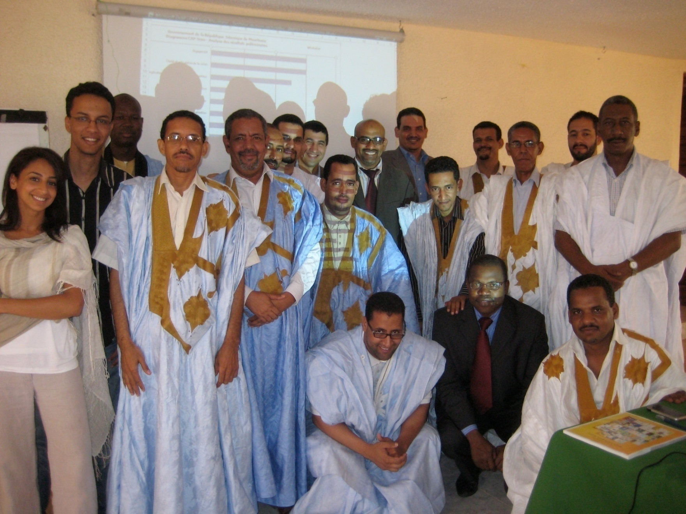
Team
Notes:
18

Slide 19
Process planning
June 30 - July 8
July 6 – 11
July 12 & 15
Sector Meetings
Self-Assessment
Group Discussion
Preparation for Working Sessions
Consolidation and synthesis
Working Sessions
Self-Assessment
Priorities
Action Plan
Monitoring
Launch
Notes:
19

Slide 20
Results per MfDR pillar

Slide 21
Results per dimension
Commitment
MfDR informs policy
Involvement of Non governmental stakeholders
Accountability and Delegation
Leadership
Donor coordination and alignment with national priorities
Linking the field and the capital
Change Management
Human Resource Management
National Development Plan evaluation systems
Monitoring and Evaluation Capacity
Data management capability
Government performance is oriented toward results
Suivi et Evaluation
Data management capability
Reporting harmonization
Judicial Independence
Legislative Oversight
Independent media
Redevabilité et contrôle
Public access to results
Budget reflects national priorities
Performance based budgeting
Internal Coordination
Processus budgétaire
Inter-sectoral Coordination
Statistics strategy
Data Disaggregation
Data quality assessment
Statistiques
Survey capability
0,00
1,00
2,00
3,00
4,00

Slide 22
Identification of priorities
Action requested
« Quick win » ?
4
Commitment
Management of
change
Budget reflects
National priorities
3
Priority = combinaison Importance, Feasibility, Urgence
Data quality
assessment
MfDR informs policy
2
No urgent action needed
Efforts without significant returns
1
Public access to information
1
2
3
4
Score of self-assessment
Notes:
22
DEFINITION DES PRIORITES
Il est impossible de couvrir tous les fronts à la fois. L’objectif est d’arriver à un consensus sur les 4-5 domaines d’action prioritaires. Les critères d’analyse sont l’importance, le score, la complexité pour chaque dimension. L’état des actions en cours entrera en ligne de compte, a priori via le critère complexité.
Le choix est un exercice complexe. Une question est par exemple de savoir s’il vaut mieux accentuer le renforcement d’une dimension déjà avancé et importante en anticipant un « effet de levier » » sur d’autres dimensions ou focaliser les efforts sur une dimension importante mais moins avancée –et généralement aussi plus complexe ?

Slide 23
Action Plan
Dimension | Programmed actions | Indicator/ Monitor-ing | Reference situation | Target situation Schedule | Financing |  |  | Resp. Exec. | Prep-aration | Exe-cution | Prior-ity | Comment/Connec-tion with existing action
 |  |  |  |  | Obtain-ed | Obtain-able | Source
Leadership
Commitment |  | CAP-Scan | 3.0 |  |  |  |  |  |  |  | 1
1.1.1 | Promulgate law organizing the monitoring and evaluation system of the CSLP | Law adopted |  | TO + 6 months |  |  |  | MEF
1.1.2 | Extend the sector CDMST: MFPMA, MPEFP, MC | No. depts. CDMT | 7 | 10 to TO + 1 yr |  |  |  | MEF/ other depart-ments
1.1.3 | Study of capacity-strengthening needs of the coordination structure for governmental action (DG of Interministerial Coordination) to ensure performance of the coordination, facilitation and support roles at the interministerial level. |  |  |  |  |  |  | MEF for submiss-ion to PM
1.1.4 | General introduction of a specialized body or unit responsible for strategic programming in the MPM and MC. | % direct/ Dept | 60% | 100% by TO + 6 months |  |  |  | Ministry submits to PM |  |  |  | Adjustment of organization charts
Clarity and articulation of vision |  | CAP-Scan | 3.0 |  |  |  |  |  |  |  | 1
1.2.1 | Make the different programming tools consistent: analysis to harmonize terminology, structure and actions. |  |  | TO + 6 months |  |  | MEF/DGCI | MEF/ DGCIM
Human Resource Management |  | CAP-Scan | 1.25 |  |  |  |  |  |  |  | 2
1.8.1 | Establishment of performance-evaluation tools for civil servants and government employees: pilot perimeter on the staff of the M&E units in the DEPs. | 3-Year Plan indicator: % of officials evaluated |  | 100% on the perimeter by TO + 1 yr

Slide 24
Action Plan and dissemination
Six priority areas were identified
Actions were developed in a full group discussion, including all key ministries
Actions focused on new action areas and refining existing projects
The Director General of the Development and Economic Cooperation of the MOF agreed to take the lead on follow-up actions
The Action Plan was disseminated to donors in-country to support the actions

Slide 25
MfDR CAP-Scan
Workshop Civil Service College, Singapore 2009
Ingwell Kuil & Abdel Aziz Ould Dahi

Slide 26
Workshop process
Use the ‘matrix’ to discuss the stage of development regarding the MfDR system in your country
Describe the main arguments of your discussion in the ‘journal’ and quantify the results
Graph the quantitative results in the ‘profile’
Prioritize the results you’ve identified in the ‘prioritization matrix’
Use the prioritization matrix to make an ‘action plan’

Slide 27
1. CAP-Scan matrix
2. CAP-Scan journal
3. CAP-Scan profile
Notes:
This presents the context, in icons, for the first chunk of work. We’re trying to get participants to realize that through this relatively painless process they are doing real data collection (the matrix), quantitative and qualitative data storage (the Journal) and analysis/presentation (the Profile)

Slide 28
3. CAP-Scan profile
5. CAP-Scan action plan
4. CAP-Scan prioritization
4
Quadrant indicating areas needing most urgent attention
MfDR Priority Ranking 3 4
M&E
Capacity
(3)
3
Public
Consultation
(3)
2
1
Results
Related to
Budget (1)
Informs
Policy (3)
Matrix Progress Scoring 2 3 4
1
2
3
4
Matrix Progress Scoring
Notes:
This slide notes that we are moving from Presentation of data (Profile) to support more analysis and decision-making (the quadrant), and planning (the MfDR Capacity Improvement Plan)

