Slide 1




HMEP Grant Program Webinar
for
Hazmat Grant Participants
October 13th, 2010

Slide 2

Grant Program History
$26.1 Million
- 2 -

Slide 3

Grant Personnel
Charles Rogoff, HMEP Grant Manager
Windy Hamilton, Sr. Grant Specialist
Crystal Catlett, Grant Specialist
Suezett Edwards, Grant Specialist
Andre White, Grant Specialist
Lisa Reichenbacher, Grant Specialist
Kyra Stewart, Sr. HMEP Grant Program Analyst
TBA, Administrative Assistant
- 3 -

Slide 4
Grant Specialist Assignments
Crystal Catlett | Suezett Edwards | Windy Hamilton | Andre White | Lisa Reichenbacher
Alaska | Arkansas | Alabama | Ely Shoshone | Connecticut
California | New York | Arizona | Fallon Paiute-Shoshone | Georgia
Delaware | Florida | Colorado | Inter Tribal | Louisiana
Kansas | Illinois | Hawaii | Council of Arizona | Michigan
Maine | Indiana | Idaho | Nez Perce Tribe | Maryland
Missouri | Iowa | Kentucky | Pueblo of Laguna | Mississippi
Nevada | Massachusetts | Minnesota | Reno Sparks | Nebraska
North Carolina | Oregon | Montana | Saint Regis Mohawk | New Jersey
Oklahoma | Texas | Ohio | San Manuel | North Dakota
Tennessee | New Hampshire | Pennsylvania | Seminole Tribe | South Carolina
West Virginia | New Mexico | Rhode Island |  | Vermont
 | Utah | South Dakota |  | Virginia
 | Wisconsin | Washington | Int. Association of Fire Fighters | Wyoming
District of Columbia | Guam |  | Int. Association of Machinists | Virgin Islands
American Samoa | Puerto Rico |  | Int. Brotherhood of Teamsters
Northern Mariana Is. |  |  | Int. Chemical Workers Union
 |  |  | National Labor College

Slide 5
Grant Schedule
HMEP
Grant Program
Timeline by Month
s
Application Schedule
n
s
i
g
n
e
o
B
i
t
u
s
a
t
s
c
e
e
i
l
R
c
p
r
o
p
o
r
A
f
n
P
r
e
o
n
o
f
Sept. 30th - HMEP Grants Awarded*
i
i
e
l
t
d
a
n
a
c
i
i
l
e
l
d
D
p
a
p
e
-
A
D
t
-
-
s
t
t
1
s
s
.
3
l
1
1
c
i
e
e
r
n
D
p
u
A
J
April
May
June
July
August
September
October
November
December
January
February
March
A
J
S
p
u
e
r
n
p
i
e
t
l
1
1
.
3
s
s
0
t
t
-
t
-
2
3
h
-
n
r
d
d
4
Q
t
Q
t
h
t
r
Q
r
S
t
S
F
r
F
-
S
-
4
F
4
2
-
2
5
4
5
D
2
D
u
5
D
u
e
u
e
e
Grant Activity Schedule
NOTE: Prior year grants must be successfully closed out which includes the submission of a final report before new grant funds will be disbursed.

Slide 6

Program Requirements
Forms
SF-270s (Reimbursements)
Quarterly SF-425s (Federal Financial Reports)
Final Report (Narrative, SF-425 & Questionnaire)
www.whitehouse.gov/omb/grants_forms

Slide 7



Eligible Activities Ineligible
• Multi-Agency Hazmat Drills-includes Hazardous Materials Spill Drills and Hazmat Tabletop Exercises
• Hazmat Technician Training
• Hazmat drills and exercises to test State and County emergency response
capabilities and to identify gaps in training and planning needs
• Hazmat IQ System
• Incident Command
• General Hazmat Public Awareness
• Hazmat decontamination in a hospital setting
• Emergency Operating Center (EOC) Leadership Exercise
• Request for multi-year funding
• National Incident Management System (NIMS) courses
• All-Hazards training courses

Slide 8



Grantee Resources & Outreach
Web Site
www.phmsa.dot.gov/hazmat/grants
Webinars
Site Visits
Hazmat Grant Portal
https://hazmatgrants.phmsa.dot.gov

Slide 9
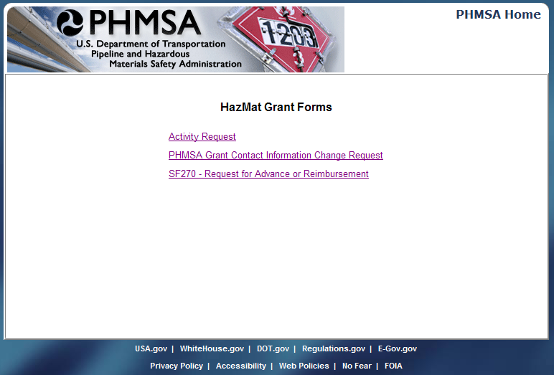
Data Entry Tool - Home Page

Slide 10
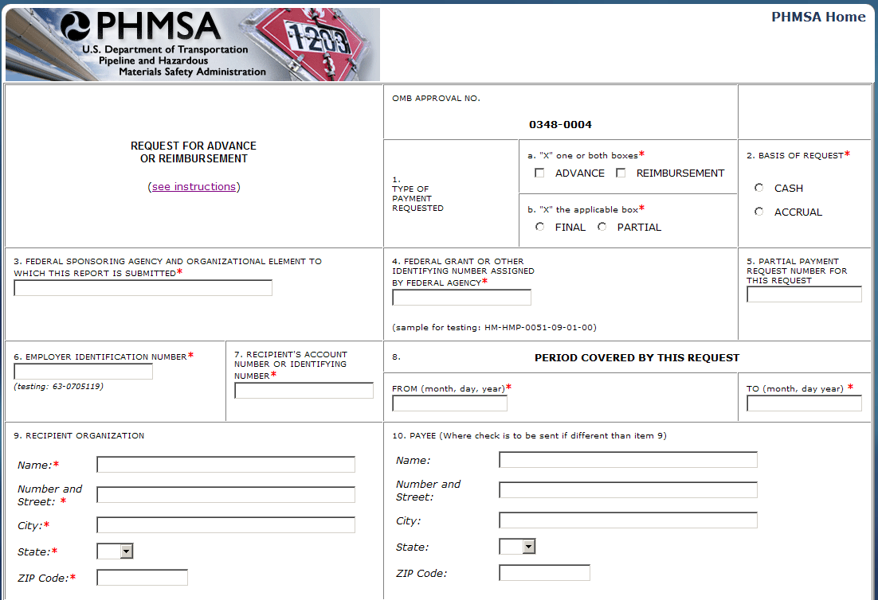
Data Entry Tool – Submission Form

Slide 11

Future Requirements
FFATA for the Sub-Grantee
www.FSRS.gov
DOT Payment System
iSupplier
Updated Final Report

Slide 12
OMB Sub-Grant Award Reporting
Due to the FFATA mandates, OMB is requiring federal grant reporting data to include information concerning sub-grant awards
Prime awardees will be required to:
report first-tier sub-awards associated with Federal contracts and grants as of Oct. 1st, 2010
Report executive compensation for new Federal contracts and grants as of Oct. 1st, 2010 (exceptions on next slide)
Register in the Central Contractor Registration (CCR) system, using the same DUNS under which the grant was awarded
Sub-Grantees are required to provide the information within 30 days of their award

Slide 13
Guidance for Sub-Award and Executive Compensation Reporting
Sub-Awardee data will be gathered by the Prime Awardee and submitted to www.FSRS.gov. The data that will be gathered will include:
Name of entity receiving award
Amount of award
Award information including
Transaction type
Funding agency
NAICS code or CFDA number
Program Source
Descriptive award title
Location of entity receiving award
Primary location of Performance, including city, State, and congressional district
Unique identifier (DUNS #) of entity receiving award and the parent entity (if applicable)
Names and total compensation of the five (5) most highly compensated officers, IF
The entity in the preceding fiscal year received 80 percent or more of its annual gross revenues in Federal awards , and
The entity received $25,000,000 or more in annual gross revenues from Federal awards, and
The public does not have access to this information through periodic reports filed with the SEC or IRS.

Slide 14
‘09-’10 Hazmat Grant Disbursements
Grant Funds Utilized
Percent Utilized
Qtr (FY10) | States ($15M Allocated) | Tribes/Territories ($.49M Allocated) | Unions (HMIT/IAFF) ($5M Allocated) | Total Utilized
Q1 | $535,846.00 | $0 | $0 | $535,846.00
Q2 | $974,072.76 | $0 | $864,672.82 | $1,838,745.58
Q3 | $2,043,986.39 | $144,224.00 | $611,909.87 | $2,800,120.26
Q4 | $2,942,278.18 | $33,538.21 | $270,247.58 | $3,212,525.76
Q1 | N/A | N/A | N/A | N/A
Total Utilized | $6,496,183.33 | $177,762.21 | $2,746,830.27 | $9,420,775.81

Slide 15

Questions
HMEP.Grants@dot.gov
www.phmsa.dot.gov/hazmat/grants
(202)366-1109

