Slide 1
Technology: Is it Eating Away at Professionalism?
Adam Parnes
Manager Employee Communications and Development
NRECA

Slide 2
Today’s Agenda
Is social media a fad?
What is social media and who’s using it?
How will we manage?
Society for Human Resource Management (SHRM) headlines
How to deal with social media at work
How co-ops are using social media
Notes:
I plan to cover the basics of what social media is and isn’t. Is it a fad? How many people are using the top three sites?
How we will manage in time with four unique generations in the workplace?
I’ll highlight some of the perceived pitfalls of social media in the work place with the help of SHRM
I’ll share how we can better deal with social media at work
Then I’ll conclude with how co-ops are using social media
Throughout the presentation I’ll be asking you all questions about how you use social media, how your co-ops manage social media how you’ve dealt with employee relations issues related to social media.
On to our first question. Is social media a fad?

Slide 3

Notes:
Is social media a fad?

Slide 4
What is Social Media?
Networking Sites:
Facebook, LinkedIn, Plaxo, MySpace
Location:
Foursquare, Places, Gowalla, MyTown
Multimedia Sharing Services:
YouTube, Vimeo, flickr
Review & Opinion Sites:
Yelp, Yahoo, Amazon
Blogs:
WordPress, Blogger, TypePad, Tumblr
Microblogs:
Twitter, FriendFeed, Yammer
Notes:
Wikipedia’s definition: Social media are media for social interaction, using highly accessible and scalable communication techniques. Social media is the use of web-based and mobile technologies to turn communication into interactive dialogue.
Social media can be broken into five segments

Slide 5
Are you using social media?
Are you a member of a social network?
What social sites do you use?
How do you use your networks?
Do you have and use a mobile phone?

Slide 6
Facebook
More than 500 million active users
50% of active users log on to Facebook everyday
Average user has 130 friends
Average user creates 90 pieces of content each month
200 million active users currently access Facebook through their mobile device
Notes:
Facebook would be the third largest country by population in the world

Slide 7
Twitter
200 million users
140 million tweets a day
500,000 accounts added daily
Notes:
Twitter would be the fifth largest country by population in the world

Slide 8
LinkedIn
Over 100 million members
In 2010, executives from every Fortune 500 company could be found on LinkedIn
68% of users are over the age of 35
74% of all users have a college degree or better
Notes:
LinkedIn would be the 12th largest country by population in the world

Slide 9
Notes:
How will we manage?

Slide 10
Recent SHRM Headlines
“Colleges, HR Experts Wonder: Is Technology Eroding Professionalism?” Aliah Wright 2/3/11
“Report: Social Media Can Disorient Employees” Kathy Gurchiek 11/15/10
“Study Links Hand-Held Devices to Poor Workplace Manners” Howard Mann 2/23/10
“Twittering and Facebooking While They Work” Jennifer Taylor Arnold 12/1/09

Slide 11
What’s your experience with social media at work?
Does your co-op have a social media policy?
Have you had an employee relations issue related to social media?
How was it handled?

Slide 12
Dealing with New Technologies at Work
Create a policy to explain your co-op’s expectations of usage
Banning usage is impractical and unrealistic
Ensure employees understand employer expectations
Communicate technology use policy
Consistently hold employees accountable
Resources
Cooperative.com >> Communications >> Social Media >> Policies and Plans

Slide 13
How are co-ops using social media?

Slide 14
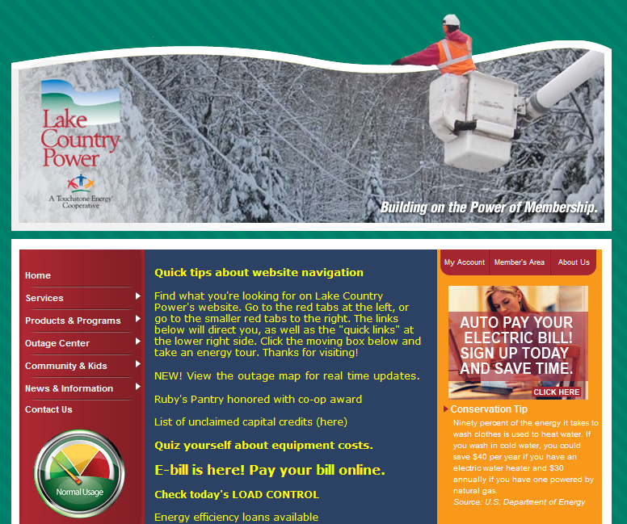
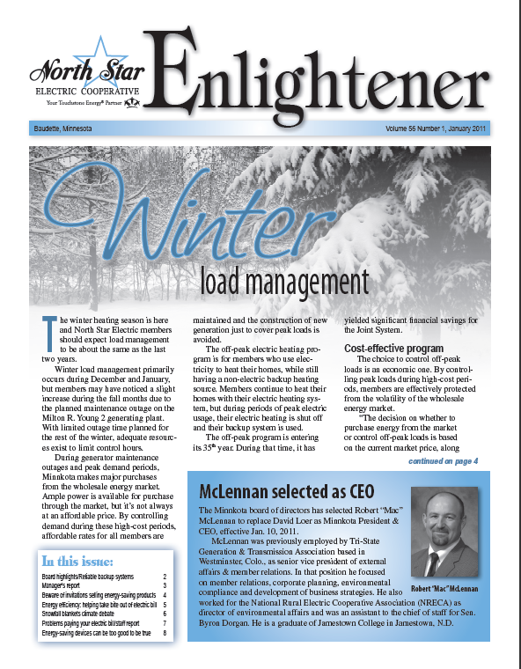
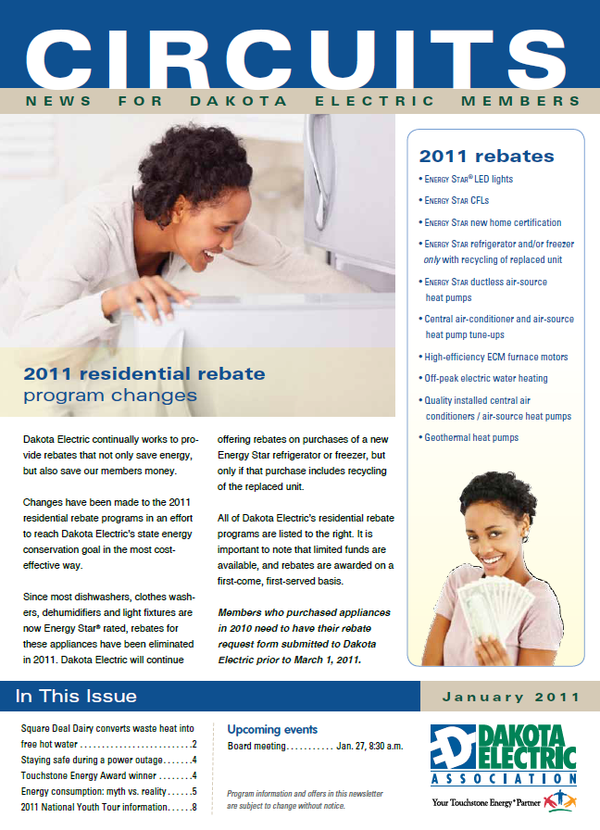


Old Communications Reality

Slide 15
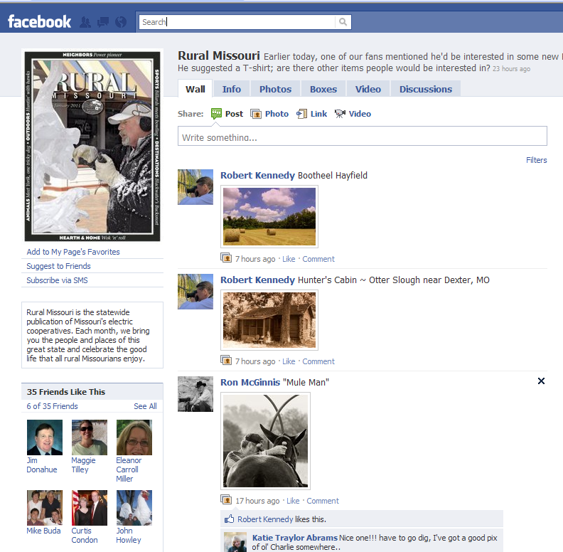
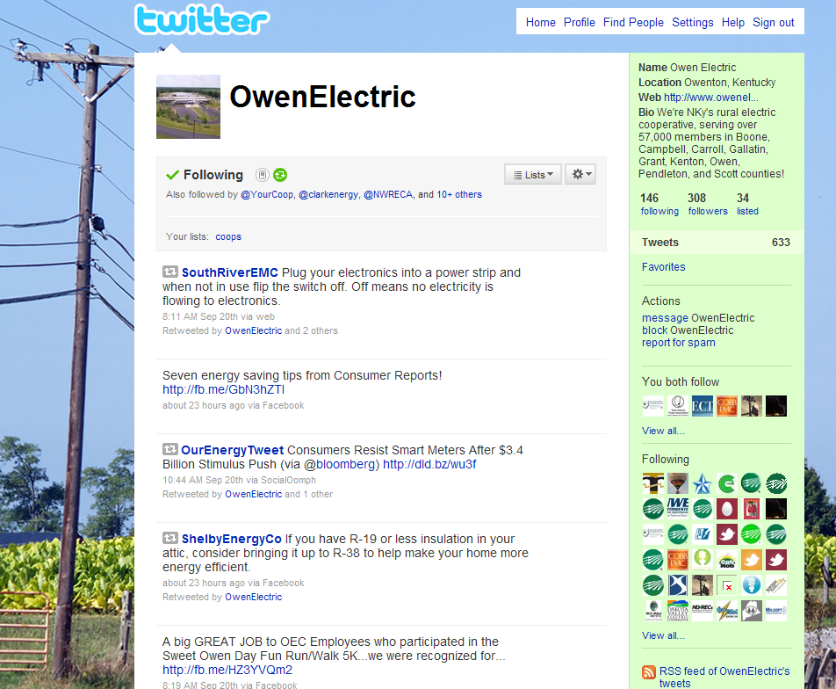
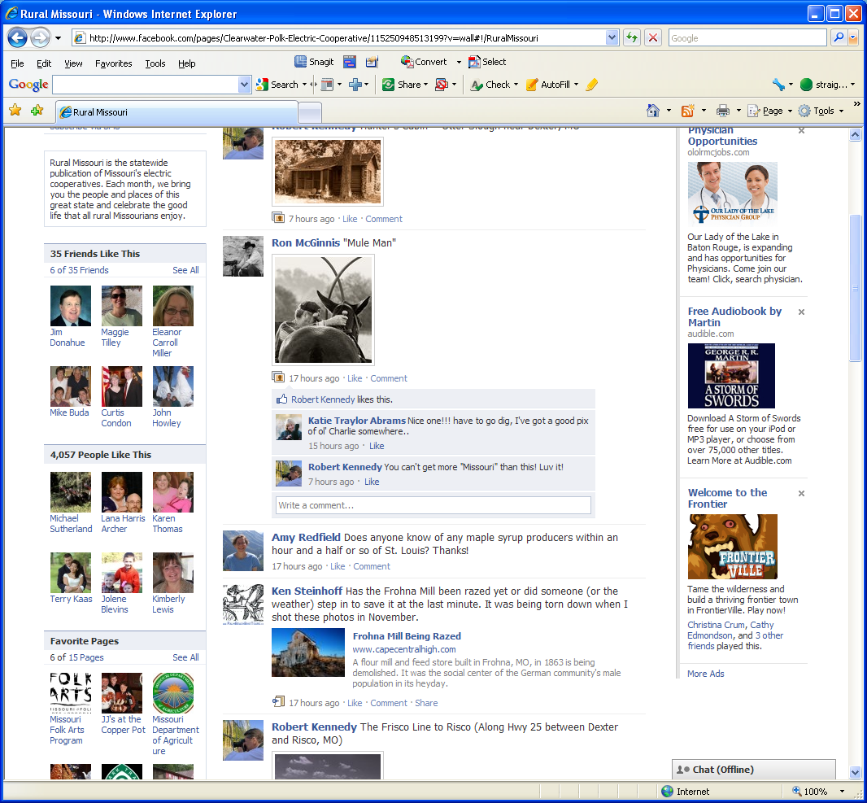
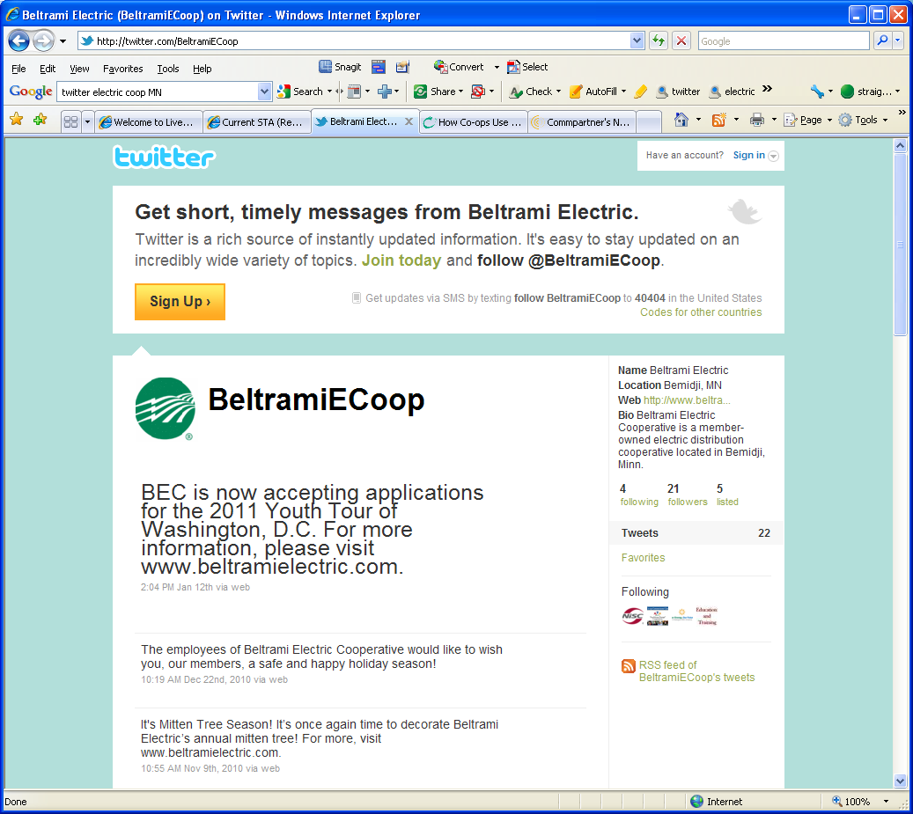
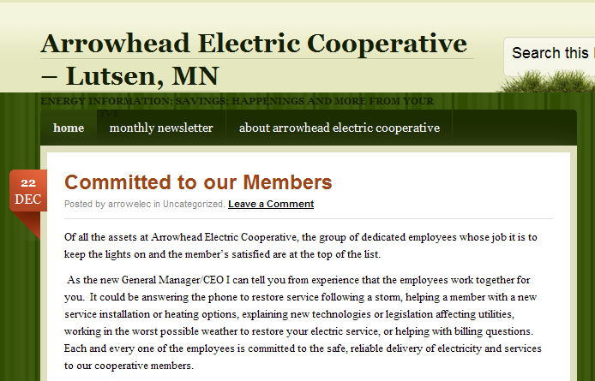




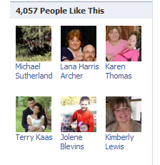




The New Reality

Slide 16
Cooperative Difference Survey 2009
Do you participate in Social Networking Websites?
% Indicating “Yes”
68.9%
42.8%
55.6%
40.9%
31.4%
21.2%
65+
National Benchmark

Slide 17
It’s about being where members are…
2009 NRECA Market Research Services, Survey of 300+ co-ops

Slide 18
How Co-ops Use Facebook
Outage/Restoration Updates and Planned Outages
Promote Youth Programs
News (co-ops, national)
Event Promotion (Annual Meetings, Community Events)
Member Questions/Answers
Promote Operation Round Up/Other Charities
Incentives (Rebates, Discounts)
Legislative Call to Action
Trivia Questions
Demand Alerts
Share Photos, Videos
Social Media ‘One-Stop Shop’

Slide 19
How Co-ops Use Twitter
Outage/Restoration Updates
Demand Alerts
News Links
Member Question/Answers
Widgets on Websites for Instant Updates
Often Co-ops tie Tweets to Facebook accounts, sharing the same information

Slide 20
How Co-ops Use flickr and YouTube
Flickr
Community Event Pictures
Lineman’s Rodeo Albums
General Press Images
YouTube
How-To’s
Press Releases
Plan/Co-op Tours
Efficiency Tips
Safety Tips
CEO Messages

Slide 21
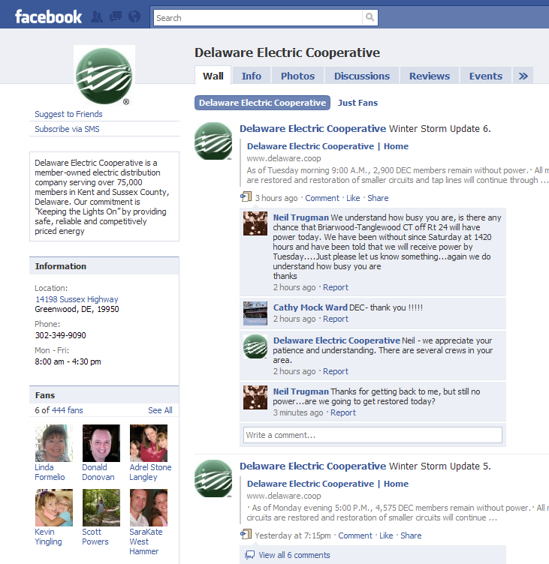
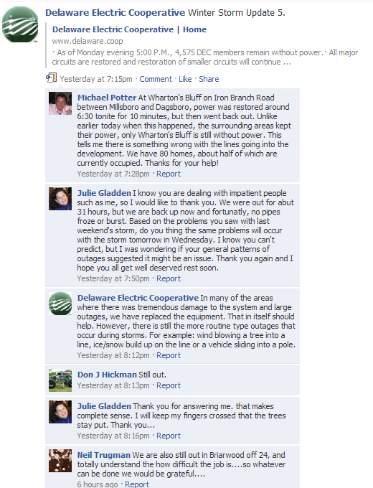
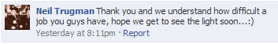
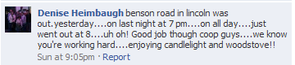
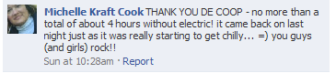

Slide 22
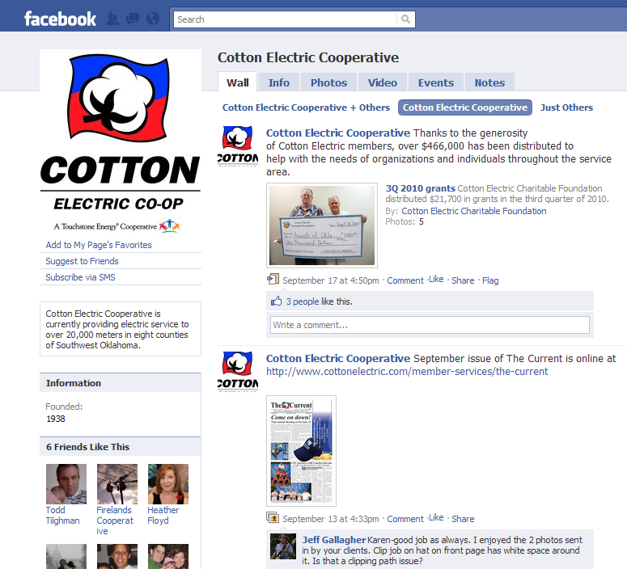
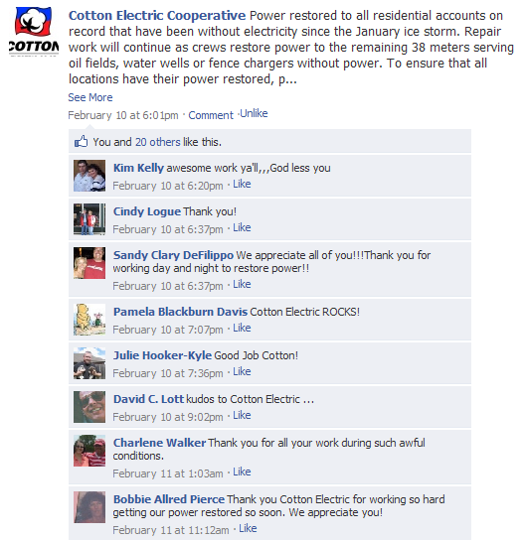
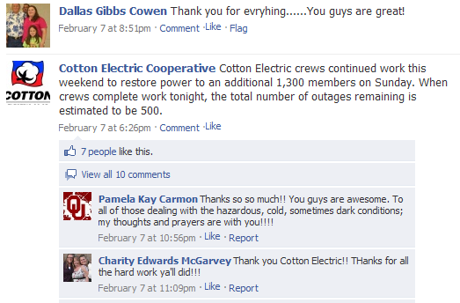
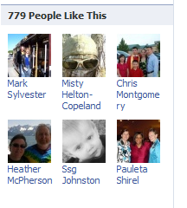

Slide 23
Easy Ways for Staff to Listen
Google Alerts: Sends email alerts (immediately, daily or weekly) whenever your keyword(s) appear anywhere online except Twitter. You can narrow the search to blogs, videos, or news items. www.google.com/alerts
NutshellMail: takes copies of all your latest updates in your social networking accounts and places them in a snapshot email. www.nutshellmail.com

Slide 24
Questions?
Thoughts about social media?

Slide 25
Adam Parnes
Email: adam.parnes@nreca.coop
Phone: 703.907.5988
Facebook: facebook.com/adamparnes
Twitter: @adamparnes
LinkedIn: linkedin.com/in/adamparnes

