Slide 1
Implementation of User Fee Charges at Primary Care Facilities: Adherence and Implications for Users and Facility Revenue
Antony Opwora
Evelyn Waweru, Mitsuru Toda, Tansy Edwards, Greg Fegan, Abdisalan Noor, Sassy Molyneux, Catherine Goodman
AfHEA Conference, Dakar Senegal
March 16th, 2011

Slide 2
Background
Universal access to health and MDGs:
Reduce financial burden on patients for equity
Major challenge for peripheral facilities:
Accessing funds through the district health system
PETS reports: 40% of resources do not reach them
User fees is an alternative funding source that is widely adopted
BUT..... user fees have documented negative impacts, especially for the poor
Calls for their removal/reduction in developing countries
Notes:
Reduction of financial burden on patients is one of the strategies in promoting universal access to equitable health services, and in a way contributes to the achievement of MDGs
A Majority of the poor in rural areas access health services at peripheral health facilities, but these facilities have a challenge in as far as accessing funding is concerned, especially through the district system. And this is exemplified by reports which show up to 40% of allocated funds do not reach these facilities.
3. The facilities are therefore forced to resort to User fees as an alternative source of funding. These have been widely adopted in many developing countries
4. But user fees impose well-documented negative impacts on users, and especially if the users are poor in rural areas (impoverishing and catastrophic expenditures)
5. There have therefore been wide-spread calls for their removal

Slide 3
Background...2
User fee reduction policy (10/20 Policy) was adopted in Kenya in 2004
Concerns that implementation of the policy is far from perfect
District level studies show that users continue paying high and variable fees for services
Drug shortage, declining revenue, poor policy design and implementation processes
National picture on adherence is warranted in view of planned direct funding to peripheral facilities
Main objective
Present a national picture on adherence to official user fee policy and make recommendations for implementation of future policy
Notes:
Kenya adopted a user fee-reduction policy called 10/20 policy in 2004, policy standardized fees payable by users in all primary facilities (10 in disps and 20 in hcs)

Slide 4
Study Design
Cluster randomized sample of facilities
Randomly selected 24 districts
Three non-municipal districts per Province (excl. Nairobi) and 3 municipal districts
Randomly selected sample of facilities in each district, stratified by facility type
Up to 7 health centres and 7 dispensaries in each district

Slide 5
Data Collection
Fieldwork: July – September 2010
Structured survey at each facility
Interviews with facility in-charge (n=248)
Records review of financial records (n=244)
Exit interviews with 3 outpatients seeking curative care (n=698)
Data entered directly onto mini-laptops
Notes:
Data collected: late July – September 2010
2. Structured survey at each facility:
-Interview with facility in-charge (n=248)
-Records reviews of HMIS and financial records (n=244)
-Exit interviews with 3 outpatients seeking curative care (n=698)

Slide 6
Data Analysis
Analysis done using StataTM v. 11
Used svy commands to account for:
Variation in sampling probability
Stratification by province and facility type
Clustering at the district and facility level
Notes:
1. Used Stata v. 11 for cleaning, recoding, and analysis
2. Defined study design using <svyset> commands to account for:
-Variation in sampling probability across facilities using pweights
-Stratification by province and health facility type
-Clustering at the district and facility level

Slide 7

Results

Slide 8
User Fee Policy
Known locally as the “10/20 Policy”
All services at Dispensaries cost KES 10, and at Health Centres KES 20
Exemptions:
All under five services
ANC
Special Conditions: Malaria, STIs + AIDS, TB
Delivery
Not clear: Registration/Card and Laboratory fees

Slide 9
Adherence to User Fee Policy (excl. patient card fees)
Notes:
1. Based on in-charge responses (excluding the purchase of patient cards), compliance with policy was lowest for adults with gonorrhea (4.3%) and adults with malaria (4.2%), and highest for adults with TB (62.2%). Approximately half of facilities reported compliance with policy for children with malaria (43.0%) and pneumonia (53.7%).
2. Compliance for ANC and delivery, for those facilities offering these services, were 22.3% and 33.7% respectively.
3. No facilities adhered to user fee policy across all the cases investigated.

Slide 10
Adherence to User Fee Policy (excl. patient card and lab fees)
Notes:
If laboratory fees were excluded from stated user fees (since it is unclear whether these should be considered part of the official fee), adherence to all user fees remained at zero, with similar patterns of adherence across age and illness groups as with laboratory fees.

Slide 11
User Payments
74.7% had paid for services that day (median Kes.30)
5% owed the facility some money for treatment received
Under 5 years old: median Kes.25
Over 5 years old: median Kes.20
24.9% needed to purchase additional medical supplies at a later stage, primarily drugs
Notes:
Poor user fee adherence rates are supported by patient information on how much they had paid for the day’s service by the time of discharge.
Almost three quarters (74.7%) had paid some money to receive services on the day of interview. The median amounts paid for patients aged above 5 years was KES 30, ranging from KES 20 in municipal health centres to KES 70 in municipal dispensaries
Five percent of all interviewees owed the facility some money for the treatment they had received on the interview day (median debt in those aged over 5 years of KES 20, and for those aged under 5 KES 25).
A quarter of all the interviewees were required to purchase additional medical supplies at a later stage, primarily drugs (91.9%).

Slide 12
Patient Card and Lab Fees
Where patient card purchase was required, the median cost was 20 KES for all cases
Lab fees varied:
Delivery was median 350 KES and adults with TB was median 300 KES, though rarely charged
More frequently charged were lab fees for first ANC visits (median 240 KES)
Notes:
1. Where patient card purchase was required, the median cost was 20 KES for all cases
2. Laboratory fees varied depending on the type of services patients sought
-The highest charged was for delivery (median 350 KES) and adults with TB (median 300 KES), though rarely charged
-More frequently charged were lab fees for first ANC visits (median 240 KES)

Slide 13
Facility Expenditure of All Revenue
82.0% of the facilities received income from user fees (Median income US$ 683; IQR 115 – 2,091)
Notes:
This graph also includes funds from other sources other than user fees

Slide 14
Importance of User Fees
Two thirds of support staff paid by user fees
Notes:
82.0% of the facilities receive income through user fees (Median of 52,050 KES annually) and currently there are hardly any other sources
Median income was US$ 683; IQR 115 – 2,091 (Oanda Historical Exchage Rates: Average Exchange rate for 2010 1US$=76.19)
2. Nearly all facility income was user fees, including patient cards and labs

Slide 15
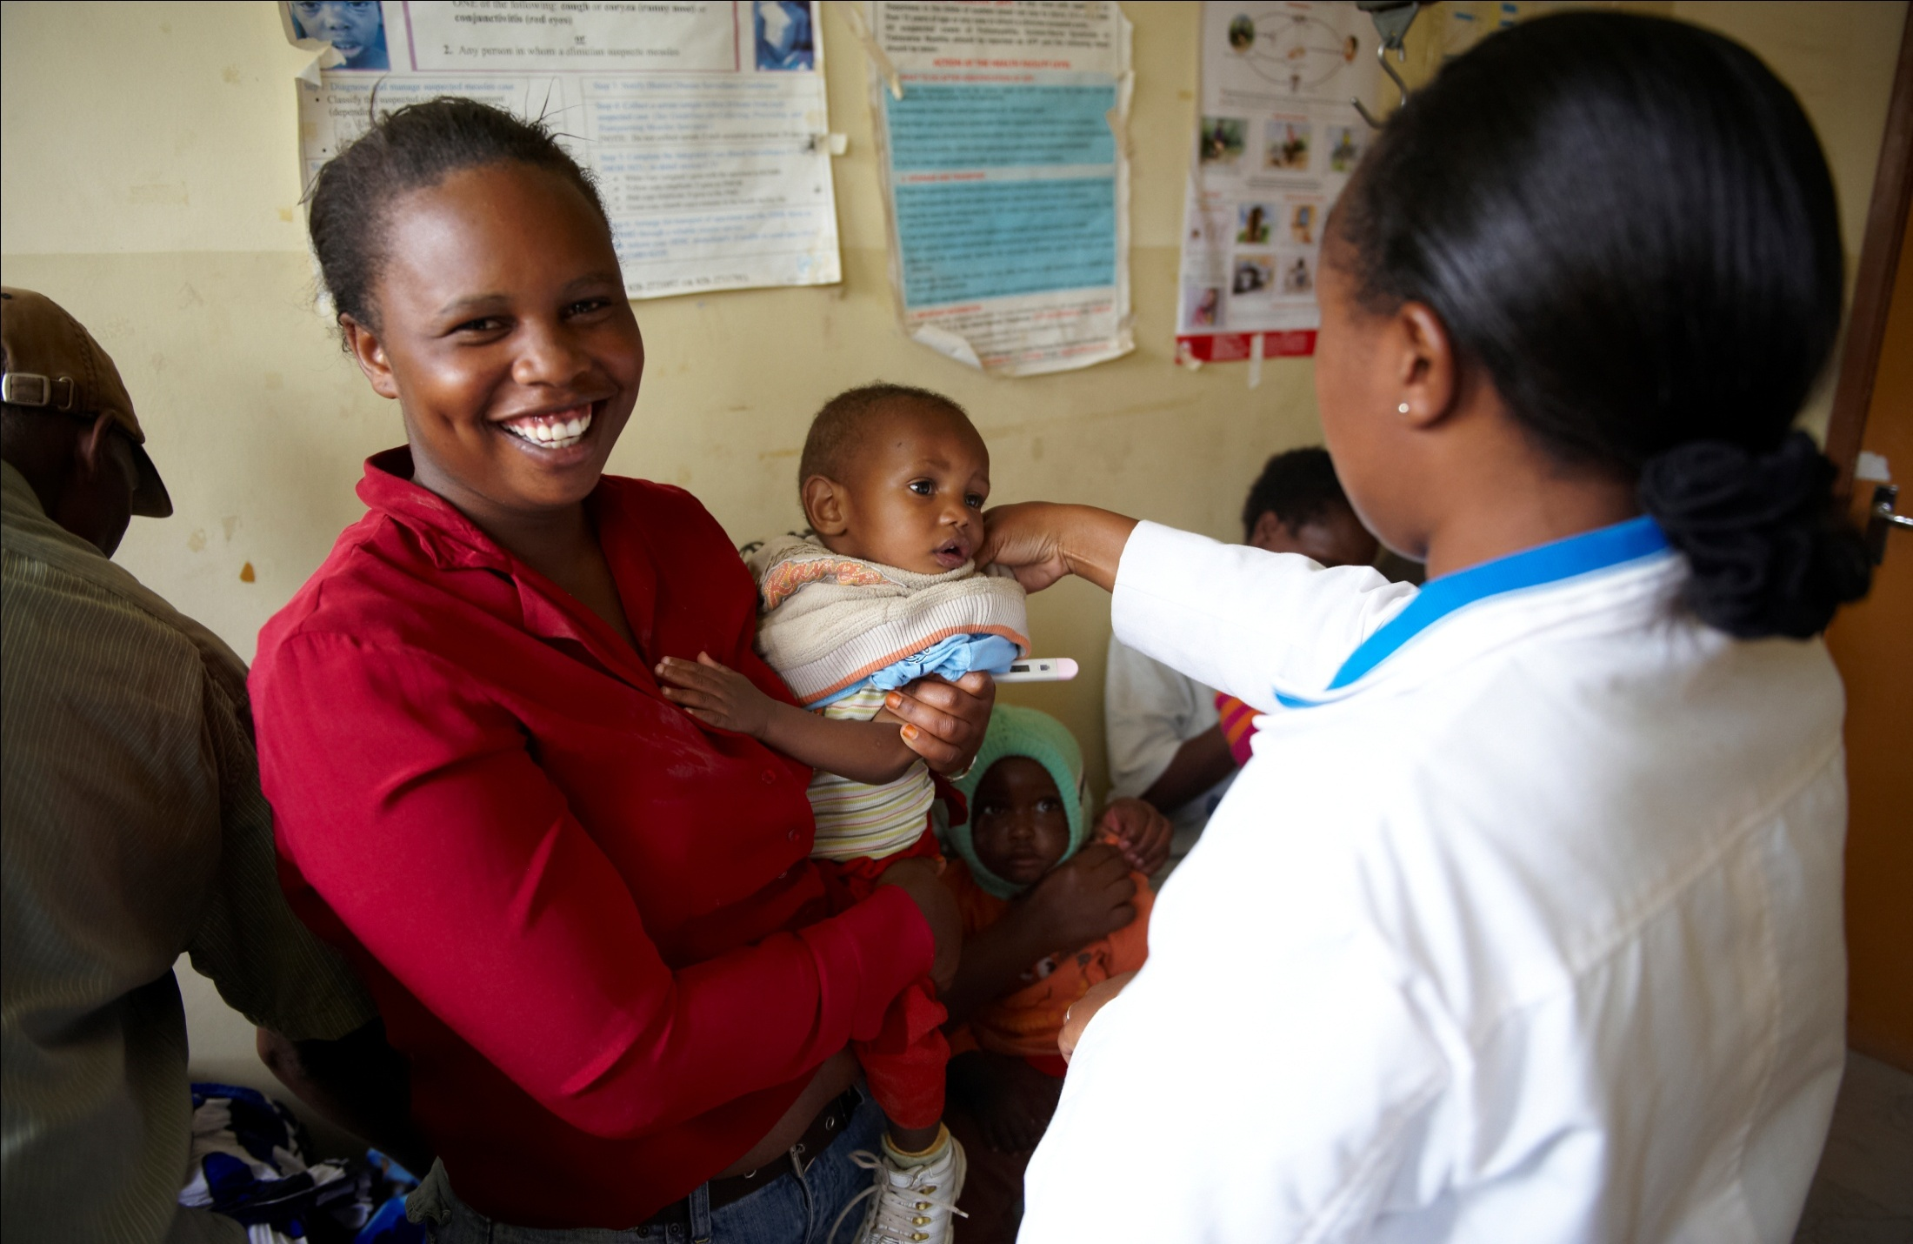
Discussion

Slide 16
Implementation of Direct Funding
Direct funding through Health Sector Services Fund (HSSF) has been established by government of Kenya
Funds credited directly to each facility’s bank account starting in October 2010, after a successful pilot in Coast
Fund managed by the facility committee (HFC)
HSSF disbursed US$ 570 to each health centre to cover one quarter
Equivalent to a year’s median income for all facilities
Significant if intended to replace user fees
Current status of HSSF - Partial roll-out
October 2010 – in most health centres
Planned for July 2011 – a subset of dispensaries

Slide 17
Conclusion
Operations of primary health facilities are hugely supported by user fees
Adherence to official user fee policy is very low
Users incur additional expenses beyond the user fees paid
Direct funding may have the potential to ease the financial burden on users, only if adherence to user fees is greatly improved
We recommend this could be enhanced by:
Clarifying user fee guidelines
Continued facility funding contingent on adherence
Extra funding (e.g. performance based financing) for facilities strictly following the guidelines and those showing improved service quality
Notes:
1. Adherence to official user fee policy was very low
2. HSSF is an opportunity for GoK to reinforce adherence to user fee policy through:
-Clarifying user fee guidelines
-Continued facility funding contingent on adherence
-Extra funding (performance based financing) for facilities strictly following the guidelines and those showing improved service quality

Slide 18
Acknowledgments
Funding from DANIDA and MOPHS
Technical assistance and advice from MOPHS staff
Simon Mulwa and John Senga for database support
Our very dedicated fieldwork team
All interviewees for their time and warm welcome

Slide 19

Thank you

