Slide 1
Chapter 4 Product and Service Design

Slide 2
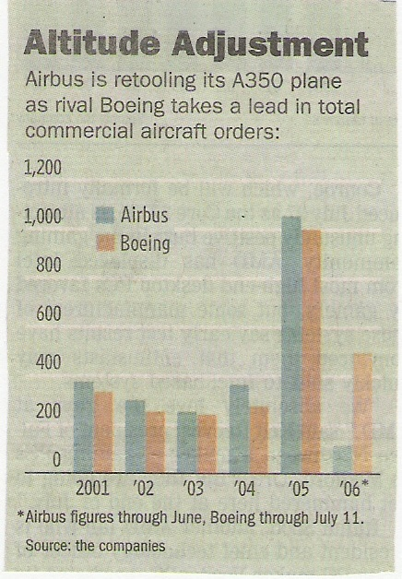
More space, faster, lighter
A-380?
B-787
WSJ - July 14, 2006

Slide 3
Reasons for Design/Redesign
Focus of Design/Redesign
Economic
Social and demographic
Political, liability, or legal
Competitive
Cost or availability
Technological
Main focus
Understand customer wants
Customer satisfaction
Secondary focus
Function of product/service
Cost/profit
Quality
Appearance
Ease of production/assembly
Ease of maintenance/service
Legal Issues: FDA, OSHA, Product liability, Uniform Commercial Code
Ethical Issues: Releasing defective products
Environmental Issues: EPA

Slide 4
Issues in Product and Service Design
Product/service life cycles
How much standardization
Mass customization
Delayed differentiation
Modular design
Product/service reliability
Perform the intended function
Robust design (Taguchi)
Wide range of conditions
Degree of newness
Cultural differences

Slide 5
Sales
Growth
Maturity
Decline
Introduction
Time
Notes:
This slide gave a reasonable depiction of the growth stage for these products when it was created. Does it still? Ask students to consider the length of the lifetime of each of the products listed. Are the lifetimes similar? What ranges of lifetime would they estimate for these products?

Slide 6
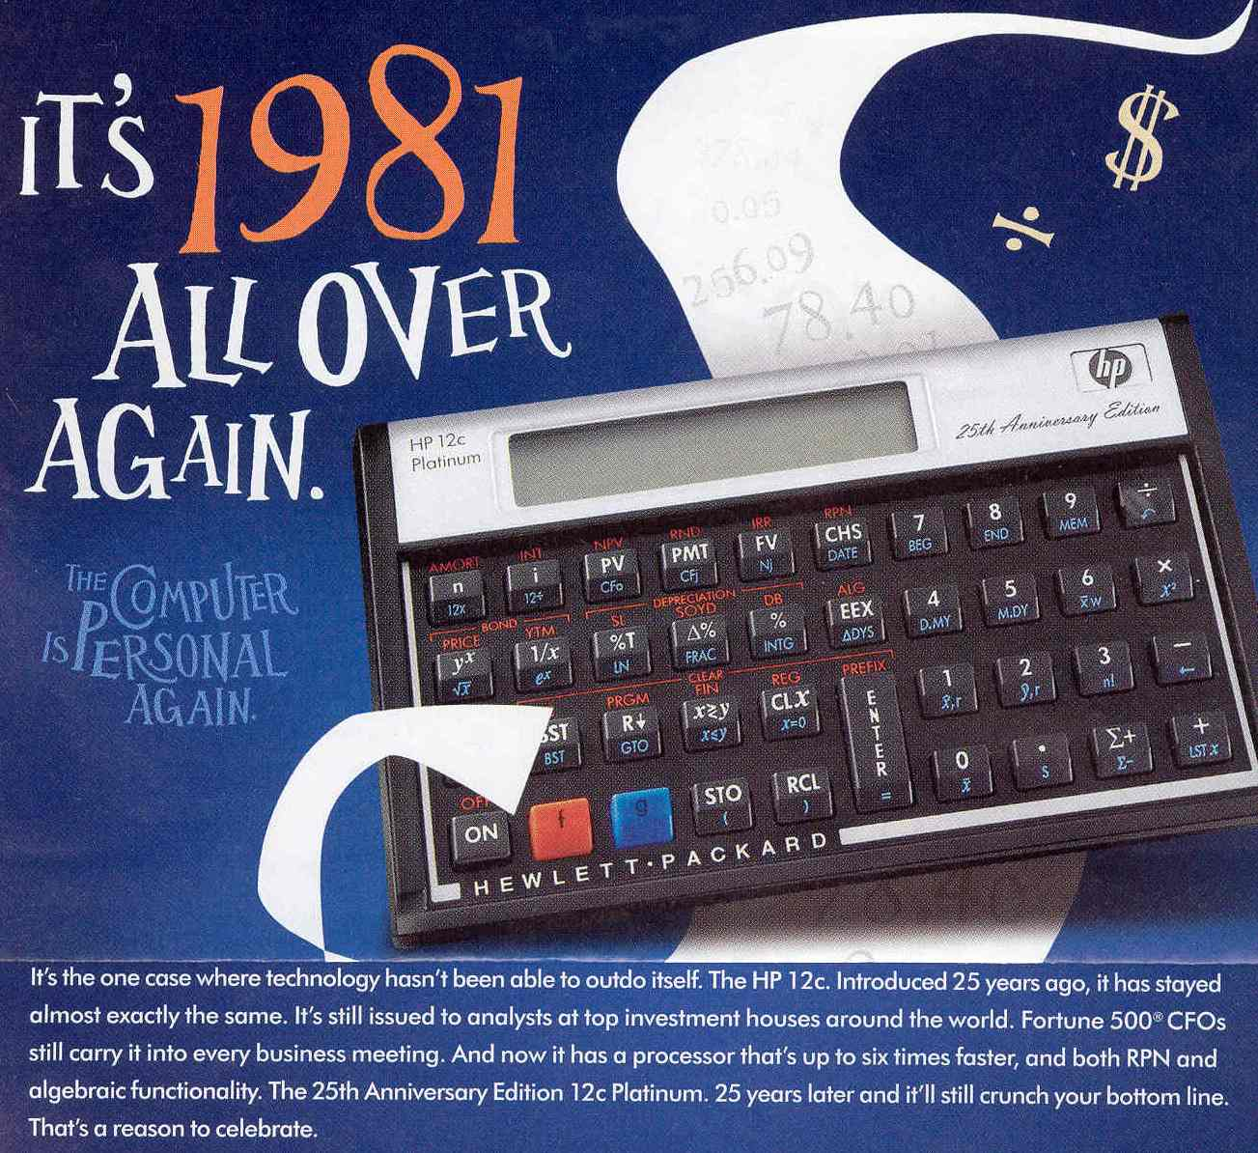
From:
Business Week
Feb 9, 2007

Slide 7
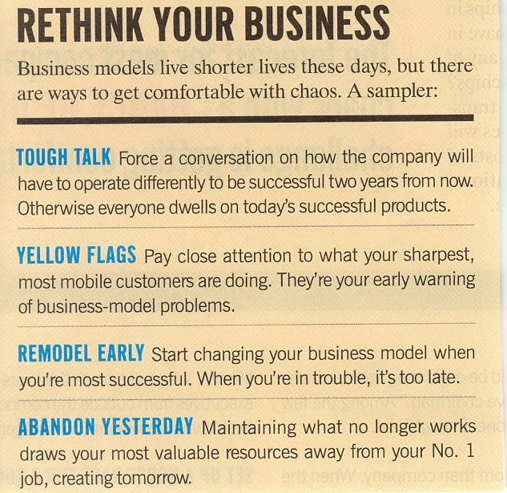
Managing your Business Model lifecycle
Fortune
Oct 2, 2006

Slide 8
Design Concepts
Reverse engineering is the dismantling and inspecting of a competitor’s product to discover product improvements.
Concurrent engineering is the bringing together of engineering design and manufacturing personnel early in the design phase.
Manufacturability is the ease of fabrication and/or assembly which is important for cost, productivity, and quality.
Design for Manufacturing(DFM) is the designers’ consideration of the organization’s manufacturing capabilities when designing a product.
Design for Operations(DFO) as above, but encompasses services as well as manufacturing.
Design for recycling (DFR)
Design for disassembly (DFD)
Remanufacturing
Component Commonality
Robust design
Computer-aided design (CAD)

Slide 9
Research & Development (R&D)
Organized efforts to increase scientific knowledge or product innovation.
Basic Research advances knowledge about a subject without near-term expectations of commercial applications.
Applied Research achieves commercial applications.
Development converts results of applied research into commercial applications.

Slide 10
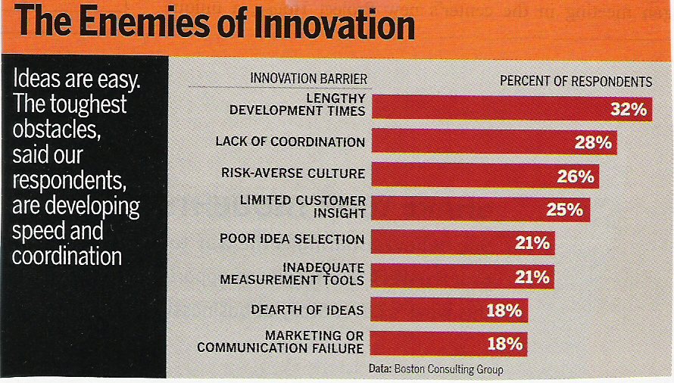
Business Week – April 14, 2006

Slide 11
Quality Function Deployment AKA: House of Quality; Voice of the Customer
QFD: An approach that integrates the “voice of the customer” into the product and service development process.
Quality function deployment (QFD) is both a philosophy and a set of planning and communication tools that focus on customer requirements in coordinating the design, manufacturing, and marketing of goods or services.
QFD fosters improved communication and teamwork among all constituencies in the design process.
QFD translates customer wants and needs to technical requirements of a product or service.

Slide 12
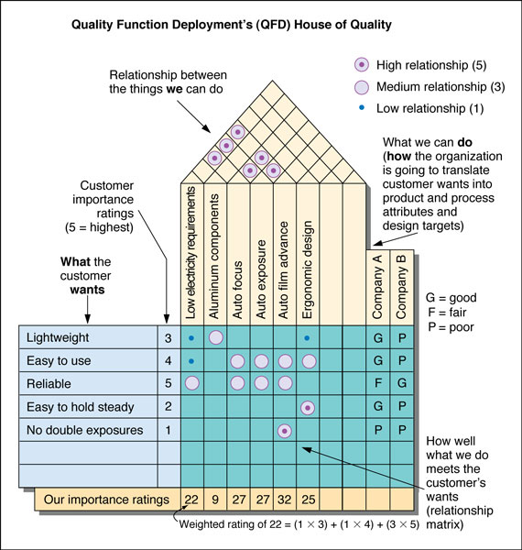
4
2
5
1
6
3
5

Slide 13
The House of Quality
Correlation
matrix
Design
requirements
Customer
requirements
Relationship
matrix
Competitive
assessment
Specifications
or
target values

Slide 14
Service Systems
Service systems range from those with little or no customer contact to very high degree of customer participation:
Insulated technical core (software development)
Production line (automatic car wash)
Personalized service (hair cut, medical service)
Consumer participation (diet program)
Self service (supermarket)

Slide 15
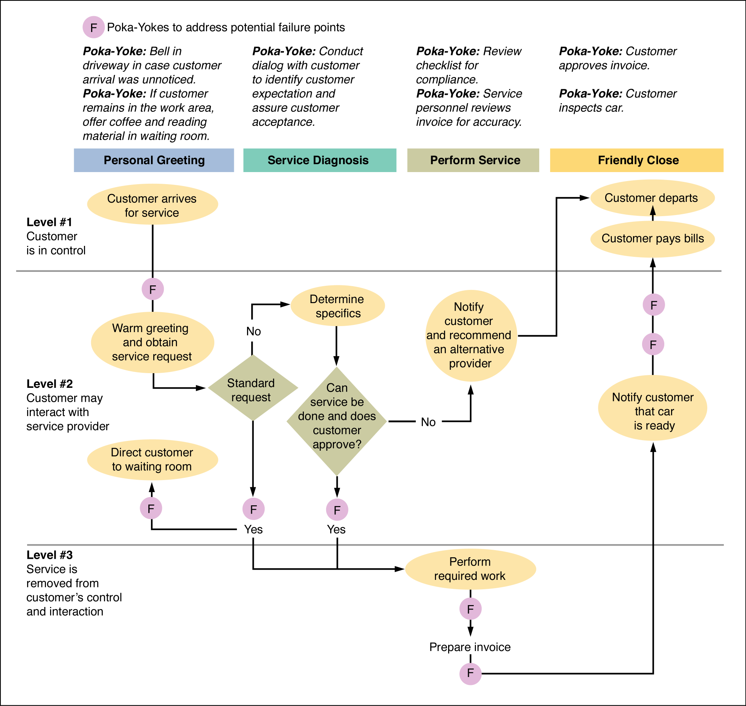
Service Blueprint Ten Minute Lube, Inc.
Tools for Process Design
Flow Diagrams
Time-Function/Process Mapping
Process Charts
Service Blueprint

Slide 16
Service Design
Service delivery system design components include:
Facility location and layout,
The service space,
Process and job design,
Technology and information support systems,
Organizational structure.

Slide 17
Challenges of Service Design
Variable requirements / time: Waiting lines
Difficult to describe
High customer contact / Participation
Service – customer encounter

Slide 18
Few Successes
Number
2000
Ideas
1750
Design review,
Testing, Introduction
Market requirement
1500
1000
1000
Functional specifications
500
Product specification
500
One success!
100
25
0
Development Stage
Notes:
This slide suggests the relatively small number of product concepts that actually become successful. Ask students to suggest reasons for such a poor success rate. Can they also suggest ways by which the success rate might be improved?

Slide 19
Cost of Development
& Manufacturing
Sales Revenue
Sales, Cost & Profit .
Profits
Losses
Time
Introduction
Growth
Maturity
Decline
Notes:
Previous slides have related the product life cycle to various management issues. This is the first to relate it to cash flow.
Ask students for suggestions as to how one might eliminate the loss occurring toward the end of the product’s life cycle.

Slide 20
Genichi Taguchi
Product and Process Design in Manufacturing
Goods that are insensitive to external sources of variation are called robust.
Genichi Taguchi states that instead of constantly directing effort toward controlling a process to assure consistent quality, design the manufactured good to achieve high quality despite the variations that will occur in the production line.
Taguchi’s loss function explains the economic value of reducing variation in manufacturing.
L(x) = k(x - T)²
where:
L(x) is the $ loss associated with deviating from the target, T
x is the actual value of the dimension,
k is a constant that translates the deviation into dollars

Slide 21
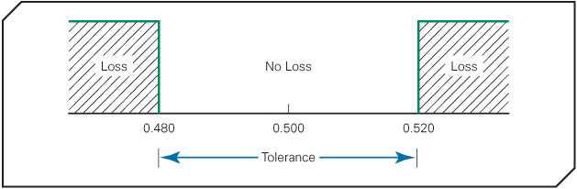
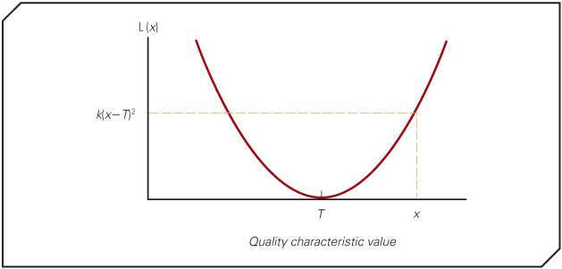
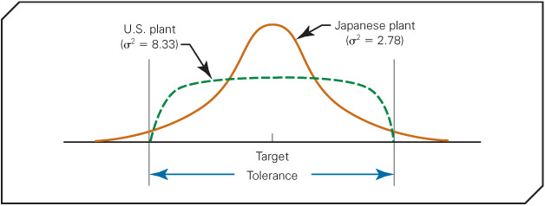
Taguchi Loss Function Explained
L(x) = k(x - T)²
______________
Specification: 0.500 ± 0.020 cm.
Failures: when close to extremes
Repair cost: $50
Thus: L(x) = $50 when (x – T) is 0.02
50 = k(0.02)²
k = 50/0.0004 = 125,000.
Therefore: L(x) = 125000(x – T)².
This means when the deviation is 0.010, the firm can still expect an average loss per unit of L(0.010) = 125,000(0.010)² = $12.50

