Slide 1
[ Rhythm Reloaded ]
Team 6 Final Presentation
Notes:
Ben:
Introduce me and dave, tell them we’re team 6

Slide 2

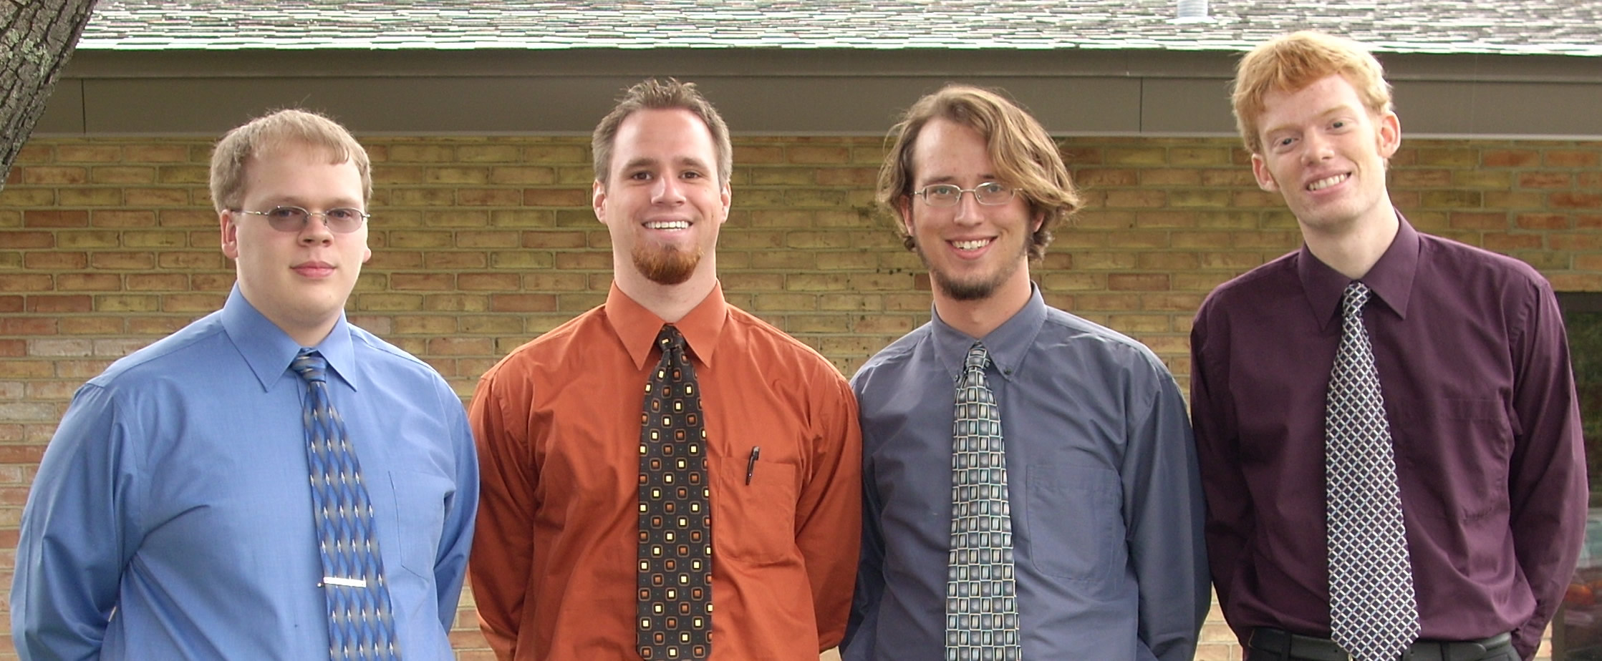
Team 6 Reintroduction
Nathan Brinks
Ben Moes
Andy Gabler
David van Geest
Notes:
Ben:
Introduce other members

Slide 3
Outline
Project Introduction
The Solution
  Design Decisions
  Progress
  Catastrophe
The Alternative Solution
  Progress
Conclusion
Acknowledgements
Questions
Notes:
Ben:
Give outline

Slide 4
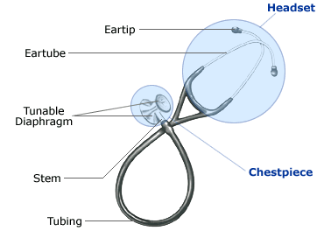
Project Introduction
Mechanical Stethoscopes
Chestpiece: metal casing with diaphragm
Earpiece: hollow tubing with spring
Electrical Stethoscopes
Preserve look
Bulky and Heavy
IR data Transfer
Introduction
Alternative Solution
Conclusion
The Solution
Notes:
Ben:
Introduce current models – breif overview of mechanical and electrical
Mechanical: uncomfortable and difficult to hear – surveys
Electrical: preserves look, limited recording, slow file transfer

Slide 5
Project Introduction
An electronic stethoscope that will:
  Aid in auscultation
  Perform frequency filtering
  Record digital audio data from the patient
  Store the audio files on the device
  Transfer the audio files to a computer via USB
  Contain these features in a convenient media-player like form-factor
  Provide a wireless chestpiece
Introduction
Alternative Solution
Conclusion
The Solution
Notes:
Ben:
Such a device will be highly beneficial in
telemedicine
example: general doctor in a remote outpost (Antarctica, Rural Africa….) can record the sound of
auscultation and send via internet to get a professional Cardiologist’s opinion.
education
attach output to a good speaker system so all can hear the sound
teachers can more easily assembly sounds to teach students what to listen for in auscultation
advanced diagnostic situations
multiple times
compare the sound last week to current sound

Slide 6
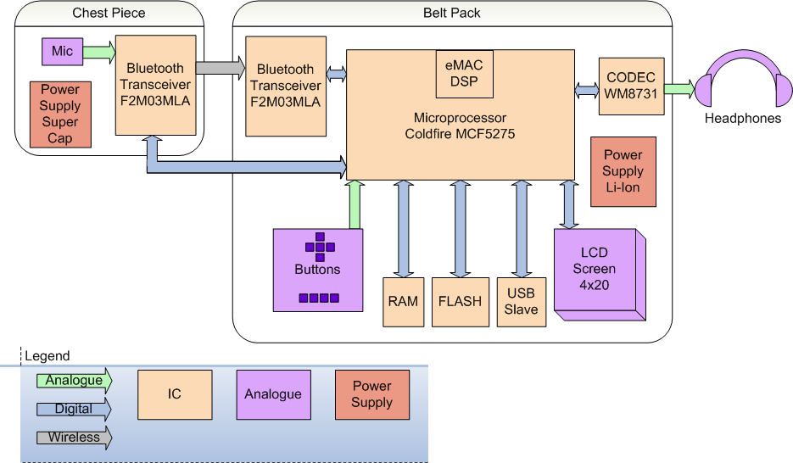
The Solution
Introduction
Alternative Solution
Conclusion
The Solution
Notes:
Ben:
So now with the change in Design we have a modified diagram.
chest piece:
mic
10 F super capacitor…will have a charging/docking station on the beltpack (for storage)
Bluetooth Module does the ADC sends wirelessly
belt pack
Bluetooth Module recieves sends digital data for processing
Micro does the controlling and work
Lithium Ion battery
LCD Screen to show mode
Buttons for Human control
Codec for output to headphones

Slide 7
Design Decision - Microprocessor
Main Criteria:
  USB Device functionality
  DSP Functionality (Hardware Multiply)
  Power consumption
  Clock Speed
  RoHS compliance
Minor Considerations
  Available memory, removable media interface, GPIO, ADC, price, dev kit
Choice: Freescale MCF5275
Introduction
Alternative Solution
Conclusion
The Solution
Notes:
Dave:

Slide 8
Design Decision – Operating System
Introduction
Alternative Solution
Conclusion
The Solution
Notes:
Dave:

Slide 9



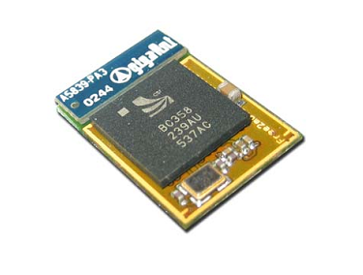
Design Decision - Wireless
Considerations
    Range
    Reliability
    Development Time
Choice: F2M03MLA:
  Benefits:
    Made for Streaming 16bit Audio
    Small Efficient Package
    Full FCC Qualification
    Built in Firmware
  Deterrents:
    Cost
Introduction
Alternative Solution
Conclusion
The Solution
Notes:
Dave:
Free2Move
Module made for quick Bluetooth development
Meets FCC requirements
Cost
Definitely could do it “cheaper” (per product) if used a basic bluetooth chip and own antenna design

Slide 10
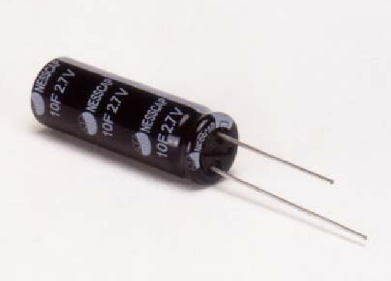
Design Decision – Chestpiece Power Supply
Choices:
  Battery – Li-ion
    Greater energy density
    More common
  Supercapacitor
    Higher risk - unique
    Quicker charge time
Choice:
  Two 10F 2.7 Volt supercapacitors in series
    Estimated Typical Runtime = 13 minutes at 22mA (observed current)
    Estimated Minimum Runtime = 4 minutes at 75mA (datasheet max.)
Introduction
Alternative Solution
Conclusion
The Solution
Notes:
Ben:
Traditional battery: long life, more common = more documented
Supercapacitor: faster charging, short use
Run Time: long run time not needed since most stethoscopes are used a few minutes at a time

Slide 11
Progress – Chestpiece Design
Introduction
Alternative Solution
Conclusion
The Solution
Notes:
Ben:
Connector supplies control interface to Bluetooth and Supercapacitor Charging circuit
Supercapacitor w/ regulator provides constant power to the rest of the chestpiece
Microphone circuit provides audio to bluetooth for transmission

Slide 12
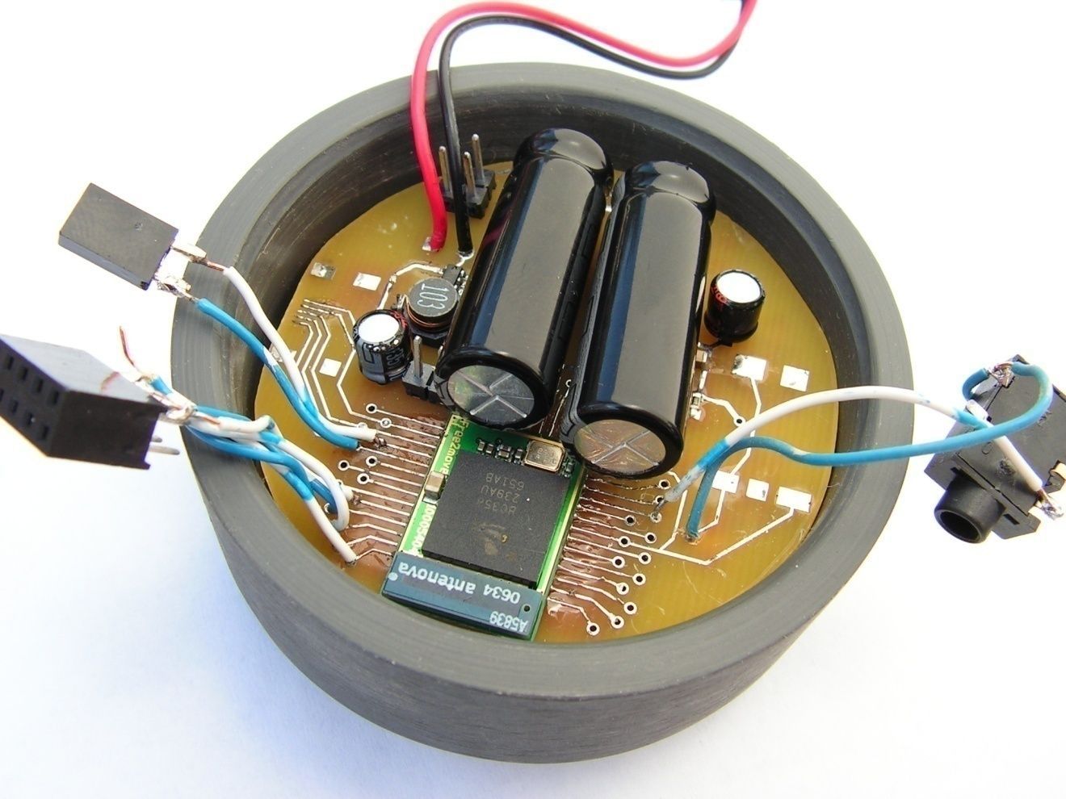
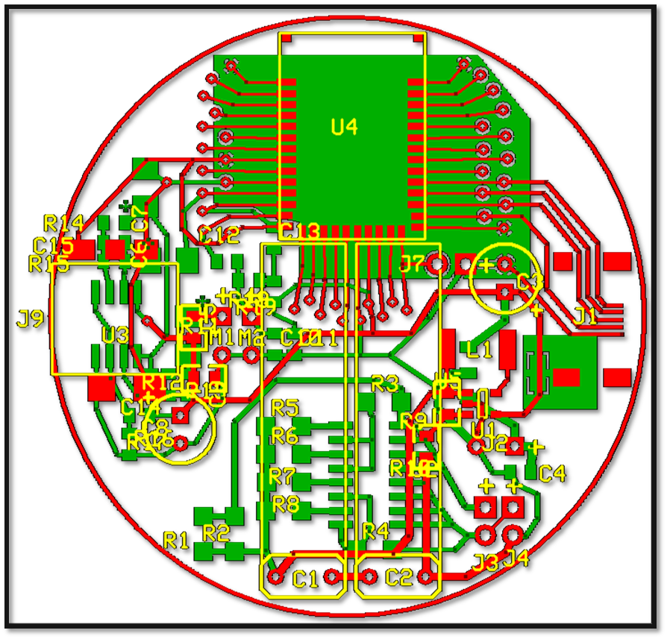
Progress – Chestpiece Design
Introduction
Alternative Solution
Conclusion
The Solution
Notes:
Ben:
Chestpiece PCB: fit a lot into a small space
Picture: chestpiece being prototyped

Slide 13
Progress
Firmware in flash
Bootloader is complete
Breadboard prototyping
  LCD functional
  CODEC control functional
  Bluetooth control functional, streaming non-functional
Filter algorithms complete
WAV encoding/decoding software complete
Chestpiece prototype in testing
I2C, SPI, UART, EPMOD drivers (mostly) complete
Introduction
Alternative Solution
Conclusion
The Solution
Notes:
Ben:
Firmware in Flash:
The OS and boot loader are stored in the Flash memory of the development board
Boots the OS upon reset
Breadboard Prototyping
Filters
Have the FIR filter Algorithm working in Matlab and will use the its filter design tools to find the filter coefficeints
Chest Piece
Casing is complete, testing response to actual sounds using a donated audio simulator
Interfaces to peripherals like CODEC, Bluetooth, and buttons were nearly complete

Slide 14
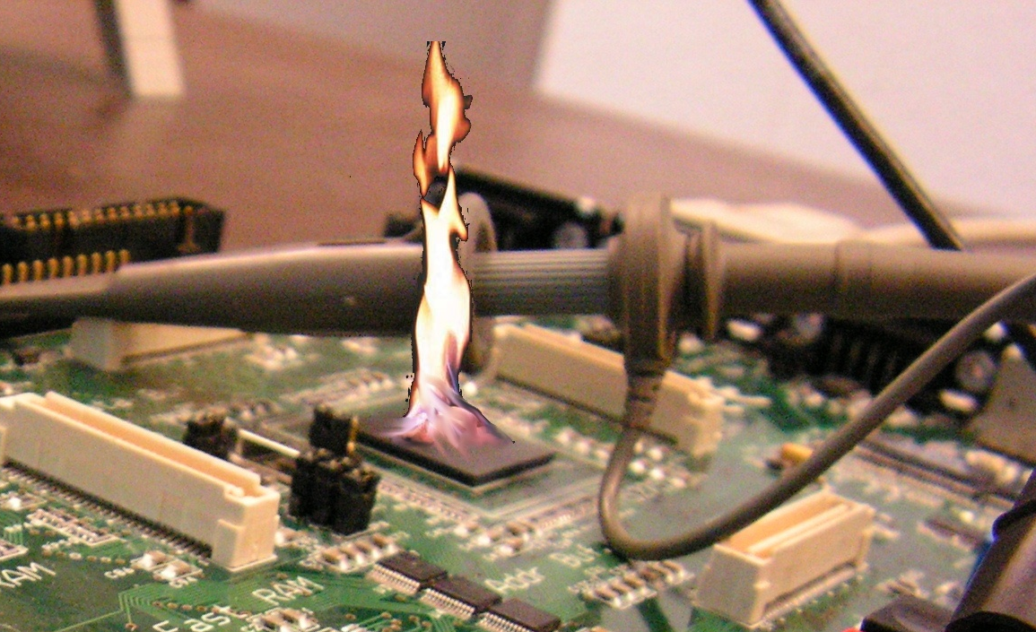
Catastrophe
During debug, microprocessor board shorted out
Board no longer boots
Replacement board not available until May 15
Introduction
Alternative Solution
Conclusion
The Solution
Dramatization
Notes:
Ben:
Ugh

Slide 15
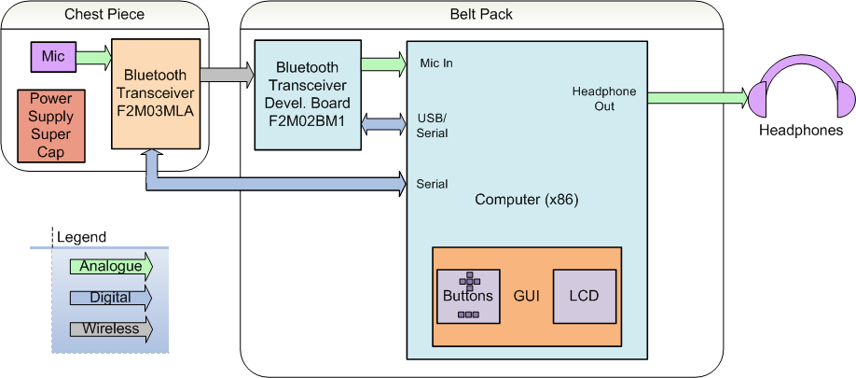
The Alternative Solution
Embedded platform emulated on PC running Ubuntu Linux and Qt graphics
Beltpack is replaced by computer, chestpiece design unchanged
Introduction
Alternative Solution
Conclusion
The Solution
Notes:
Dave:
Drivers
even with a proven OS getting the drivers to work properly is a challenge
working to get this done but it is definitely going to be a challenge
Software
Just starting to being this stage. A bit of an unknown and it will be a challenge.
Filter Software
LCD Menu System
File Recording System
Final PCB development
The challenge of bringing all the components together and getting them to work.

Slide 16
The Alternative Solution - Progress
Wired audio streaming functional
Digital filtering, recording, and playback complete
Qt GUI design complete
Wireless audio streaming non-functional
Power supply testing complete
Introduction
Alternative Solution
Conclusion
The Solution
Notes:
Dave:
Drivers
even with a proven OS getting the drivers to work properly is a challenge
working to get this done but it is definitely going to be a challenge
Software
Just starting to being this stage. A bit of an unknown and it will be a challenge.
Filter Software
LCD Menu System
File Recording System
Final PCB development
The challenge of bringing all the components together and getting them to work.

Slide 17
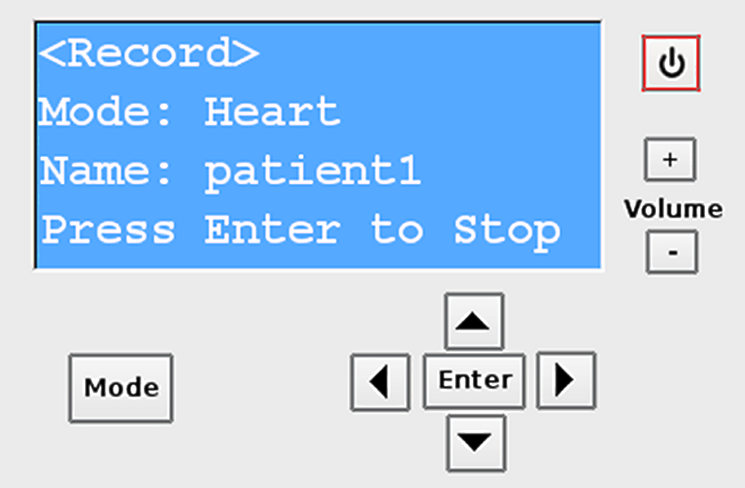
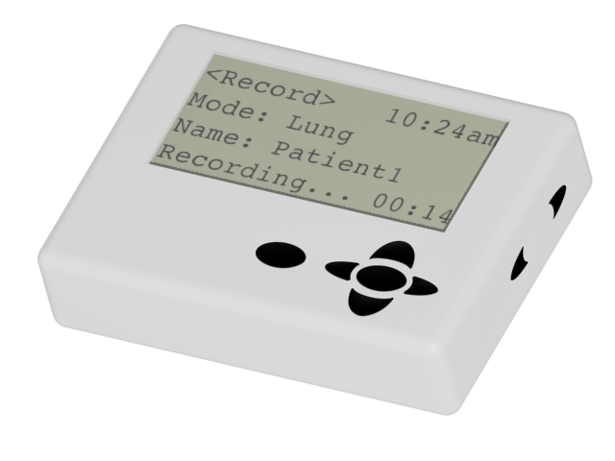
The Alternative Solution - Progress
Introduction
Alternative Solution
Conclusion
The Solution
Notes:
Dave:

Slide 18
Conclusion
What we have learned
  Deceptive marketing and poor product support are big problems
  Device interfaces are very important
  Open-source software is not always functional
What we would do differently
  Microprocessor selection
  Add 5th team member – mechanical
  Wireless design
Introduction
Alternative Solution
Conclusion
The Solution
Notes:
Dave:

Slide 19


Resources
Francis Andries – Andries Auscultation
Dr. Rob “The Bossman” Bossemeyer
David Dunayczan – Freescale Semiconductor
David Josephson – Josephson Engineering
Dr. Srinivas Janardan – Grand River Gastroenterology
uClinux-dev, uClinux-coldfire, uClinux.org, uCdot.org, CLUG, u-boot-users
DornerWorks Embedded Systems Engineering
CodeSourcery
Prof. Randall Brouwer
Prof. Steven VanderLeest
Professor Joel Adams
Kyle Schlansker
Zach Luchies
Matthew Fetke – Videon Central
Liew Tsi Chung – Freescale Semiconductor
Notes:
Dave:

Slide 20

Questions?
Rhythm Reloaded supports GNU Linux

