Slide 1
Mono And .NET
PC54
→ Miguel de Icaza
VP Developer Platform
Novell, Inc.

Slide 2
Agenda
Introduction to Mono
Mono’s Customizable CLR
Mono’s C# Eval
Assembly binary reshaping
Turbo charging games and graphics
Static Compilation
Others

Slide 3
Mono 2.0 Just released!
An open source .NET implementation:
A subset of .NET
Sponsored by Novell
~120 non-affiliated contributors (1.2 -> 2.0)
Direction driven by contributors

Slide 4
Compatibility
Our goal is to have a compatible runtime to the CLR
ECMA specifications make it possible
Develop, build, debug on Visual Studio or Unix
Deploy on Linux, Mac OSX and embedded

Slide 5
APIs
Server
Client
Third Party
ASP.NET
Gtk#
Windows.Forms
Postgress, MySQL
Sqlite, Oracle, Sybase
Apache and FastCGI
Gdk#
Mono.Cairo
Tao.Framework
C5
System.Data
SQL Server
Cocoa#
Pango#
NDesk.DBus
Infrastructure
Mono.Cecil
Mono.ZeroConf
Mono.Nat
Mono.Addins
Novell.Ldap
Java/IKVM
Mono.RelaxNG
Mono.Fuse
Mono.Torrent
Mono.Nat
Gecko# (Mozilla)
Mono.Upnp

Slide 6



Mono's CLI Implementation
We can offer a few bonuses
Take .NET where no .NET has gone before
Offering new forward-compatible features
Support special scenarios

Slide 7

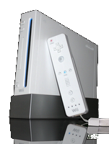

Mono's CLI Implementation
We can offer a few bonuses
Take .NET where no .NET has gone before
Offering new forward-compatible features
Support special scenarios

Slide 8
CLRs For Everyone
Microsoft has the CLR, CF and the CoreCLR
CoreCLR is a small version of CLR
CoreCLR used in Mesh and Silverlight
Compact Framework used in XNA

Slide 9
CLRs For Everyone
Microsoft has the CLR, CF and the CoreCLR
CoreCLR is a small version of CLR
CoreCLR used in Mesh and Silverlight
Compact Framework used in XNA
For everyone else, there is Mono

Slide 10
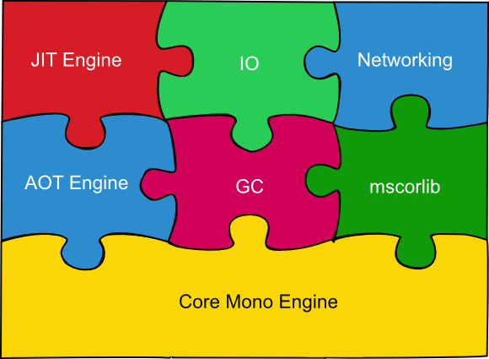
Mono Adaptability From full framework to tailored framework
Full framework is 100 megs (uncompressed)
Minimal setup is 2 megs (uncompressed)
Modular runtime can be shrunk/grown:

Slide 11
The Evolution of a Compiler (or, C# 5 today)

Slide 12
Mono's C# 3.0 Compiler
C# compiler written in C#
Originally, a project to learn to write C# code

Slide 13
Mono's C# 3.0 Compiler
C# compiler written in C#
Originally, a project to learn to write C# code
First bootstrap (2001)
17 seconds to bootstrap, 10,000 lines
csc compiled it in a second

Slide 14
Mono's C# 3.0 Compiler
C# compiler written in C#
Originally, a project to learn to write C# code
First bootstrap (2001)
17 seconds to bootstrap 10,000 lines
csc compiled it in a second
Speed is no longer a problem
Today 82,000 lines in 2.2 seconds
1.6x slower than csc

Slide 15
Mono.CSharp.dll – Compiler Service
Mono.CSharp.Evaluator
Encapsulates the compiler in one class
Provides C# Eval and C# Run:
using System;
using Mono.CSharp;
class MyFirstCSharpInterpreter {
static void Main (string [] args)
{
object r = Evaluator.Evaluate (args [0]);
Console.WriteLine (r);
}
}

Slide 16
Mono.CSharp – Applications
Read-Eval-Print-Loop (repl)
Script applications with C#
Rapid prototyping in target language
Automation
Would be cool to have this on every app!

Slide 17
The csharp Command
Python and Ruby have interactive shells
Read-Eval-Print Loop
Expressions and Statements:
csharp> 1;
1;
csharp> “Hello, World”.IndexOf (“,”);
5;
csharp> 1 +
> 2;
3
csharp> var a = Console.ReadLine ();

Slide 18
LINQ From The Command Line
$ csharp
Mono C# Shell, type “help;” for help
Enter statements below.
csharp> using System.IO;
csharp> var last_week = DateTime.Now – TimeSpan.FromDays (7);
csharp> from f in Directory.GetFiles (“/etc”)
> let fi = new FileInfo (f)
> where fi.LastWriteTime < last_week
> select f;
{ “/etc/adjtime”, “/etc/asound.state”,
“/etc/ld.so.cache”, “/etc/mtab”,
“/etc/printcap”, “/etc/resolv.conf” }
csharp>

Slide 19
Interactive LINQ To XML
csharp> LoadLibrary (“System.Xml.Linq”);
csharp> using System.Xml.Linq;
csharp> var xml = new XElement("CompilerSources", > from f in Directory.GetFiles ("/cvs/mcs/mcs") > let fi = new FileInfo (f) > orderby fi.Length > select new XElement ("file",
> new XAttribute ("name", f),
> new XAttribute ("size", fi.Length))); csharp> xml; <CompilerSources> <file name="/cvs/mcs/mcs/mcs.exe.config" size="395" /> <file name="/cvs/mcs/mcs/gmcs.exe.config" size="464" /> <file name="/cvs/mcs/mcs/OPTIMIZE" size="498" /> <file name="/cvs/mcs/mcs/lambda.todo" size="658" /> [...] </CompilerSources>

Slide 20
GUI Shell C# eval hosted in a GUI
Replace base class, with GUI base class:

Slide 21
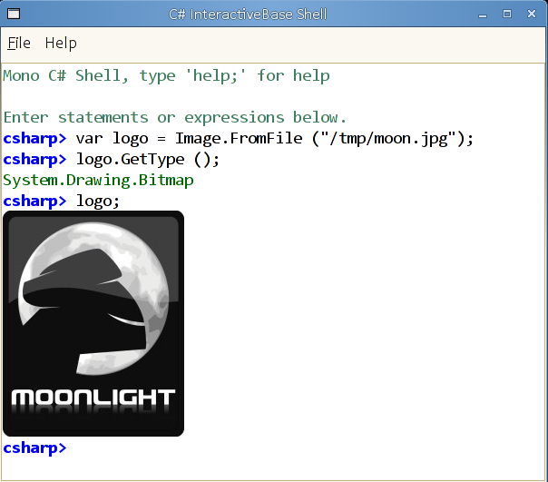
GUI Shell C# eval hosted in a GUI
Replace base class, with GUI base class:

Slide 22
GUI Shell, Quick Plot Method
Plot (Func<double,double>);

Slide 23
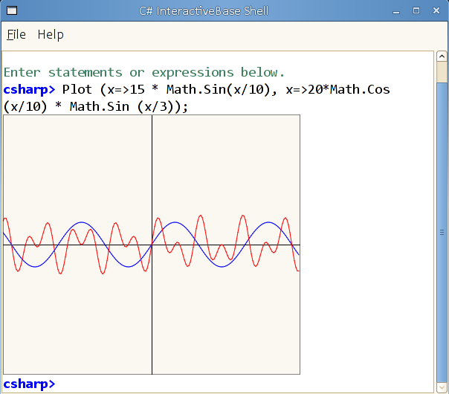
GUI Shell, Quick Plot Method
Plot (Func<double,double>);

Slide 24
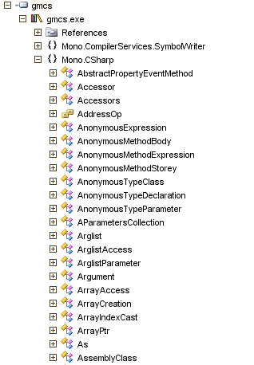
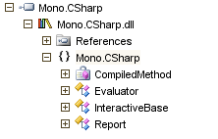
Reshaping The API Turning the compiler into a library
Complete
C# Compiler
Mono.CSharp
Everything public
Minimal API

Slide 25
Reshaping The API Avoid manual work, reusing Mono.Cecil and Mono.Linker
Complete
C# Compiler
Mono Linker
Mono.CSharp
Everything public
Uses Mono.Cecil
Reshapes code
Desired API
Removes or hides
Minimal API
link.xml

Slide 26
Mono Linker Use Cases
Shrinking Assemblies
Shipping only what is required
Simplify deployment
Create your own Compact Framework
What you need from the superset
.NET 3.5 to Silverlight
We reshape our assemblies.
Minimal hand-editing/tuning.

Slide 27
Beyond the CLR: Innovating On A Solid Foundation Virtual machines are fascinating
Great innovations are possible
Build on an existing large ecosystem
Instrument, expand, innovate
Special code generation

Slide 28
Beyond the CLR: Innovating On A Solid Foundation Virtual machines are fascinating
Great innovations are possible
Build on an existing large ecosystem
Instrument, expand, innovate
Special code generation
VM potential limited by vendor realities
Provider scarcity
Shipping dates
Staffing
Product Management
Feature prioritization

Slide 29
Injecting Code Into A Live Process The Mono.Attach.VirtualMachine API
On the root AppDomain, on a new thread

Slide 30
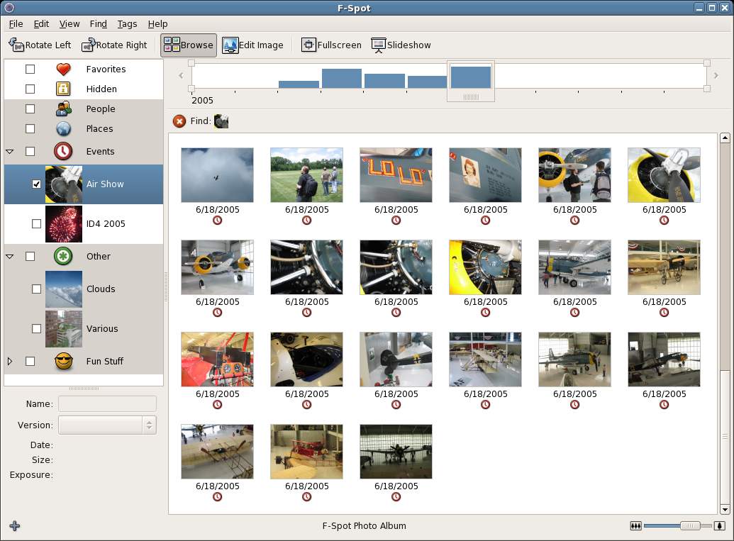
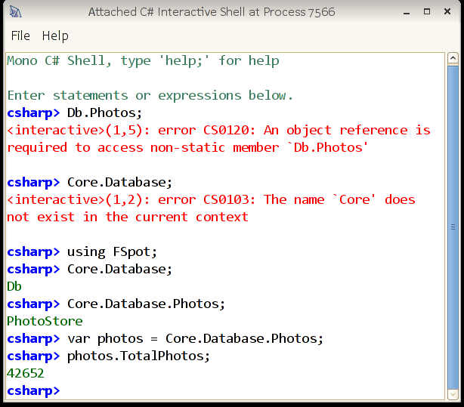
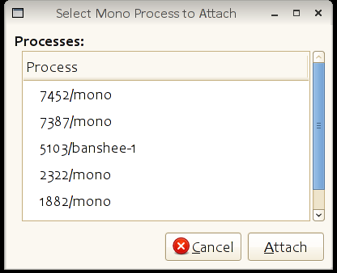
Injecting GUI Interactive C# Consoles for everyone!

Slide 31
Turbocharging Games
Fast, Productive, Safe.
Pick all three.

Slide 32
Game Software Components .
Display
Simulation
Game Logic
Support
Rendering
Shading
Scene
Animation
Geometry
GUI
Physics
Collision
Particles
Terrain
World rules
Enemy AI
User control
Camera
Behavior
Audio
Input
Networking

Slide 33

The Problem Games are real-time programs
30 to 60 frames per second (0.016 seconds)
Input
AI
Updates
User control
Network events
Scripted, slow
React to change
Update scene
Render Graphics
Play audio

Slide 34
Problem: Scripting Is A Bottleneck Gaming's Achilles' Heel
Display
Simulation
Game Logic
Support
Rendering
Shading
Scene
Animation
Geometry
GUI
Physics
Collision
Particles
Terrain
World rules
Enemy AI
User control
Camera
Behavior
Audio
Input
Networking
C/C++
C/C++
Script
C/C++

Slide 35
Language Choices
Fully Dynamic
Easy
C#/Java
Productivity
C/C++
Assembly Language
Difficult
Slow
Performance
Fast

Slide 36
Mono in Gaming Today Moving from scripting to static/compiled
Mono’s CLR is ideal for embedding

Slide 37
Mono in Gaming Today Moving from scripting to static/compiled
Mono’s CLR is ideal for embedding
Some examples
SecondLife: Switched from LSL to Mono
50x to 300x performance increase

Slide 38
Mono in Gaming Today Moving from scripting to static/compiled
Mono’s CLR is ideal for embedding
Some examples
SecondLife: Switched from LSL to Mono
50x to 300x performance increase
Unity3D: Powers Cartoon Network’s FusionFall
Uses C#, UnityScript and Boo
UnityScript is a strongly typed Javascript

Slide 39
Demo

Slide 40
Managed Code In Gaming Improving developer productivity while maintaining program speed
Traditional
Game AI
Scripted
Slow/easy
Game Engines
Compiled
Fast/Hard
Graphics Engine
Compiled
Fast/Hard

Slide 41
Managed Code In Gaming Improving developer productivity while maintaining program speed
Traditional
Improved
Game AI
Scripted
Slow/easy
Managed
Fast/Easy
Game Engines
Compiled
Fast/Hard
Compiled
Fast/Hard
Graphics Engine
Compiled
Fast/Hard
Compiled
Fast/Hard

Slide 42
Managed Code In Gaming Improving developer productivity while maintaining program speed
Traditional
Improved
Future
Game AI
Scripted
Slow/easy
Managed
Fast/Easy
Managed
Fast/Easy
Game Engines
Compiled
Fast/Hard
Compiled
Fast/Hard
Managed
Fast/Easy
Graphics Engine
Compiled
Fast/Hard
Compiled
Fast/Hard
Compiled
Fast/Hard

Slide 43
3D Floating Point Vector Operations At the core of gaming engines
Exploring an innocent looking loop in C#:
UpdatePos (Vector3f [] points, ref Vector3f delta)
{
for (int i = 0; i < points.Length; i++)
points [i] += delta;
}
x_{i}
y_{i}
z_{i}
δ_{x}
δ_{y}
δ_{z}
x_{i}+δ_{x}
y_{i}+δ_{y}
z_{i}+δ_{z}
+
=
Vector3f static operator + (Vector3f a, Vector3f b)
{
return new Vector3f (a.x+b.x, a.y+b.y, a.z+b.z);
}

Slide 44
UpdatePos Method In IL The code that does the addition
.method private static hidebysig
default void UpdatePos (valuetype [Mono.Simd]Mono.Simd.Vector4f[] points, valuetype [Mono.Simd]Mono.Simd.Vector4f& delta) cil managed
{
// Method begins at RVA 0x2144
// Code size 50 (0x32)
.maxstack 4
.locals init (int32 V_0)
IL_0000: ldc.i4.0
IL_0001: stloc.0
IL_0002: br IL_0028
IL_0007: ldarg.0
IL_0008: ldloc.0
IL_0009: ldelema [Mono.Simd]Mono.Simd.Vector4f
IL_000e: dup
IL_000f: ldobj [Mono.Simd]Mono.Simd.Vector4f
IL_0014: ldarg.1
IL_0015: ldobj [Mono.Simd]Mono.Simd.Vector4f
IL_001a: call valuetype [Mono.Simd]Mono.Simd.Vector4f valuetype
[Mono.Simd]Mono.Simd.Vector4f::op_Addition(valuetype [Mono.Simd]Mono.Simd.Vector4f,
valuetype [Mono.Simd]Mono.Simd.Vector4f)
IL_001f: stobj [Mono.Simd]Mono.Simd.Vector4f
IL_0024: ldloc.0
IL_0025: ldc.i4.1
IL_0026: add
IL_0027: stloc.0
IL_0028: ldloc.0
IL_0029: ldarg.0
IL_002a: ldlen
IL_002b: conv.i4
IL_002c: blt IL_0007
IL_0031: ret
} // end of method X::UpdatePos

Slide 45
Vector4f.op_Addition in IL The IL implementation
// method line 24
.method public static hidebysig specialname
default valuetype Mono.Simd.Vector4f op_Addition (valuetype Mono.Simd.Vector4f v1, valuetype Mono.Simd.Vector4f v2) cil managed
{
// Method begins at RVA 0x24ac
// Code size 69 (0x45)
.maxstack 7
.locals init (
valuetype Mono.Simd.Vector4f V_0)
IL_0000: ldloca.s 0
IL_0002: ldarga.s 0
IL_0004: ldfld float32 Mono.Simd.Vector4f::x
IL_0009: ldarga.s 1
IL_000b: ldfld float32 Mono.Simd.Vector4f::x
IL_0010: add
IL_0011: ldarga.s 0
IL_0013: ldfld float32 Mono.Simd.Vector4f::y
IL_0018: ldarga.s 1
IL_001a: ldfld float32 Mono.Simd.Vector4f::y
IL_001f: add
IL_0020: ldarga.s 0
IL_0022: ldfld float32 Mono.Simd.Vector4f::z
IL_0027: ldarga.s 1
IL_0029: ldfld float32 Mono.Simd.Vector4f::z
IL_002e: add
IL_002f: ldarga.s 0
IL_0031: ldfld float32 Mono.Simd.Vector4f::w
IL_0036: ldarga.s 1
IL_0038: ldfld float32 Mono.Simd.Vector4f::w
IL_003d: add
IL_003e: call instance void valuetype Mono.Simd.Vector4f::'.ctor'(float32, float32, float32, float32)
IL_0043: ldloc.0
IL_0044: ret
} // end of method Vector4f::op_Addition

Slide 46
UpdatePos in x86 code Generated asssembly code
00000000 <X_UpdatePos>: 69: 89 0c 24 mov %ecx,(%esp)
0: 55 push %ebp 6c: 8b 4d d8 mov -0x28(%ebp),%ecx
1: 8b ec mov %esp,%ebp 6f: 89 4c 24 04 mov %ecx,0x4(%esp)
3: 53 push %ebx 73: 8b 4d dc mov -0x24(%ebp),%ecx
4: 57 push %edi 76: 89 4c 24 08 mov %ecx,0x8(%esp)
5: 56 push %esi 7a: 8b 4d e0 mov -0x20(%ebp),%ecx
6: 83 ec 38 sub $0x38,%esp 7d: 89 4c 24 0c mov %ecx,0xc(%esp)
9: 8b 75 08 mov 0x8(%ebp),%esi 81: 83 ec 10 sub $0x10,%esp
c: 8b 7d 0c mov 0xc(%ebp),%edi 84: 8b 4d c4 mov -0x3c(%ebp),%ecx
f: 33 db xor %ebx,%ebx 87: 89 0c 24 mov %ecx,(%esp)
11: e9 ad 00 00 00 jmp c3 <X_UpdatePos+0xc3> 8a: 8b 4d c8 mov -0x38(%ebp),%ecx
16: 8b c0 mov %eax,%eax 8d: 89 4c 24 04 mov %ecx,0x4(%esp)
18: 39 5e 0c cmp %ebx,0xc(%esi) 91: 8b 4d cc mov -0x34(%ebp),%ecx
1b: 0f 86 b5 00 00 00 jbe d6 <X_UpdatePos+0xd6> 94: 89 4c 24 08 mov %ecx,0x8(%esp)
21: 8b cb mov %ebx,%ecx 98: 8b 4d d0 mov -0x30(%ebp),%ecx
23: c1 e1 04 shl $0x4,%ecx 9b: 89 4c 24 0c mov %ecx,0xc(%esp)
26: 8b c6 mov %esi,%eax 9f: 50 push %eax
28: 03 c1 add %ecx,%eax a0: e8 43 00 00 00 call op_Addition
2a: 05 10 00 00 00 add $0x10,%eax a5: 83 c4 20 add $0x20,%esp
2f: 89 45 bc mov %eax,-0x44(%ebp) a8: 8b 45 bc mov -0x44(%ebp),%eax
32: 8b 08 mov (%eax),%ecx ab: 8b 4d e4 mov -0x1c(%ebp),%ecx
34: 89 4d c4 mov %ecx,-0x3c(%ebp) ae: 89 08 mov %ecx,(%eax)
37: 8b 48 04 mov 0x4(%eax),%ecx b0: 8b 4d e8 mov -0x18(%ebp),%ecx
3a: 89 4d c8 mov %ecx,-0x38(%ebp) b3: 89 48 04 mov %ecx,0x4(%eax)
3d: 8b 48 08 mov 0x8(%eax),%ecx b6: 8b 4d ec mov -0x14(%ebp),%ecx
40: 89 4d cc mov %ecx,-0x34(%ebp) b9: 89 48 08 mov %ecx,0x8(%eax)
43: 8b 40 0c mov 0xc(%eax),%eax bc: 8b 4d f0 mov -0x10(%ebp),%ecx
46: 89 45 d0 mov %eax,-0x30(%ebp) bf: 89 48 0c mov %ecx,0xc(%eax)
49: 8b 07 mov (%edi),%eax c2: 43 inc %ebx
4b: 89 45 d4 mov %eax,-0x2c(%ebp) c3: 8b 46 0c mov 0xc(%esi),%eax
4e: 8b 47 04 mov 0x4(%edi),%eax c6: 3b d8 cmp %eax,%ebx
51: 89 45 d8 mov %eax,-0x28(%ebp) c8: 0f 8c 4a ff ff ff jl 18 <X_UpdatePos+0x18>
54: 8b 47 08 mov 0x8(%edi),%eax ce: 8d 65 f4 lea -0xc(%ebp),%esp
57: 89 45 dc mov %eax,-0x24(%ebp) d1: 5e pop %esi
5a: 8b 47 0c mov 0xc(%edi),%eax d2: 5f pop %edi
5d: 89 45 e0 mov %eax,-0x20(%ebp) d3: 5b pop %ebx
60: 8d 45 e4 lea -0x1c(%ebp),%eax d4: c9 leave
63: 83 ec 10 sub $0x10,%esp d5: c3 ret
66: 8b 4d d4 mov -0x2c(%ebp),%ecx

Slide 47
Mono.SIMD: Mapping To Native Instructions SIMD aware runtime
Object-oriented APIs for Vector processing
Vector4f, Vector4i, Vector2d, Vector16b, etc
Mapped to hardware operations
C#
pos += delta
IL
call [Mono.Simd]Mono.Simd.Vector4f::op_Addition( valuetype [Mono.Simd]Mono.Simd.Vector4f, valuetype [Mono.Simd]Mono.Simd.Vector4f)
x86
movups (%eax),%xmm0
movups (%edi),%xmm1
addps %xmm1,%xmm0
movups %xmm0,(%eax)
Detect
SIMD
use

Slide 48
UpdatePos With Mono’s SIMD
00000000 <X_UpdatePos>:
0: 55 push %ebp
1: 8b ec mov %esp,%ebp
3: 53 push %ebx
4: 57 push %edi
5: 56 push %esi
6: 83 ec 04 sub $0x4,%esp
9: 8b 75 08 mov 0x8(%ebp),%esi
c: 8b 7d 0c mov 0xc(%ebp),%edi
f: 33 db xor %ebx,%ebx
11: eb 29 jmp 3c <X_UpdatePos+0x3c>
13: 8d 64 24 00 lea 0x0(%esp),%esp
17: 90 nop
18: 39 5e 0c cmp %ebx,0xc(%esi)
1b: 0f 86 2a 00 00 00 jbe 4b <X_UpdatePos+0x4b>
21: 8b cb mov %ebx,%ecx
23: c1 e1 04 shl $0x4,%ecx
26: 8b c6 mov %esi,%eax
28: 03 c1 add %ecx,%eax
2a: 05 10 00 00 00 add $0x10,%eax
2f: 0f 10 00 movups (%eax),%xmm0
32: 0f 10 0f movups (%edi),%xmm1
35: 0f 58 c1 addps %xmm1,%xmm0
38: 0f 11 00 movups %xmm0,(%eax)
3b: 43 inc %ebx
3c: 8b 46 0c mov 0xc(%esi),%eax
3f: 3b d8 cmp %eax,%ebx
41: 7c d5 jl 18 <X_UpdatePos+0x18>
43: 8d 65 f4 lea -0xc(%ebp),%esp
46: 5e pop %esi
47: 5f pop %edi
48: 5b pop %ebx
49: c9 leave
4a: c3 ret

Slide 49
SIMD Operations Mix Developer created tests

Slide 50
Mono.SIMD: Speedups Physics simulations, no optimizations
Based on the C++ simulation code at
sharp-gamedev.blogspot.com/2008/09/updated-c-version.html

Slide 51
Ahead Of Time Compilation Batch compilation of CIL/.NET code
Ahead of Time compilation (AOT):
“ngen” in the .NET world
Precompiled IL code to native code
Visible effects
Saves on startup time
Decreases footprint across multiple processes
Produces slower code
Not complete
Can handle most of the JIT generated code
A few bits are not AOTed

Slide 52
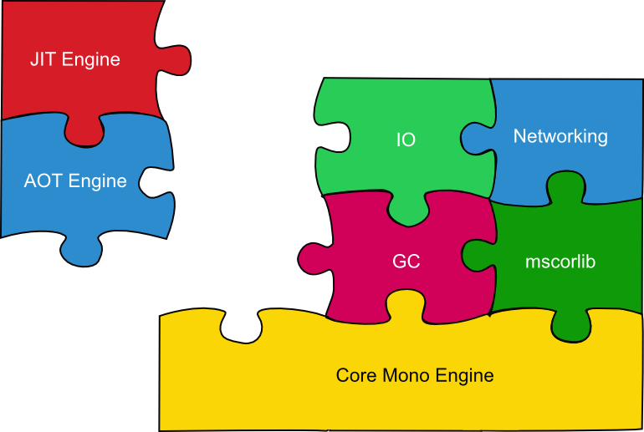
Full Ahead Of Time Compilation Entirely static compilation of CIL/.NET code
Some devices disable on the fly codegen:
iPhone OS 2.x, XBox360
Full AOT: Does AOT for the missing bits

Slide 53
Demo – Mono on iPhone.

Slide 54
Other Topics Much more
Mono Continuations
Like Stackless-Python
Cooperative multi-threading
Avoids concurrency bugs
Concurrency achieved with processes
Supercomputing Mono
64 bit arrays

Slide 55
Learning More About Mono
http://www.mono-project.com
Getting Started
http://www.mono-project.com/Start
Community blogs
http://www.go-mono.com/monologue
Miguel’s blog
http://tirania.org/blog

Slide 56
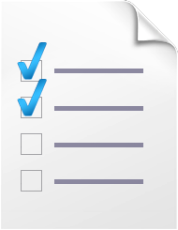


Evals & Recordings
Please fill out your evaluation for this session at:
This session will be available as a recording at:
www.microsoftpdc.com

Slide 57
Please use the microphones provided
Q&A

Slide 58

© 2008 Microsoft Corporation. All rights reserved. Microsoft, Windows, Windows Vista and other product names are or may be registered trademarks and/or trademarks in the U.S. and/or other countries.
The information herein is for informational purposes only and represents the current view of Microsoft Corporation as of the date of this presentation. Because Microsoft must respond to changing market conditions, it should not be interpreted to be a commitment on the part of Microsoft, and Microsoft cannot guarantee the accuracy of any information provided after the date of this presentation. MICROSOFT MAKES NO WARRANTIES, EXPRESS, IMPLIED OR STATUTORY, AS TO THE INFORMATION IN THIS PRESENTATION.

